Slide 1
How to Run Product Segments
Brumbaugh 20260312

Slide 2
1. Dowload and open the data file
From https://ceresanalytics.com/R_for_IBF_NextLevel/makeProductSegments.xlsx

Slide 3
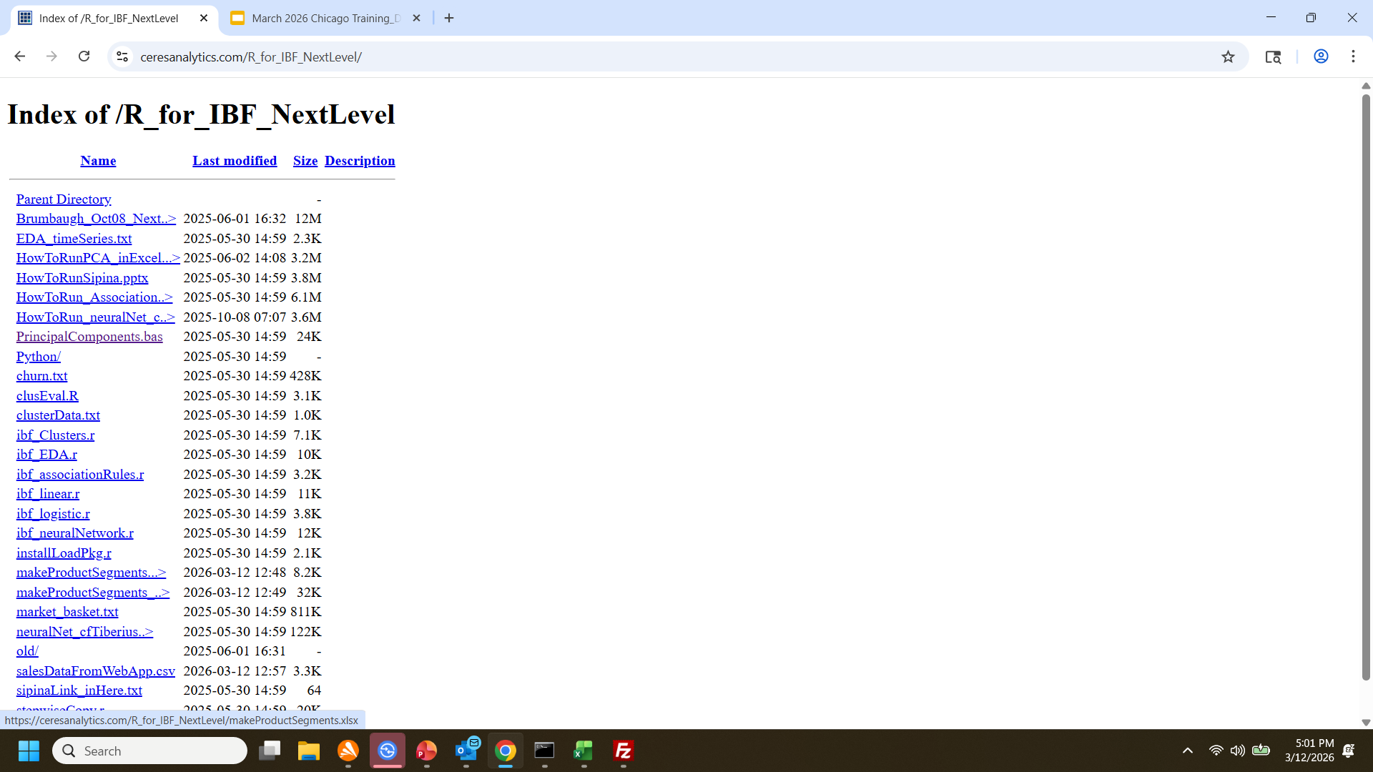
Macro-free:
Go to https://ceresanalytics.com/R_for_IBF_NextLevel and Right click on “makeProductSegments.xls” and “Save as…” (in your preferred location) OR
Click on https://ceresanalytics.com/R_for_IBF_NextLevel/makeProductSegments.xlsx
and “Save as…” (in your preferred location)
With Macro:
Go to https://ceresanalytics.com/R_for_IBF_NextLevel and Right click on “makeProductSegments_withMacro.xlsm” and “Save as…” (in your preferred location) OR
Click on https://ceresanalytics.com/R_for_IBF_NextLevel/makeProductSegments_withMacro.xlsm
and “Save as…” (in your preferred location)

Slide 4
2. IFF you need to add the macro to makeProductSegments.xlsx file, Show “Developer” Tab
And open VBA editor

Slide 5
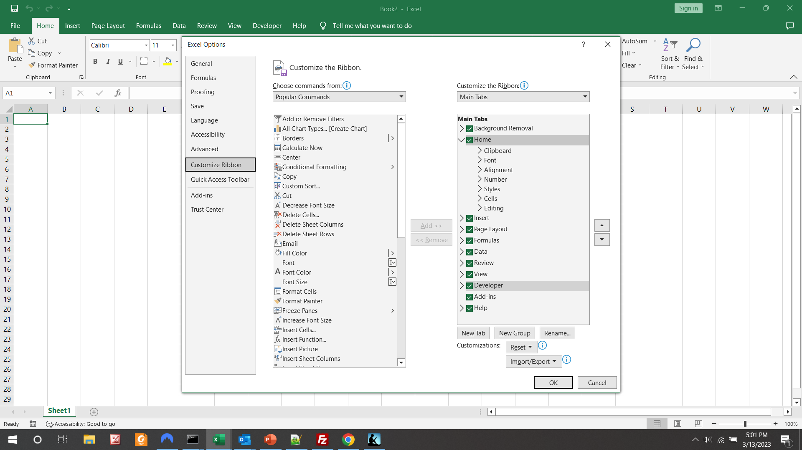
File/Options/Customize Ribbon
Check “Developer”

Slide 6
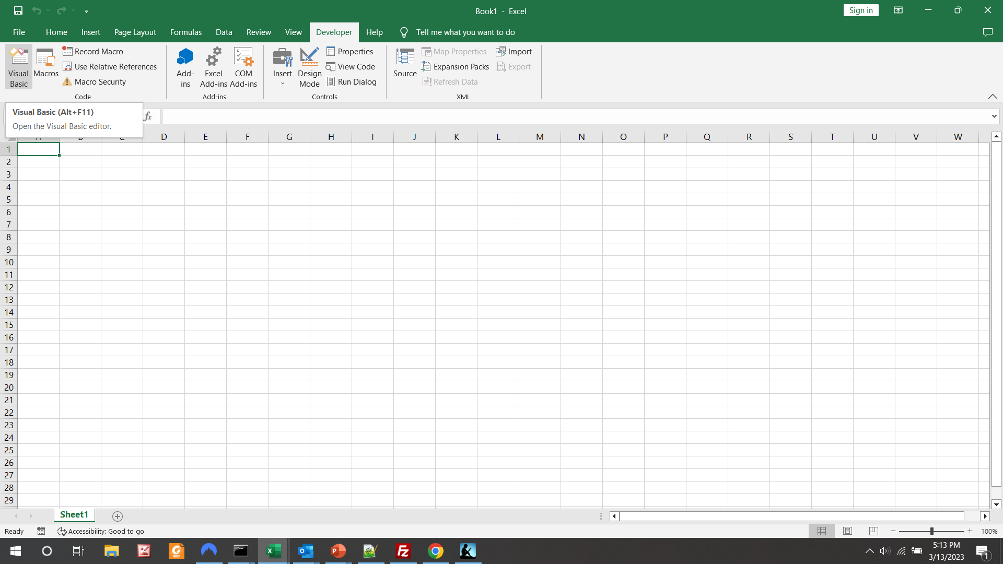

Slide 7
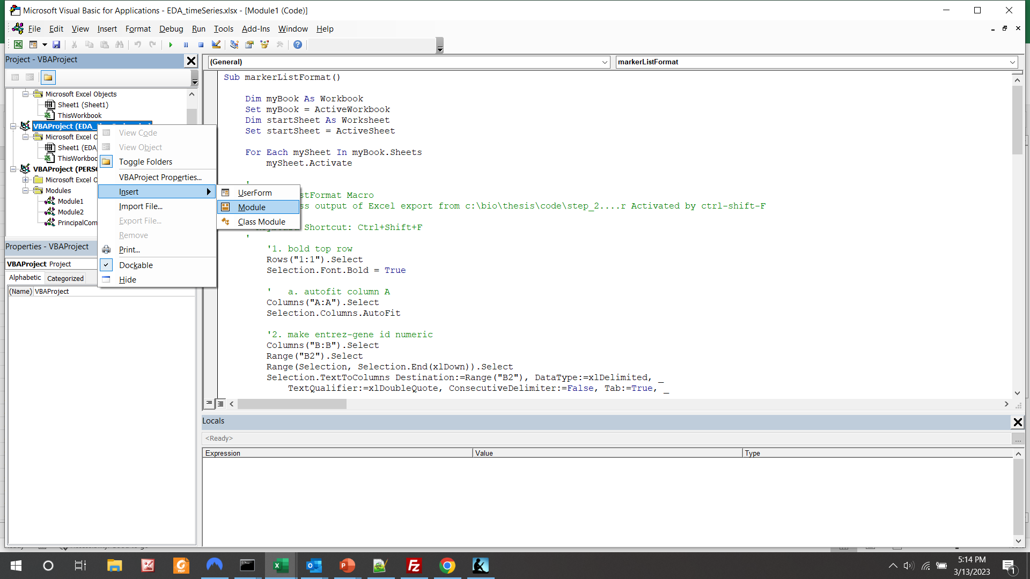
Find your workbook name and right-click to pop up the menu
Hover over “Insert” to pop up the next module
Then left-click“Module”

Slide 8
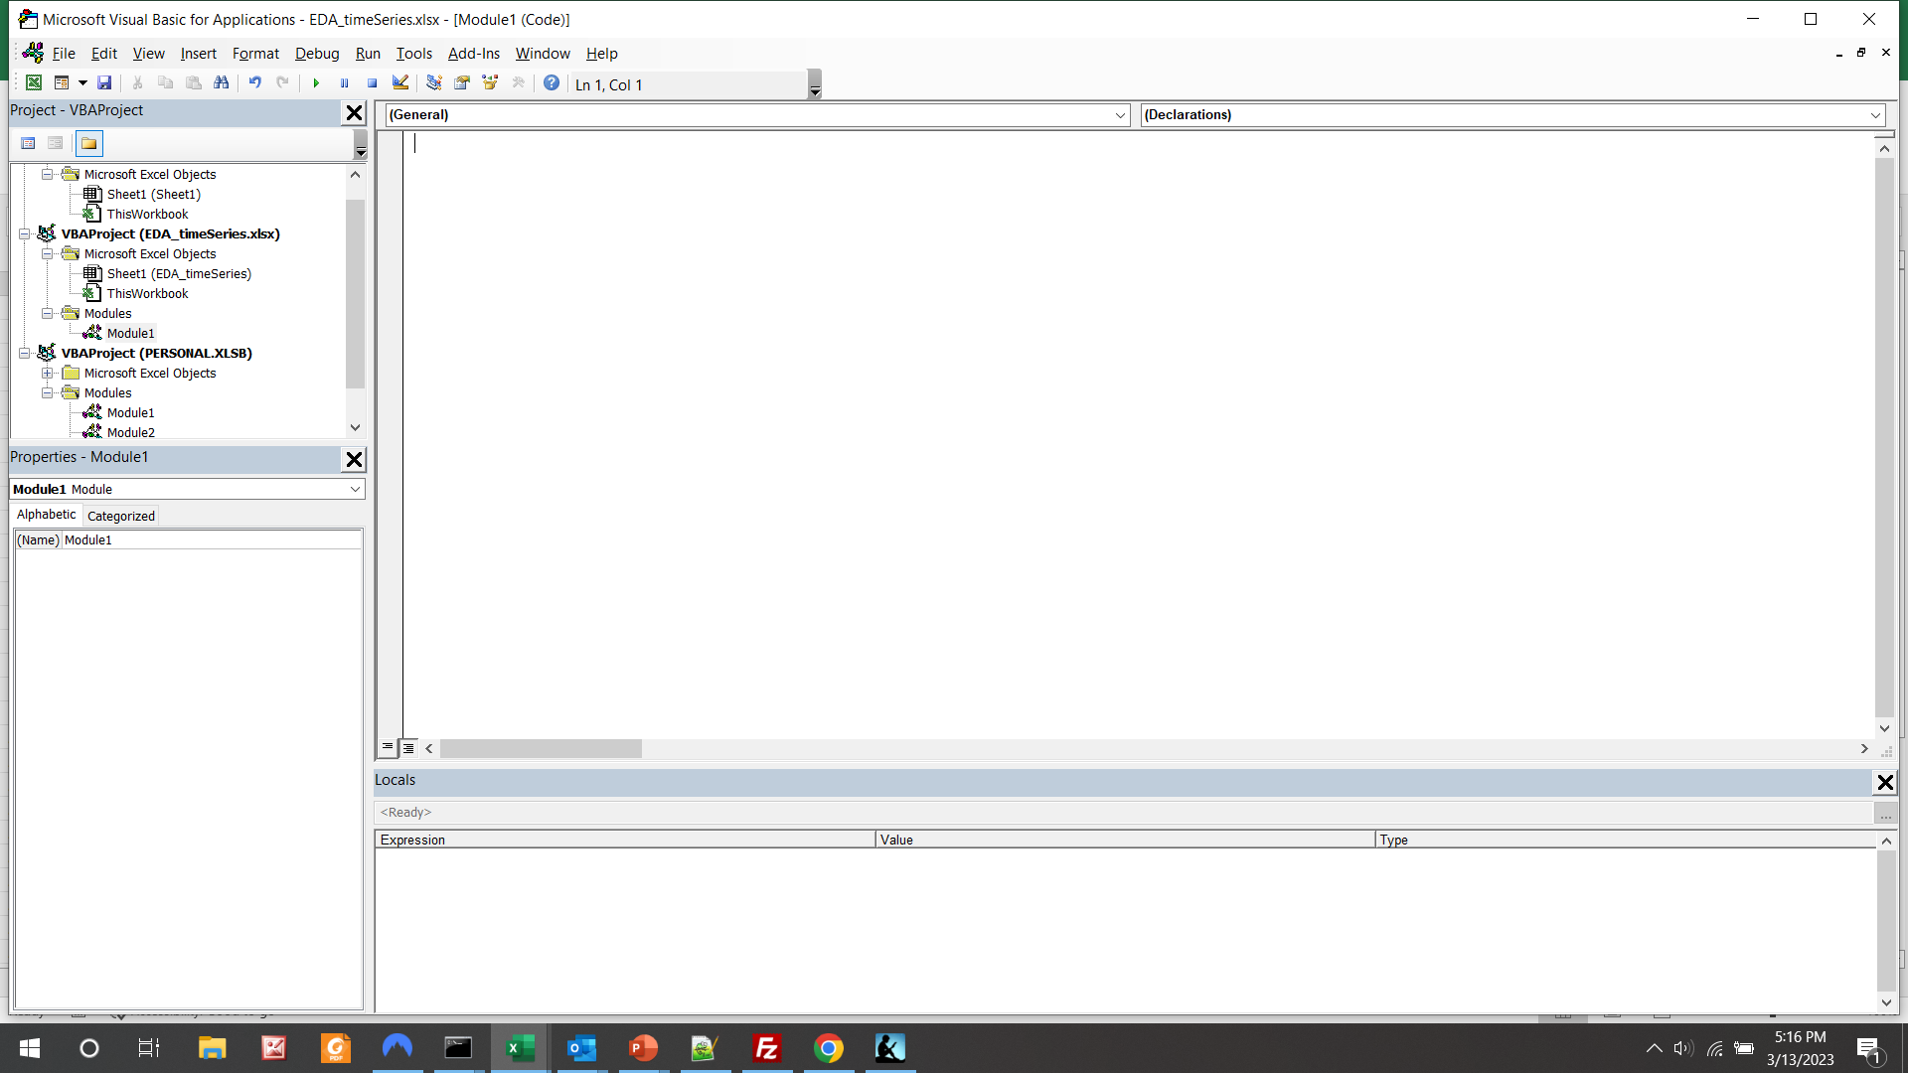
See blank “Module1”

Slide 9
3. Copy the macro
From https://ceresanalytics.com/R_for_IBF_NextLevel/productSegments.bas

Slide 10
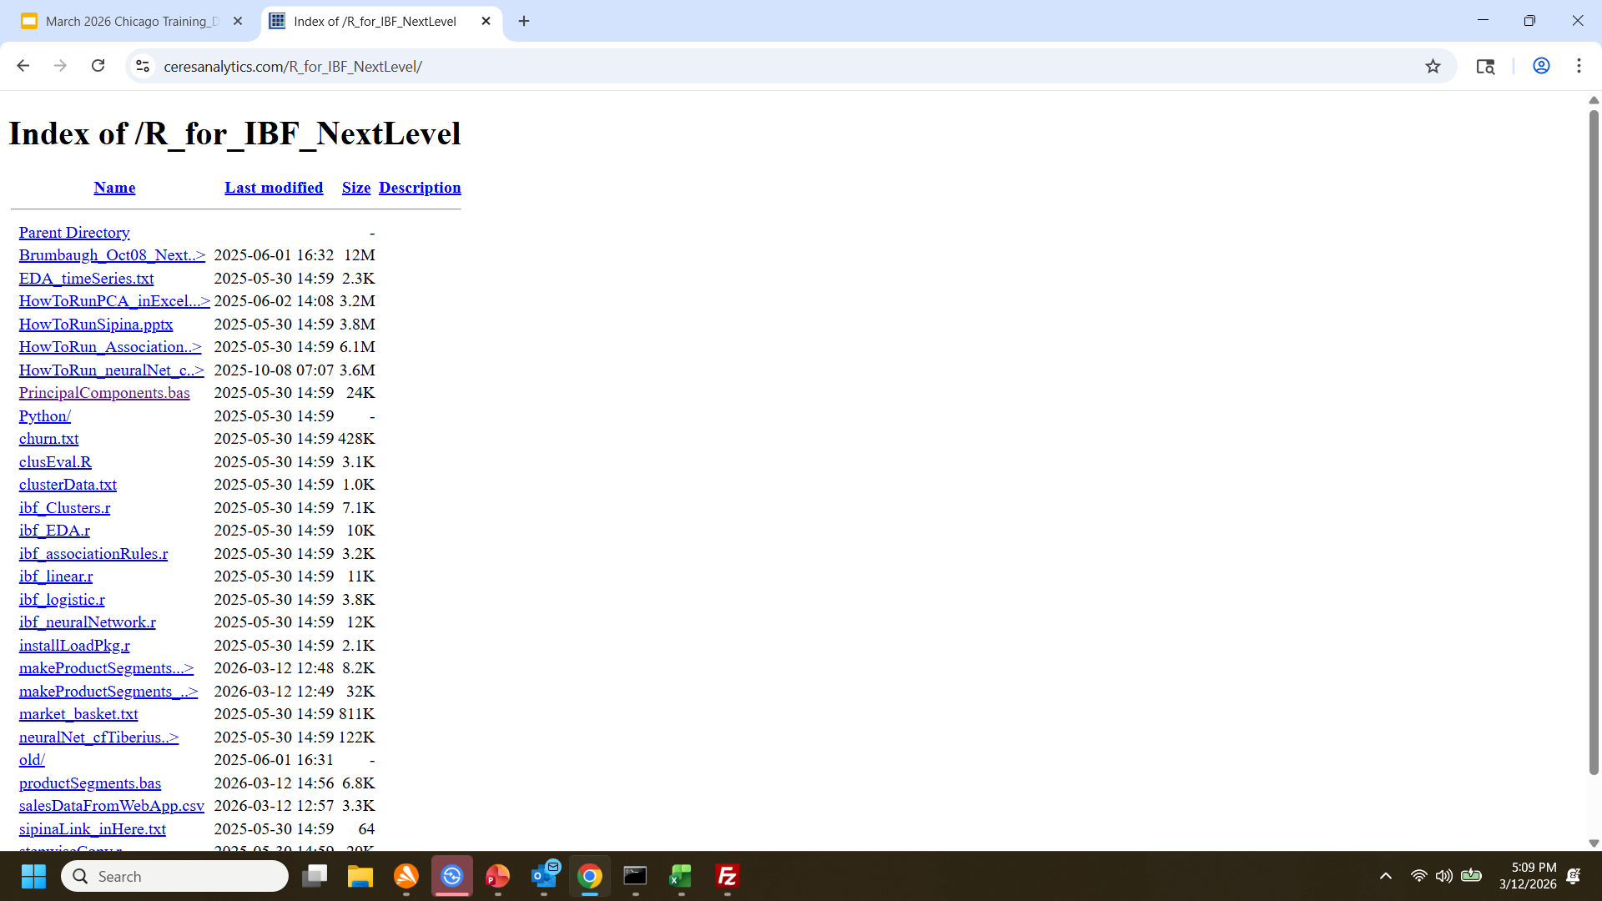
Click to open on web

Slide 11
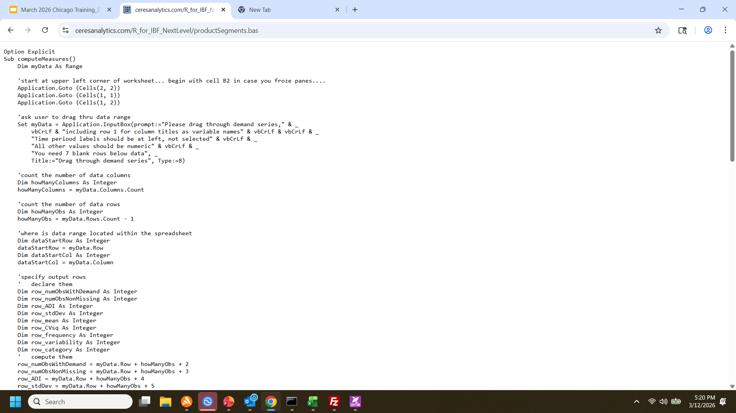
File will display
Ctrl A + Ctrl C to copy

Slide 12
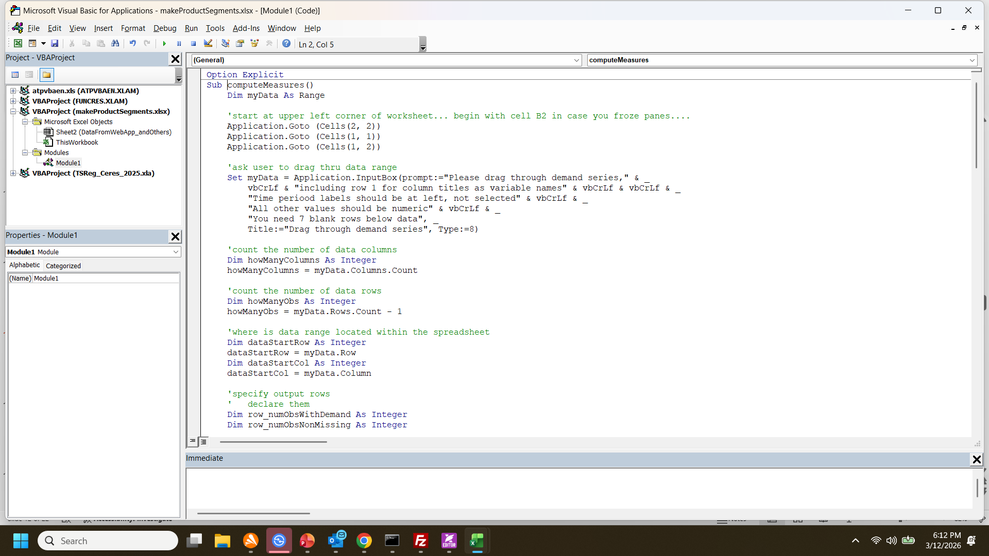
In VBA editor, control-V to paste

Slide 13
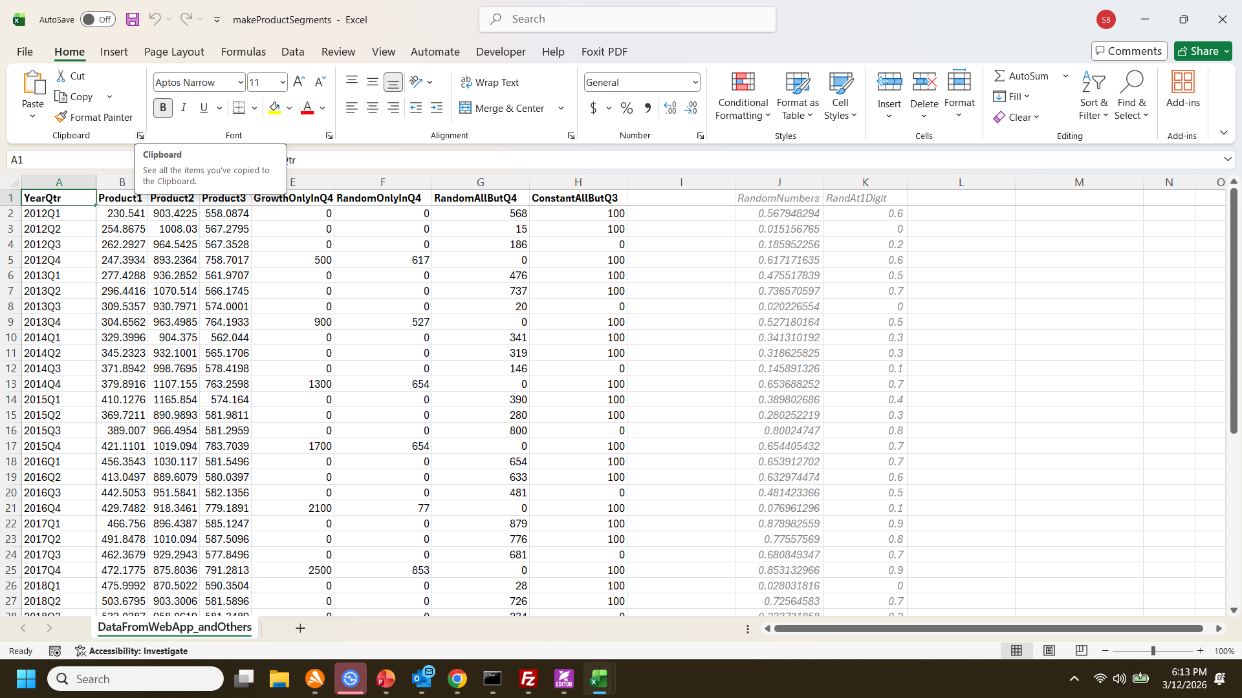
Navigate back to spreadsheet, and click on “File”

Slide 14
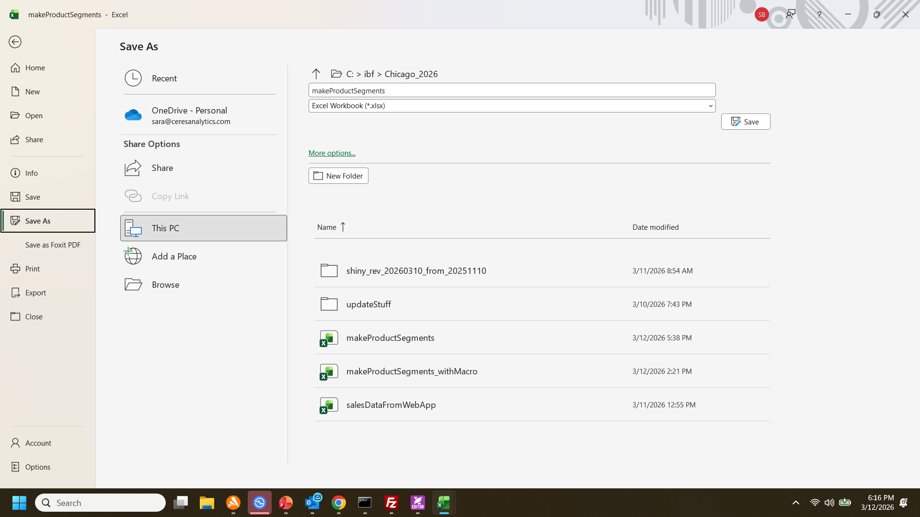
Then “Save As” …

Slide 15
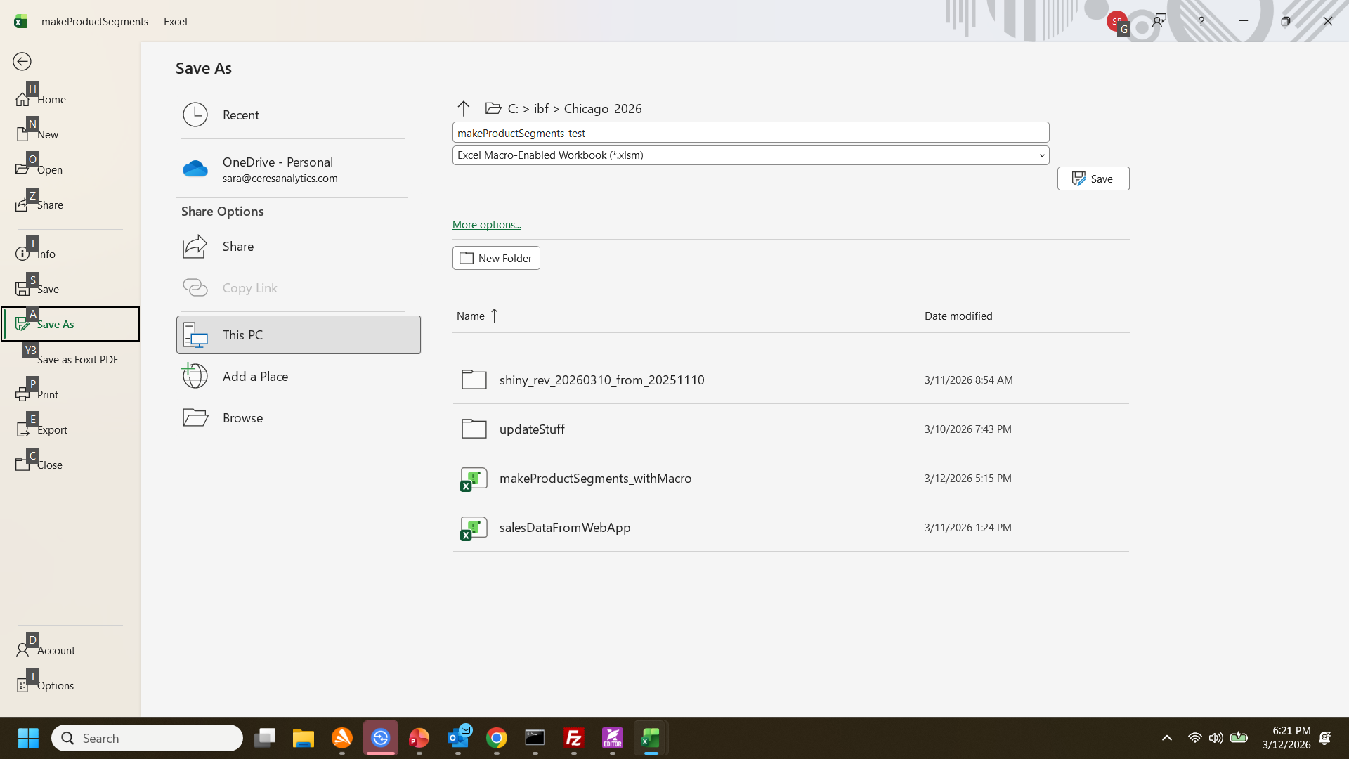
Then “Save as”
Choose “Excel Macro-Enabled Workbook (*.xlsm)”
(and you can change the name or folder location if you want)

Slide 16
3. Run the macro

Slide 17
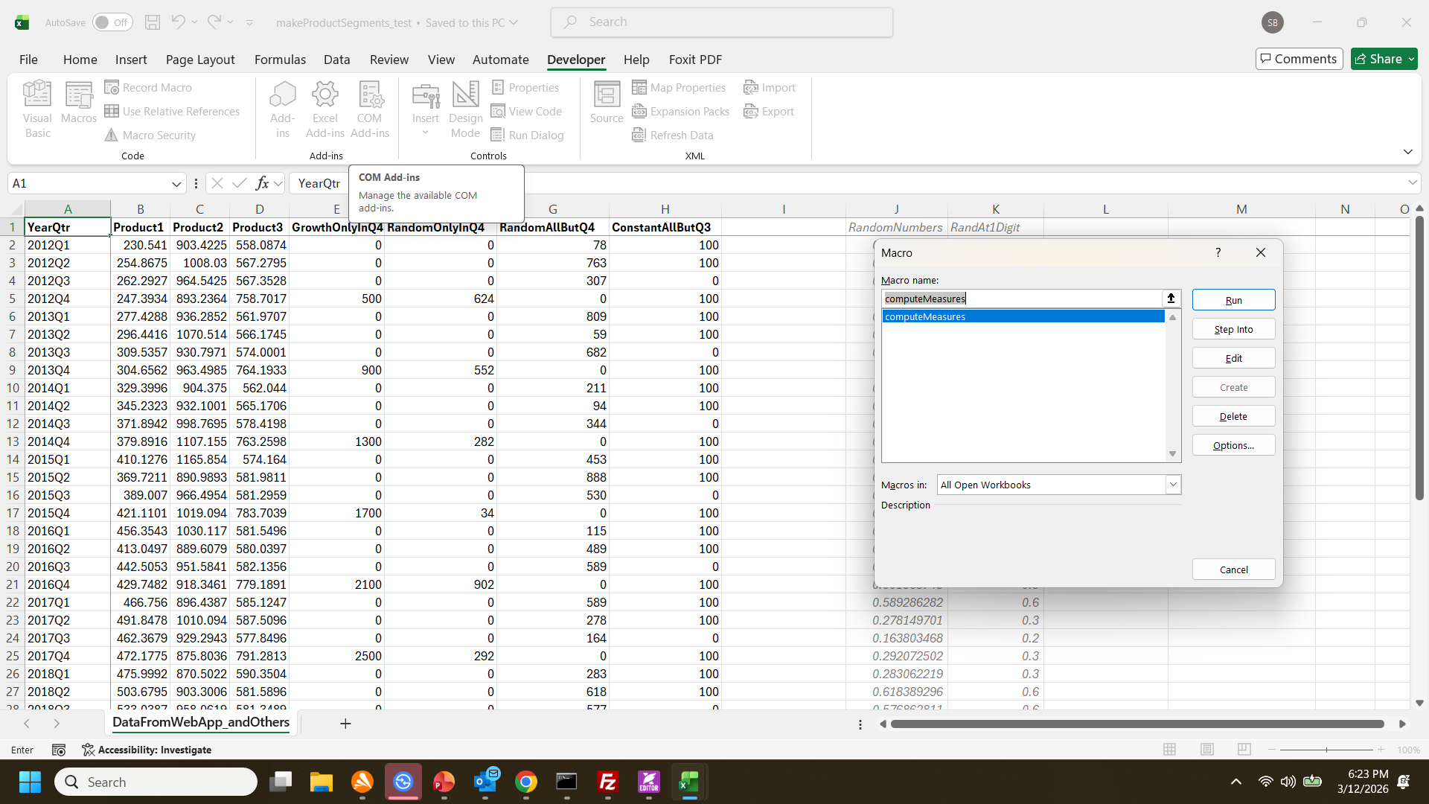
1
2
3
4

Slide 18
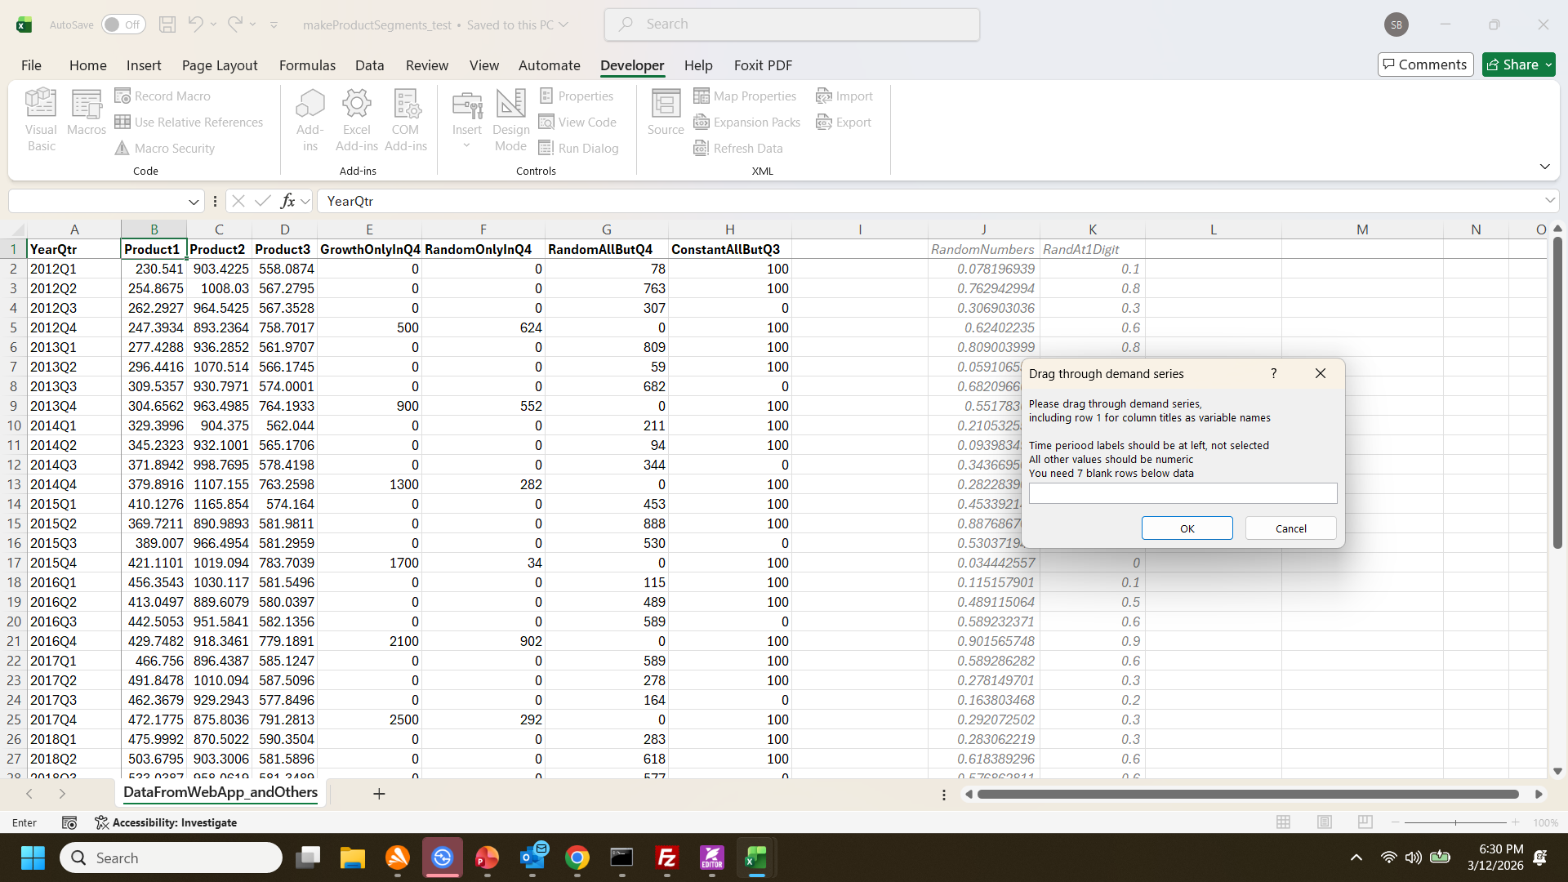
You’ll be asked to drag thru your demand series
Click on Cell B1, then…

Slide 19
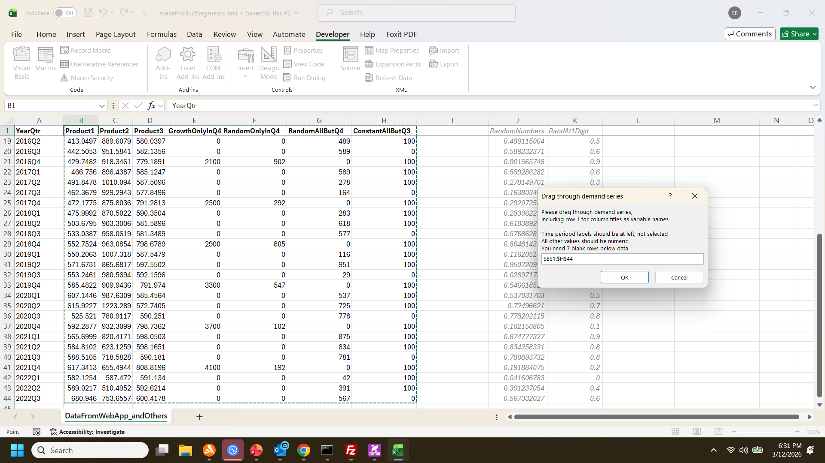
Drag thru the range
(Fastest way: after clicking cell B1, hold down Ctrl Shift keys, then press right cursor (→) and down cursor (↓)), then—after range appears in box prompt, click OK

Slide 20
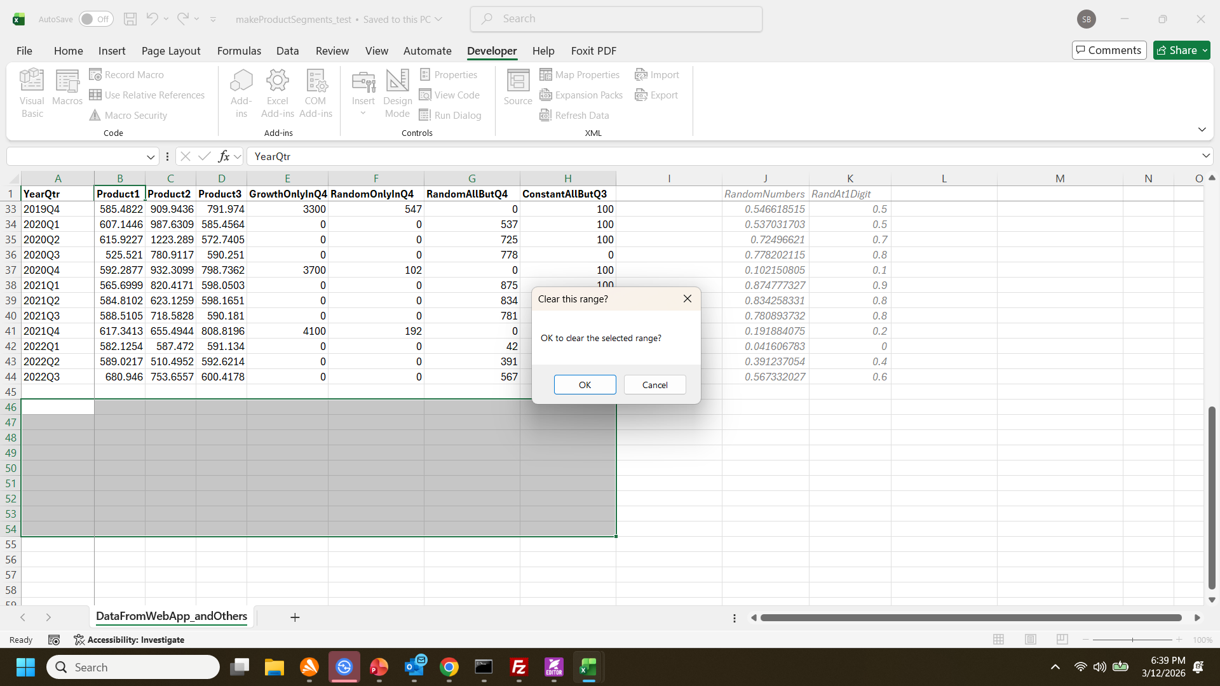
Next, Excel will select the range where it will put its numeric output. If the range is already blank, click “OK”.
Otherwise, click “Cancel” and the macro will stop.
If you choose to cancel, you’ll want to revise your spreadsheet so that you have 10 blank rows after the bottom of your data. Then you can re-start the macro by clicking Developer/Macros/”compute measures” again (see slide 17)

Slide 21
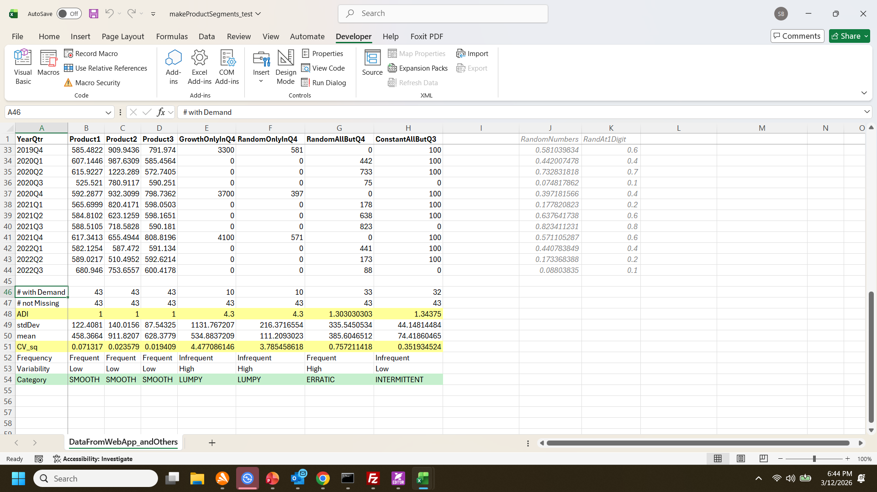
After clicking “OK”, your results will appear.
“ADI” is the 1st yellow line
“CV_sq” is the 2nd yellow line
“Category” is the green line

