Slide 1
How to install and run neuralNet_cfTiberius.xlsm
In Excel

Slide 2
Download the macro-enabled workbook
https://ceresanalytics.com/R_for_IBF_NextLevel/neuralNet_cfTiberius.xlsm OR
https://ceresanalytics.com/R_for_IBF_NextLevel/ and click on “neuralNet_cfTiberus.xlsm”

Slide 3
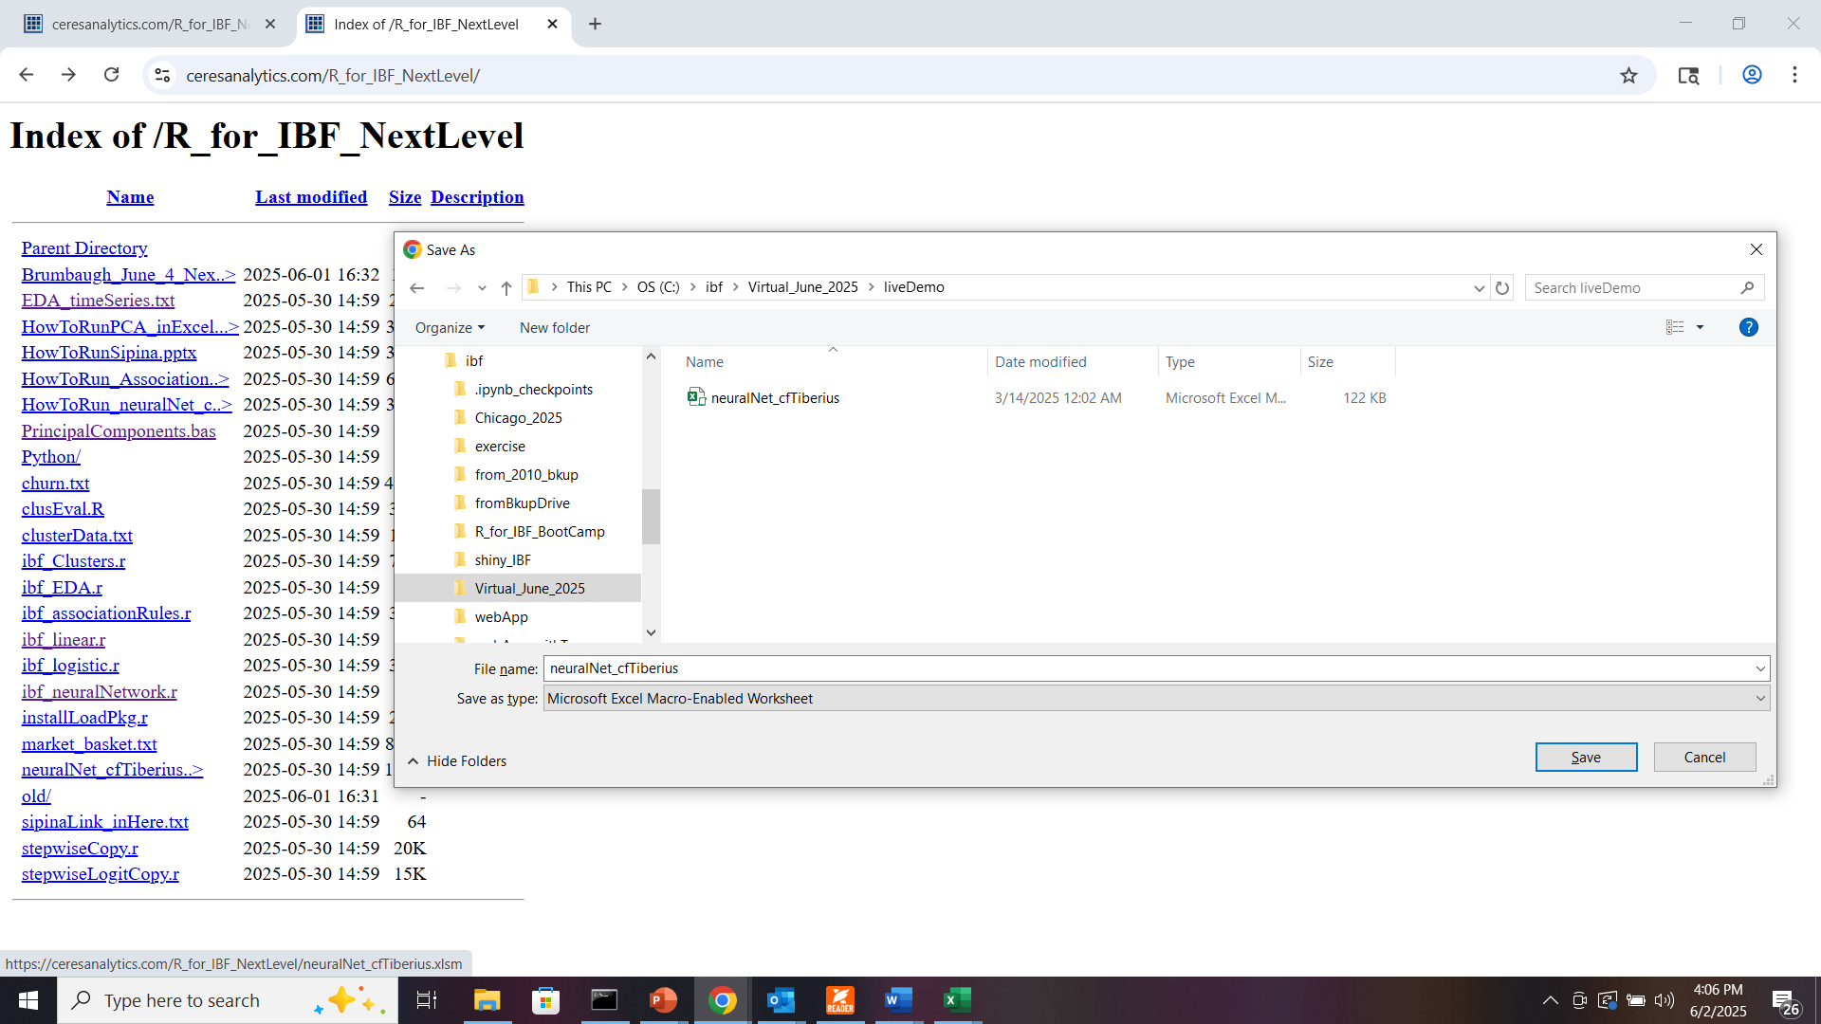

Slide 4
Manage add-ins
AnalysisToolPak
AnalysisToolPak

Slide 5
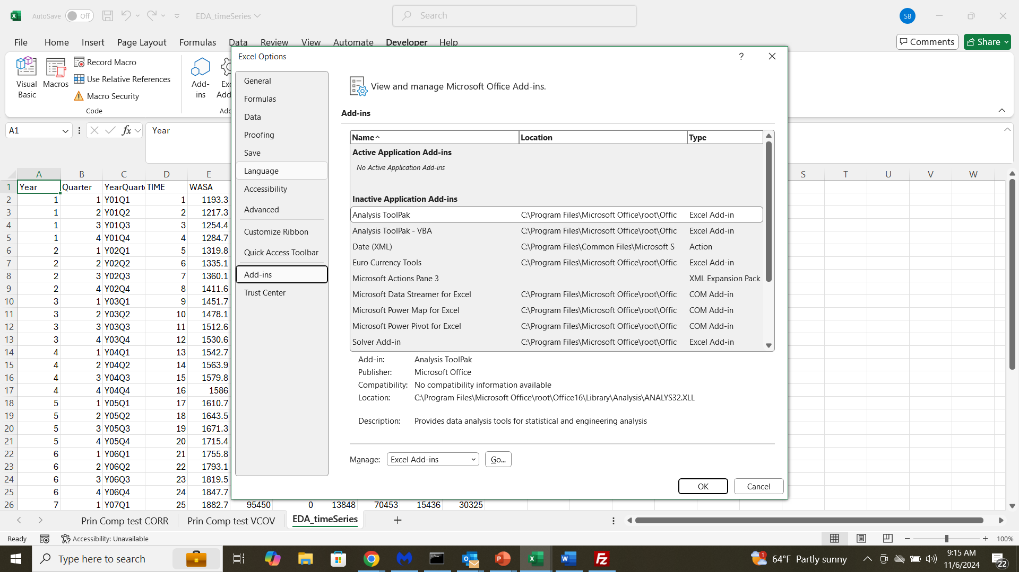
(1) From File/Options (bottom choice)
(2)
(3)

Slide 6
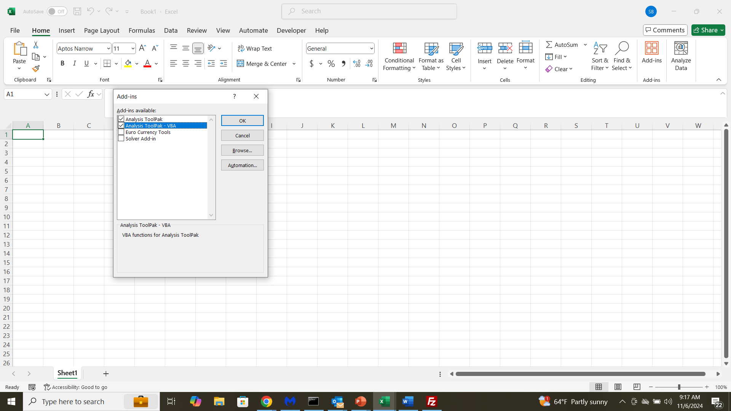

Slide 7
Open neuralNet_cfTiberius.xlsm
from your saved location

Slide 8
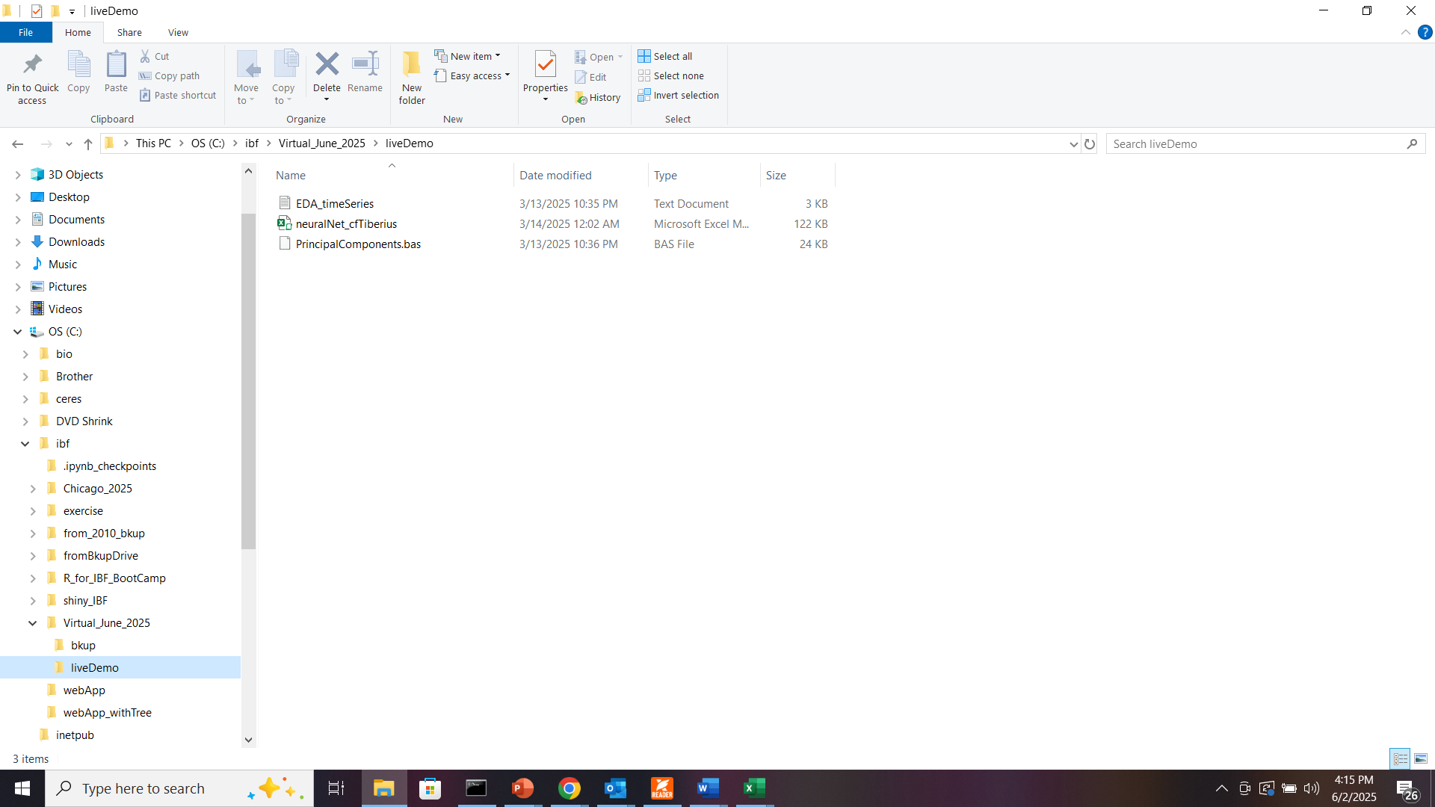
1. Windows Explorer
2. Navigate to folder
3. RIGHT CLICK on NeuralNet_cfTiberius.xlsx

Slide 9
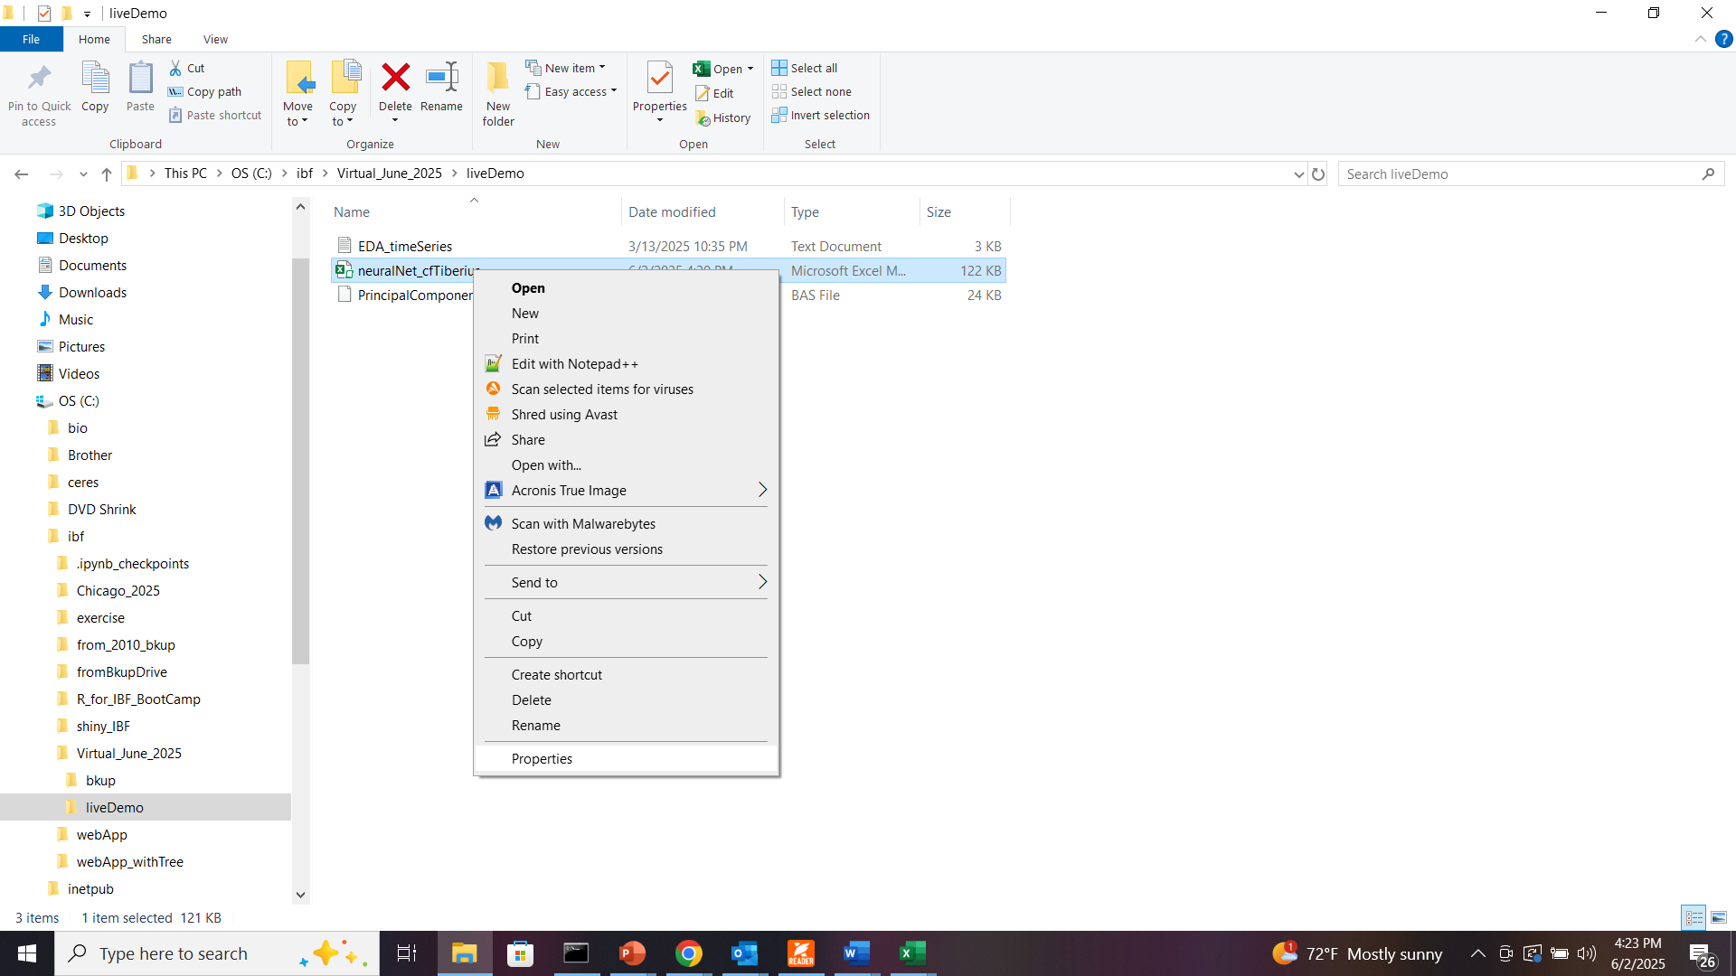
Choose properties

Slide 10
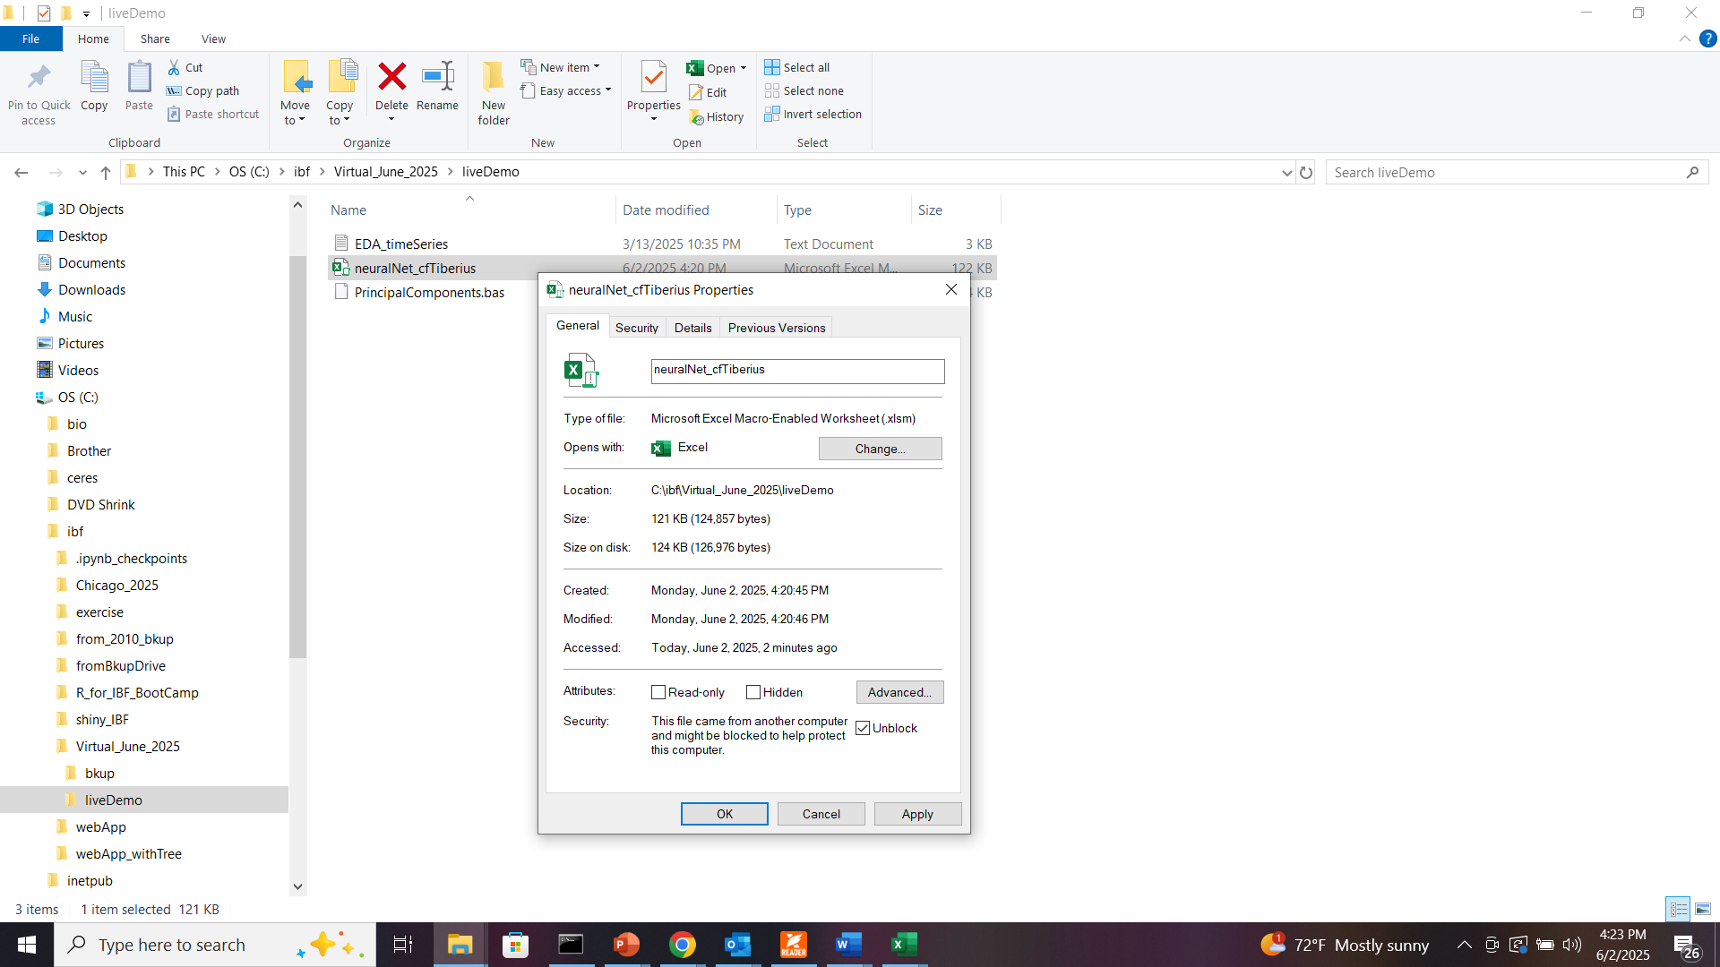
1) Check Unblock
2) Click OK
If you don’t see this, options at:
https://support.microsoft.com/en-us/office/enable-or-disable-macros-in-microsoft-365-files-12b036fd-d140-4e74-b45e-16fed1a7e5c6

Slide 11
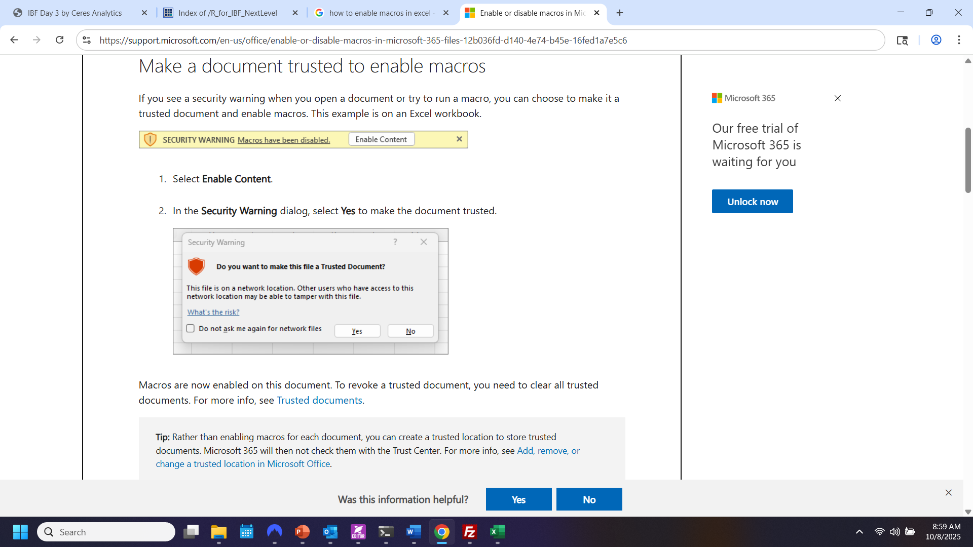
Preferred approach,
Details in Appendix at slide 18

Slide 12
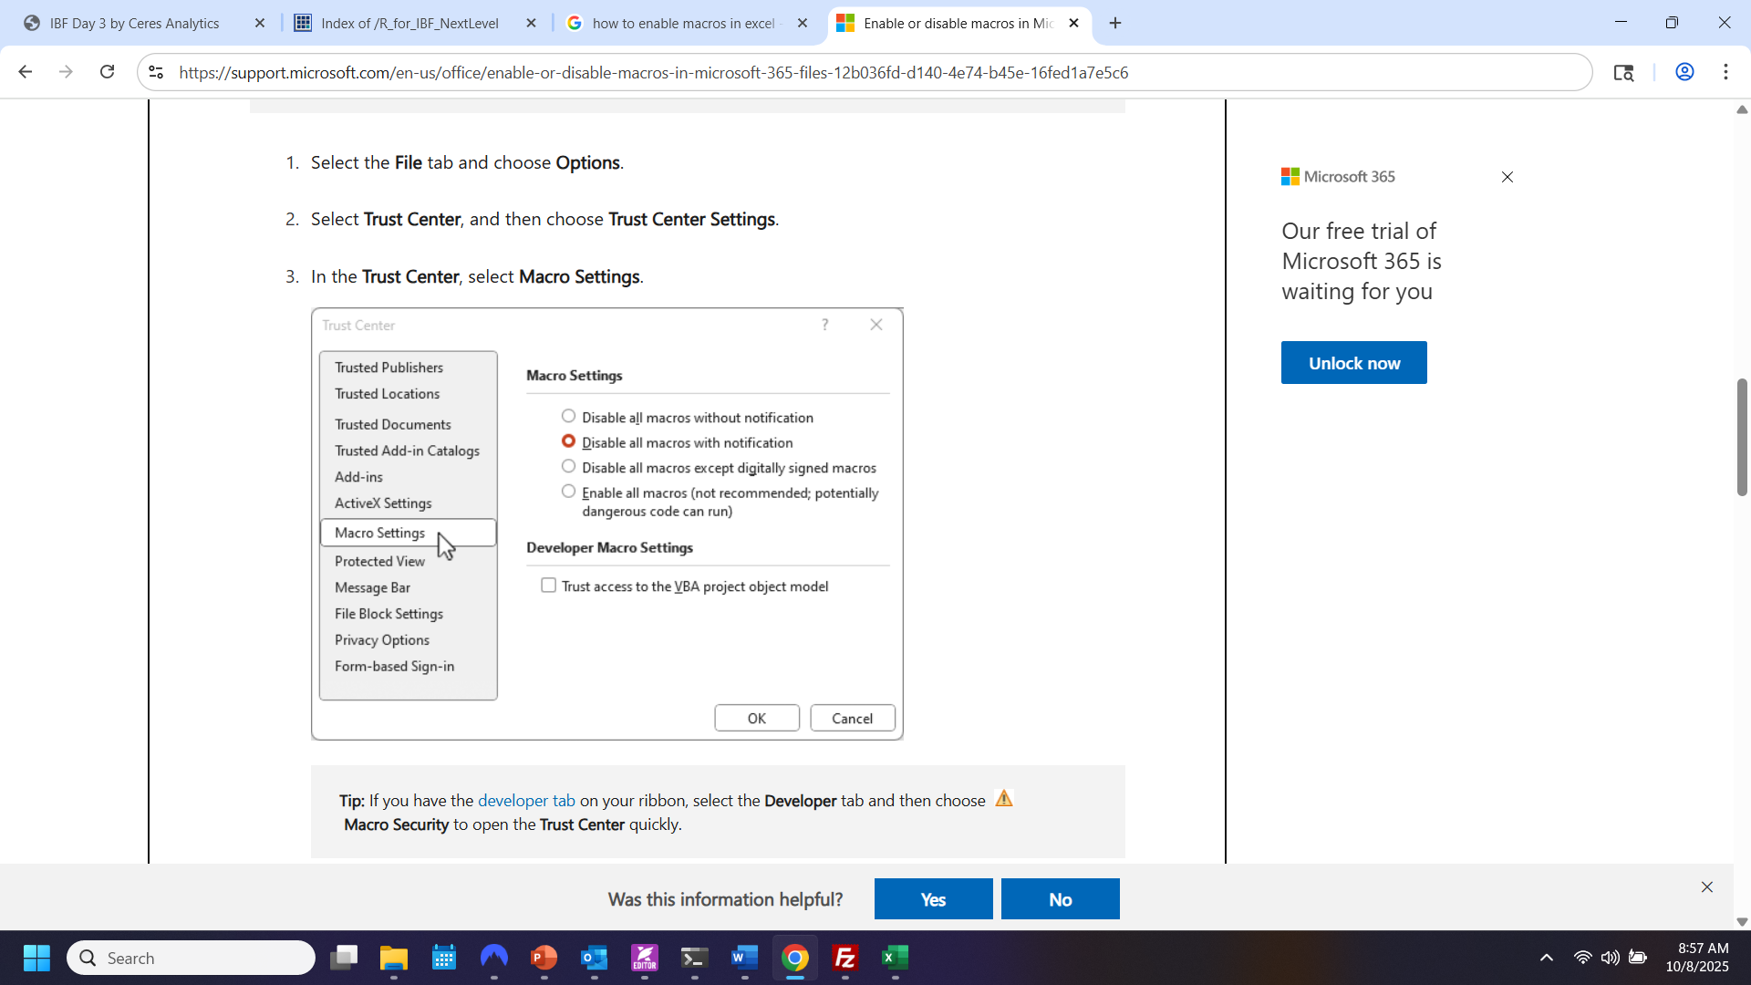
UNRECOMMENDED, *but* If you do this, make sure you restore original setting after running neuralNet_cfTiberius.xlsm

Slide 13
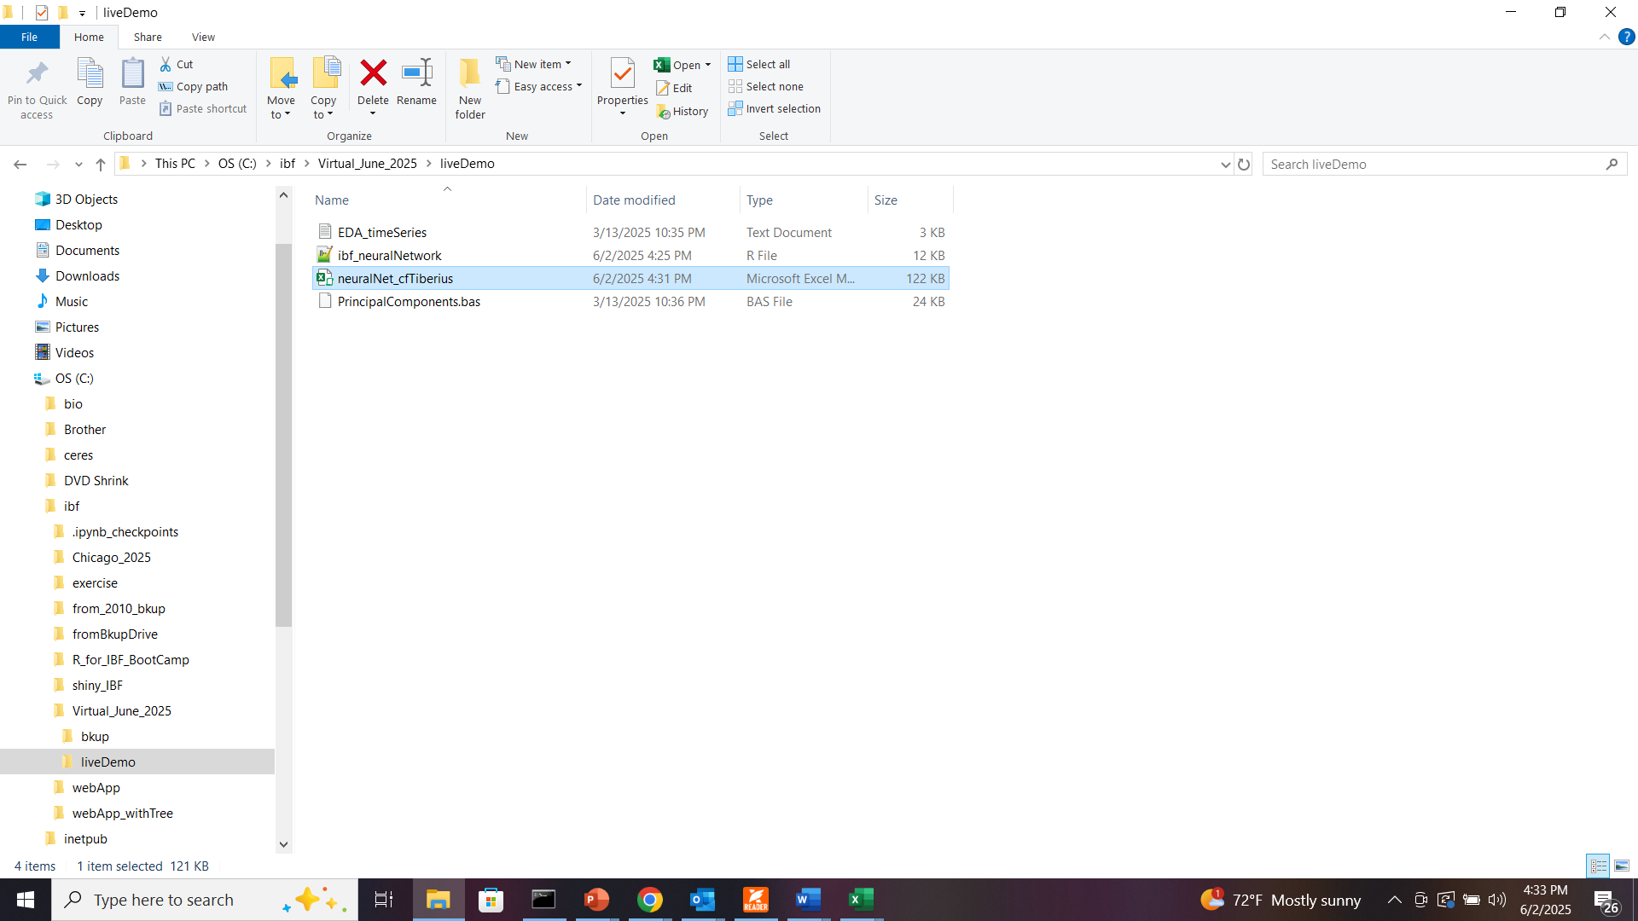
Double-click to open

Slide 14
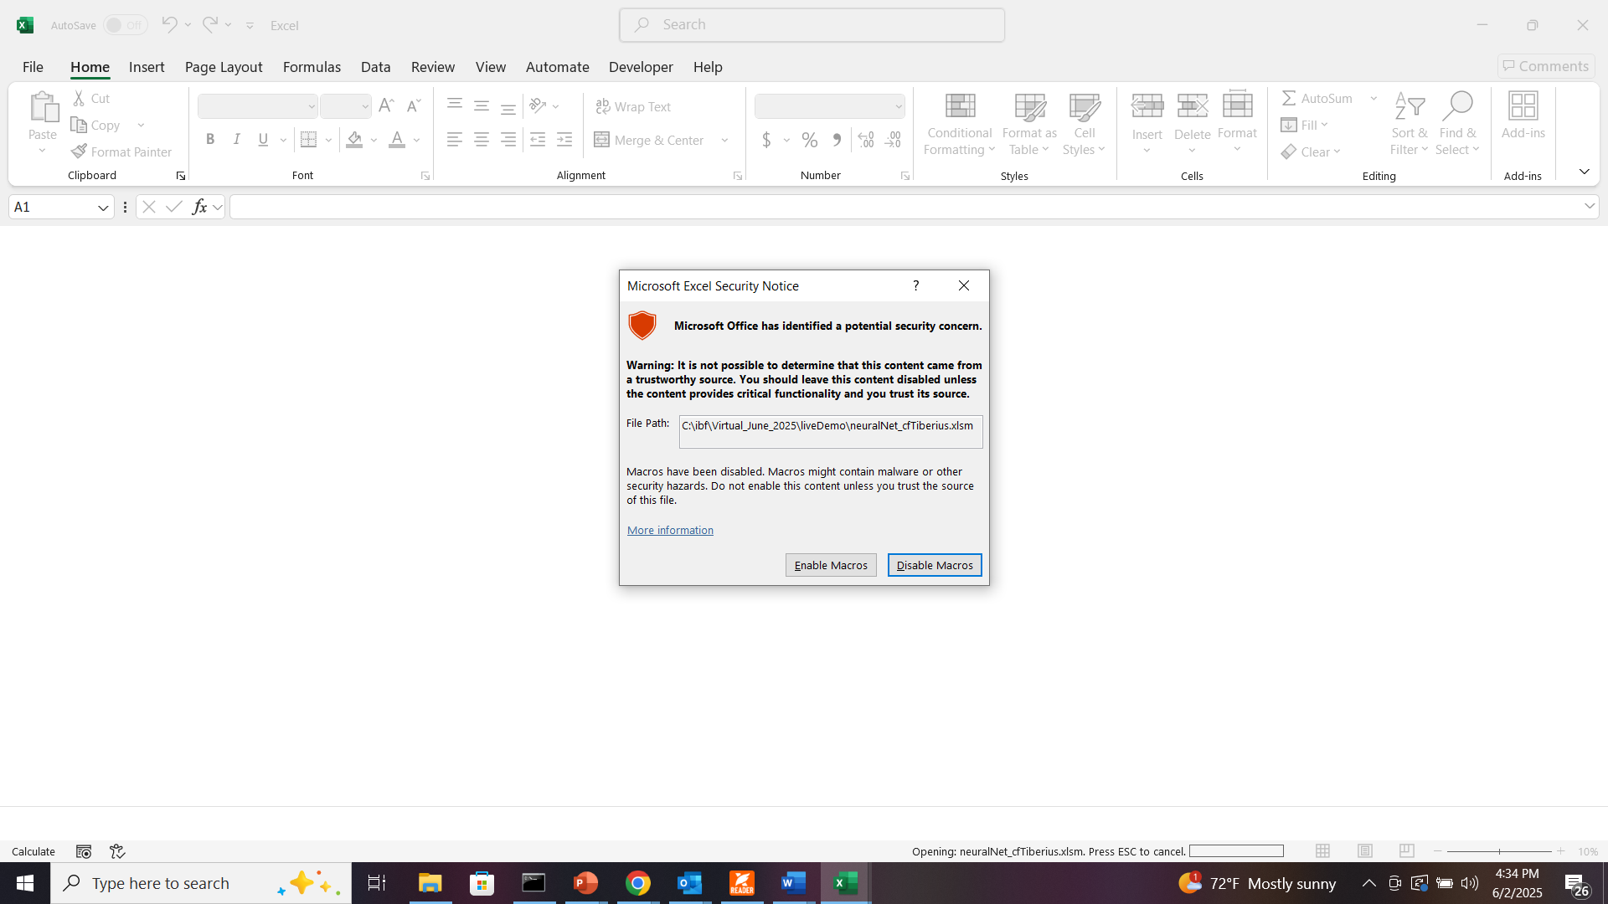
Click “Enable Macros”

Slide 15
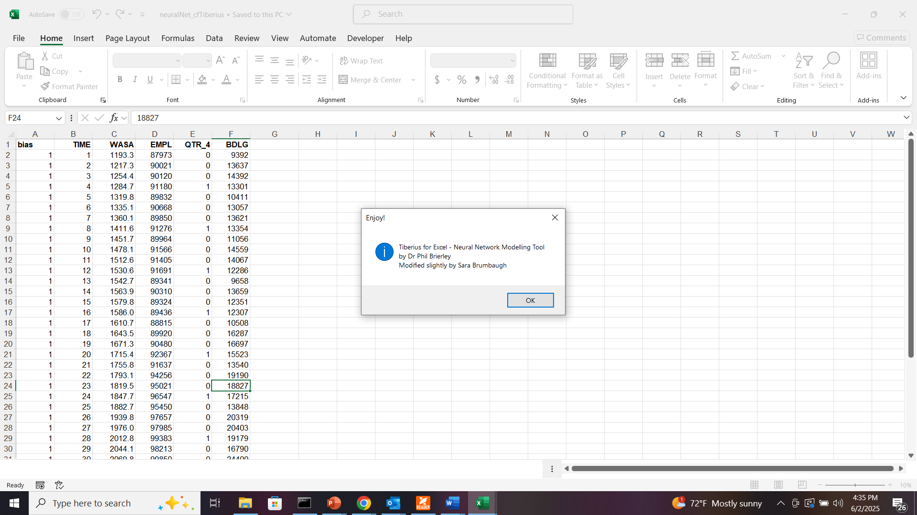

Slide 16
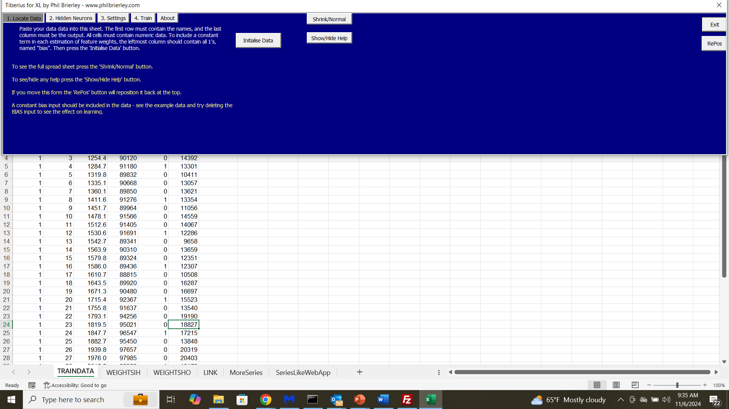

Slide 17
NOTE: You can run Tiberius with your own data:
Simply paste it into the TRAINDATA sheet from cell B1
Make sure the dependent variable (what you want to predict) is in the rightmost column
Edit column A (“bias”) to have as many rows as the data you pasted in
Then click “Initialise Data” to read them in

Slide 18
Appendix
What happens if you don’t unblock macros when opening file neuralNet_cfTiberius.xlsm

Slide 19
After you did this…
1. Windows Explorer
2. Navigate to folder
3. NeuralNet_cfTiberius.xlsx

Slide 20
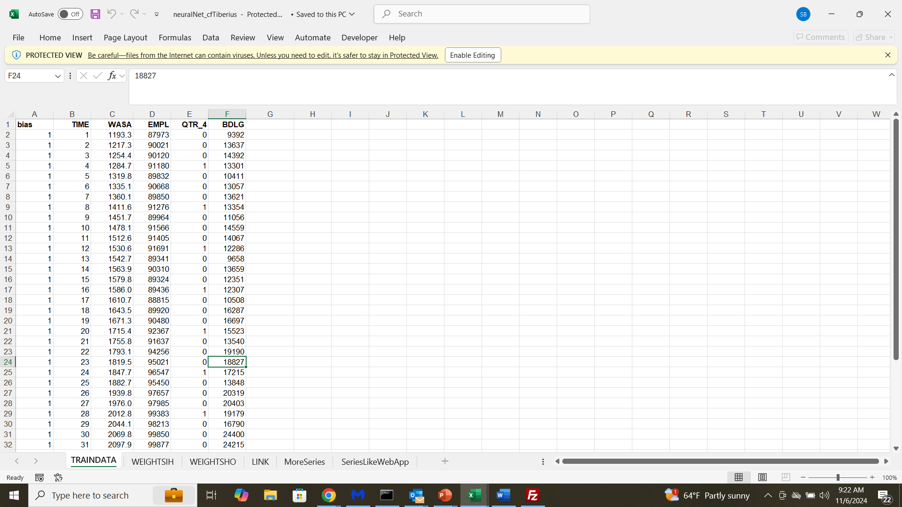
You’ll see this

Slide 21
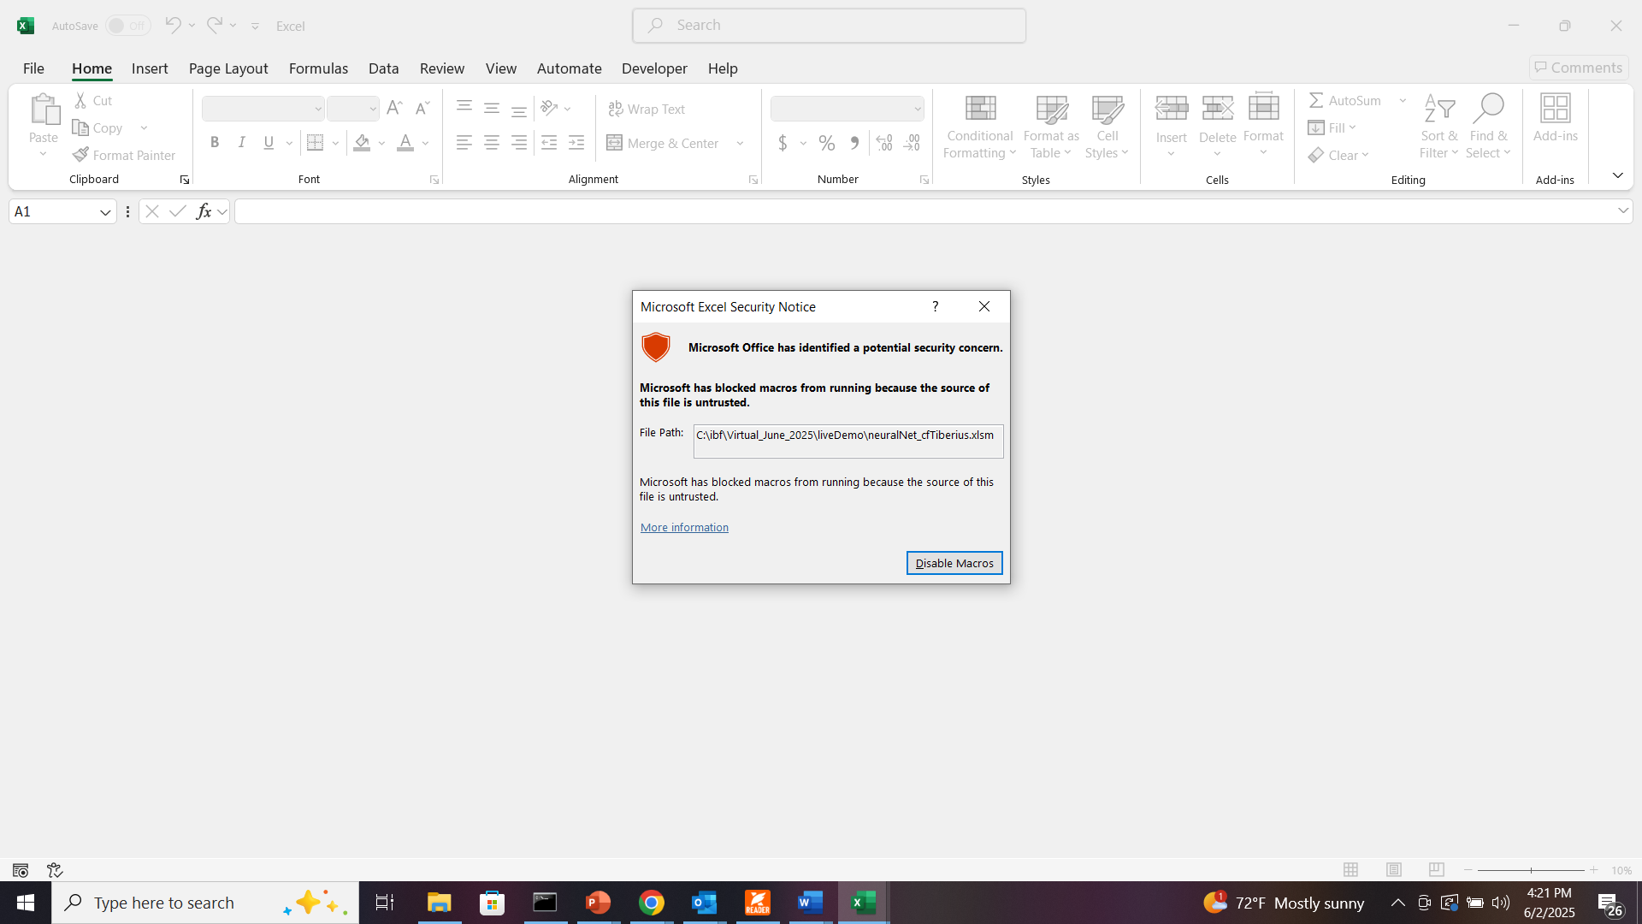

Slide 22
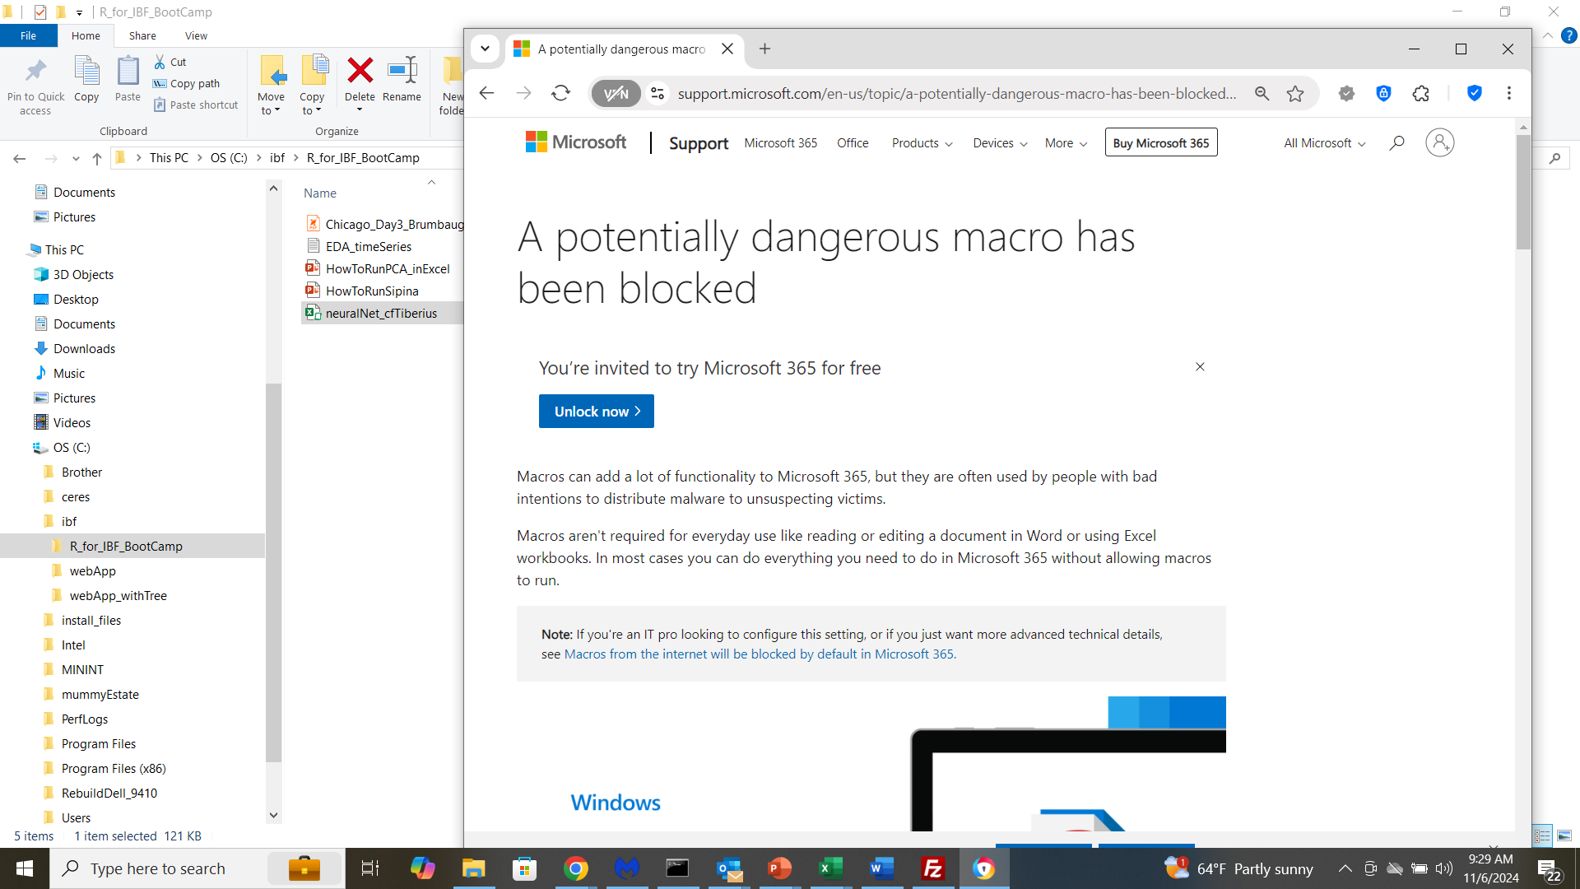
Scroll down …

Slide 23
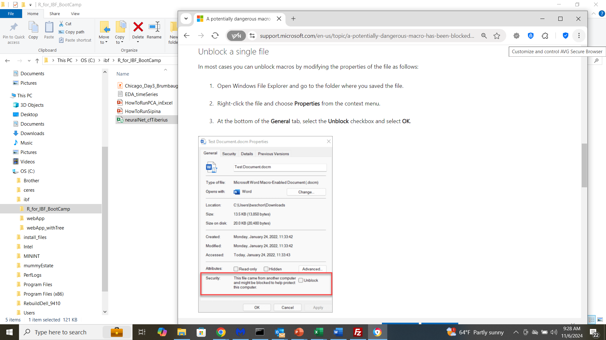

Slide 26
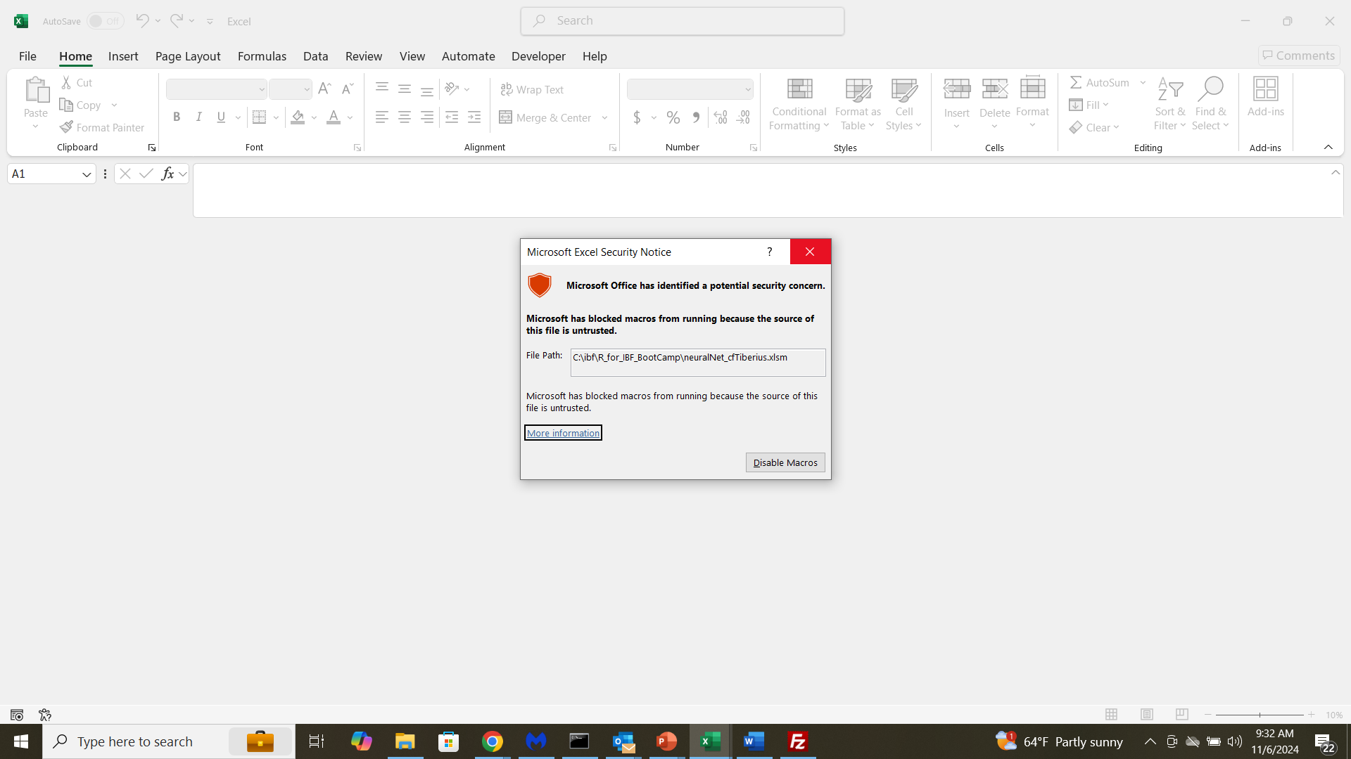
Close Excel and re-open
… then resume from slide #12

