Slide 1
How to run Association Rule Software (ARS)
As distributed with SIPINA
20241127
(see “HowToRunSipina.pptx” for installation)

Slide 2
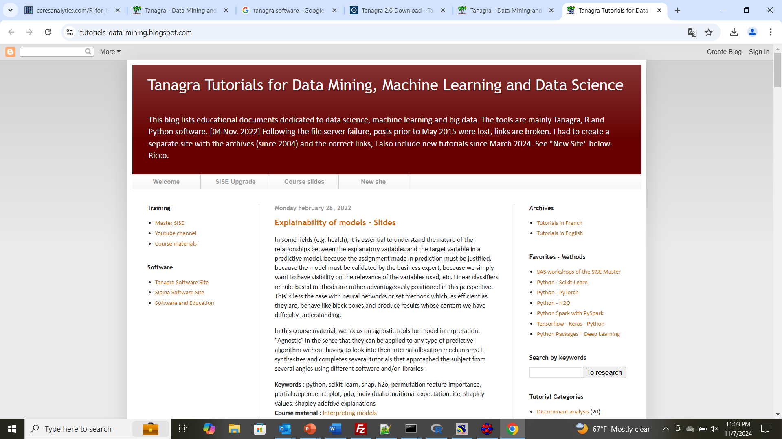

Slide 3
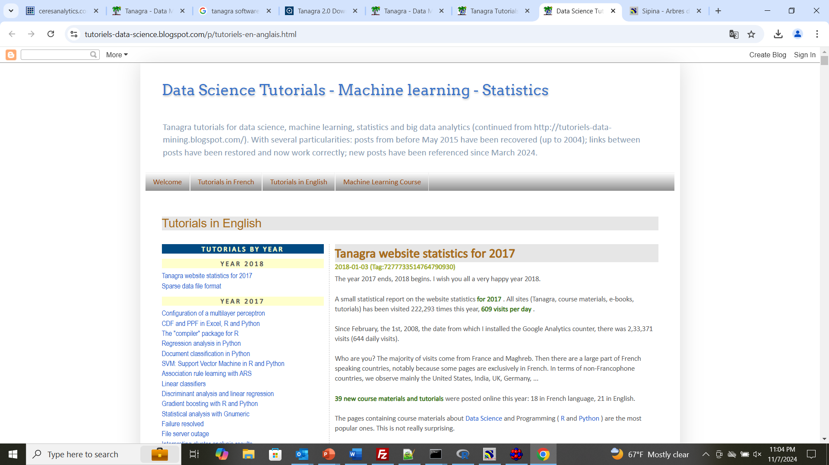
https://tutoriels-data-science.blogspot.com/p/tutoriels-en-anglais.html#8700823904090274821

Slide 4
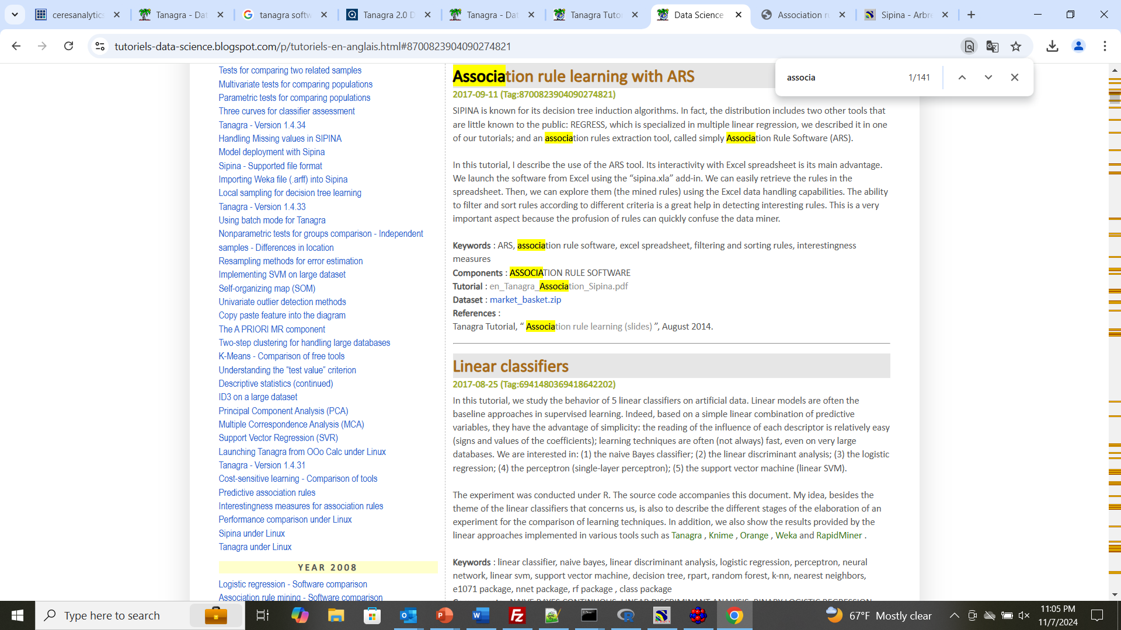
https://tutoriels-data-science.blogspot.com/p/tutoriels-en-anglais.html#8700823904090274821

Slide 5
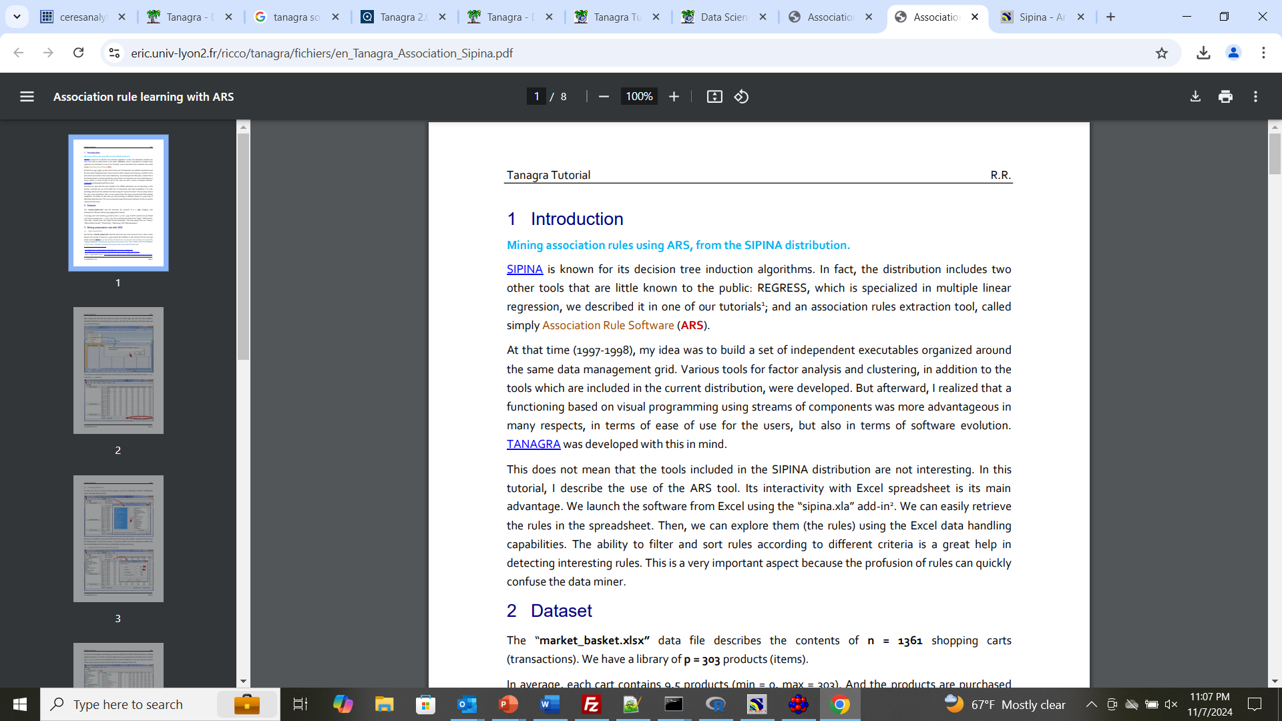
https://eric.univ-lyon2.fr/ricco/tanagra/fichiers/en_Tanagra_Association_Sipina.pdf

Slide 6
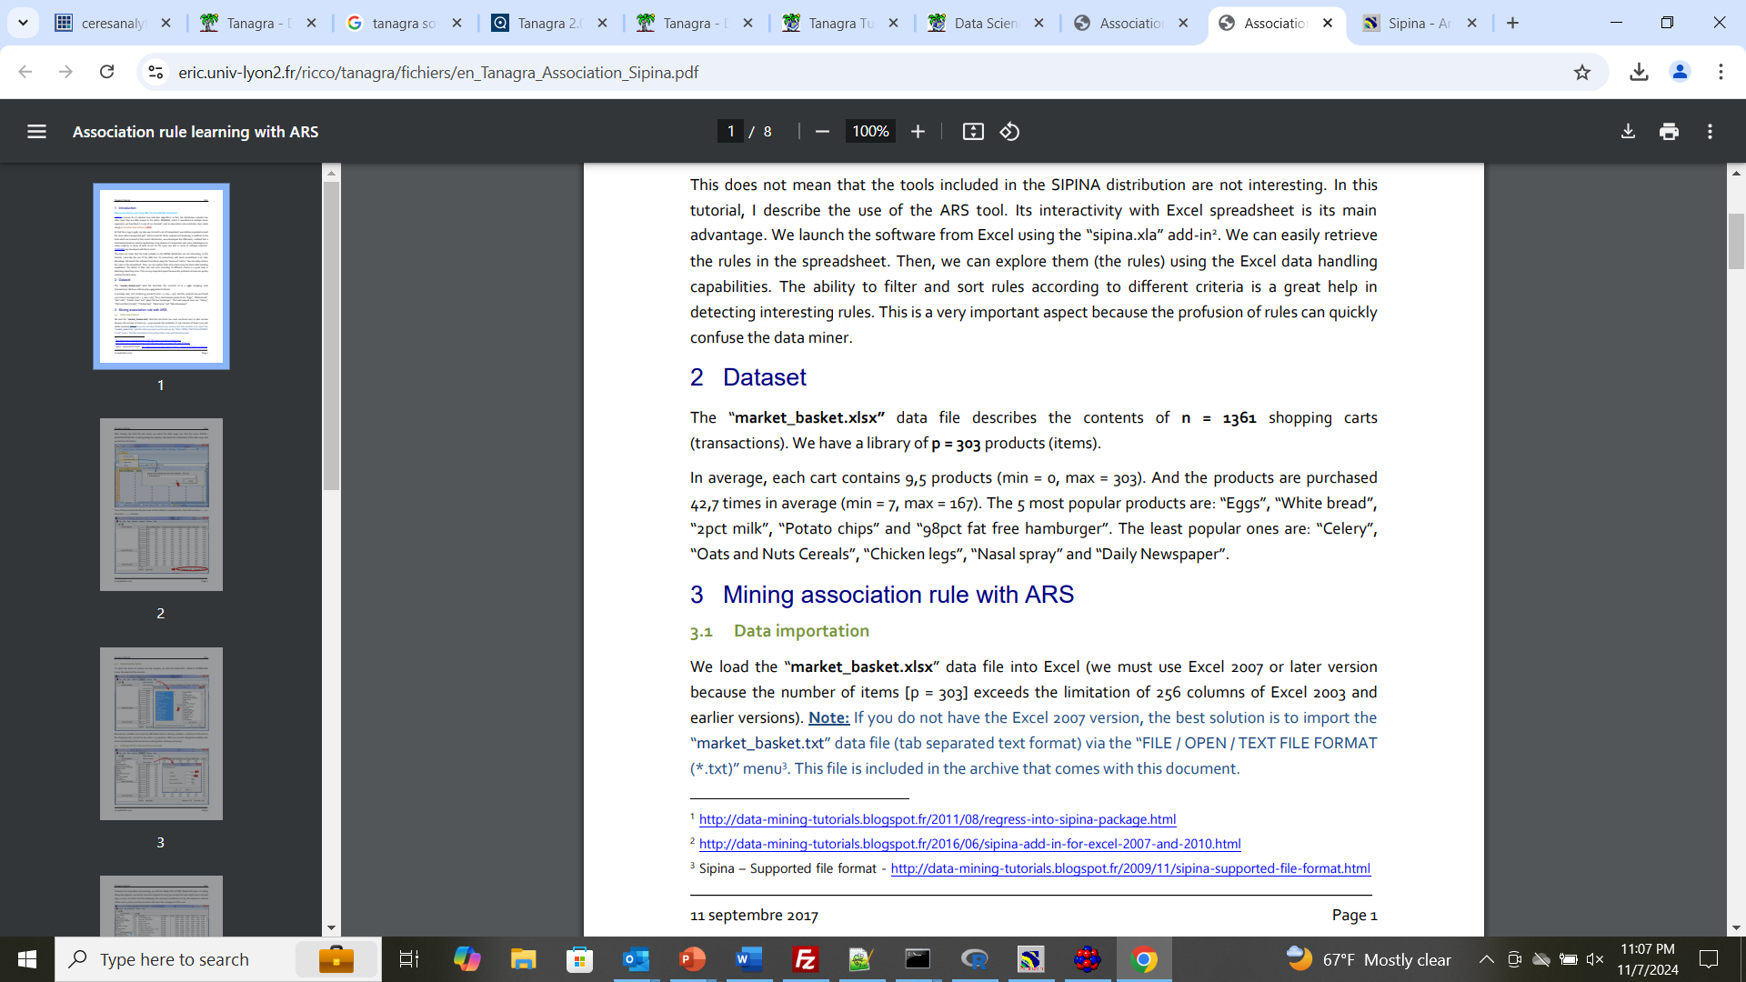

Slide 7
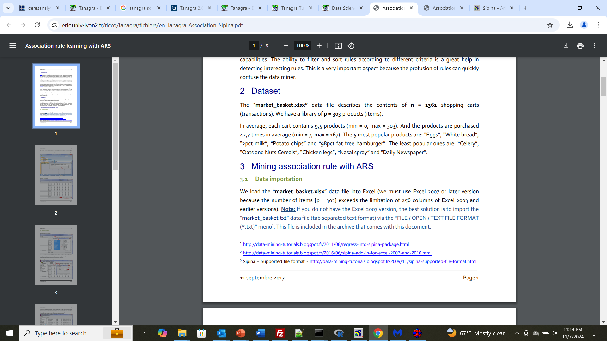

Slide 8
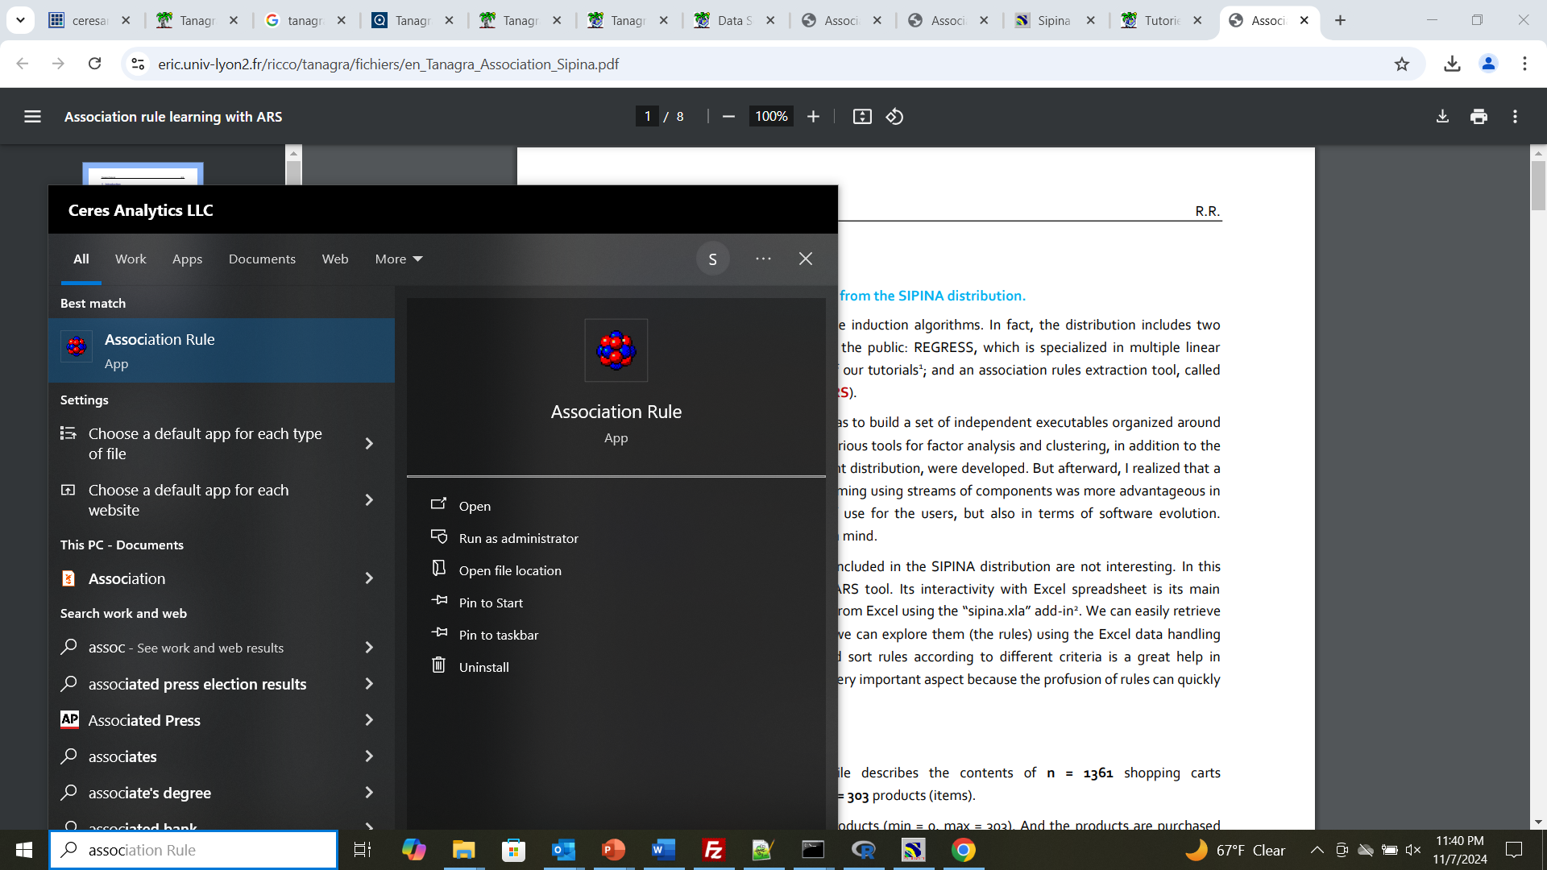

Slide 9
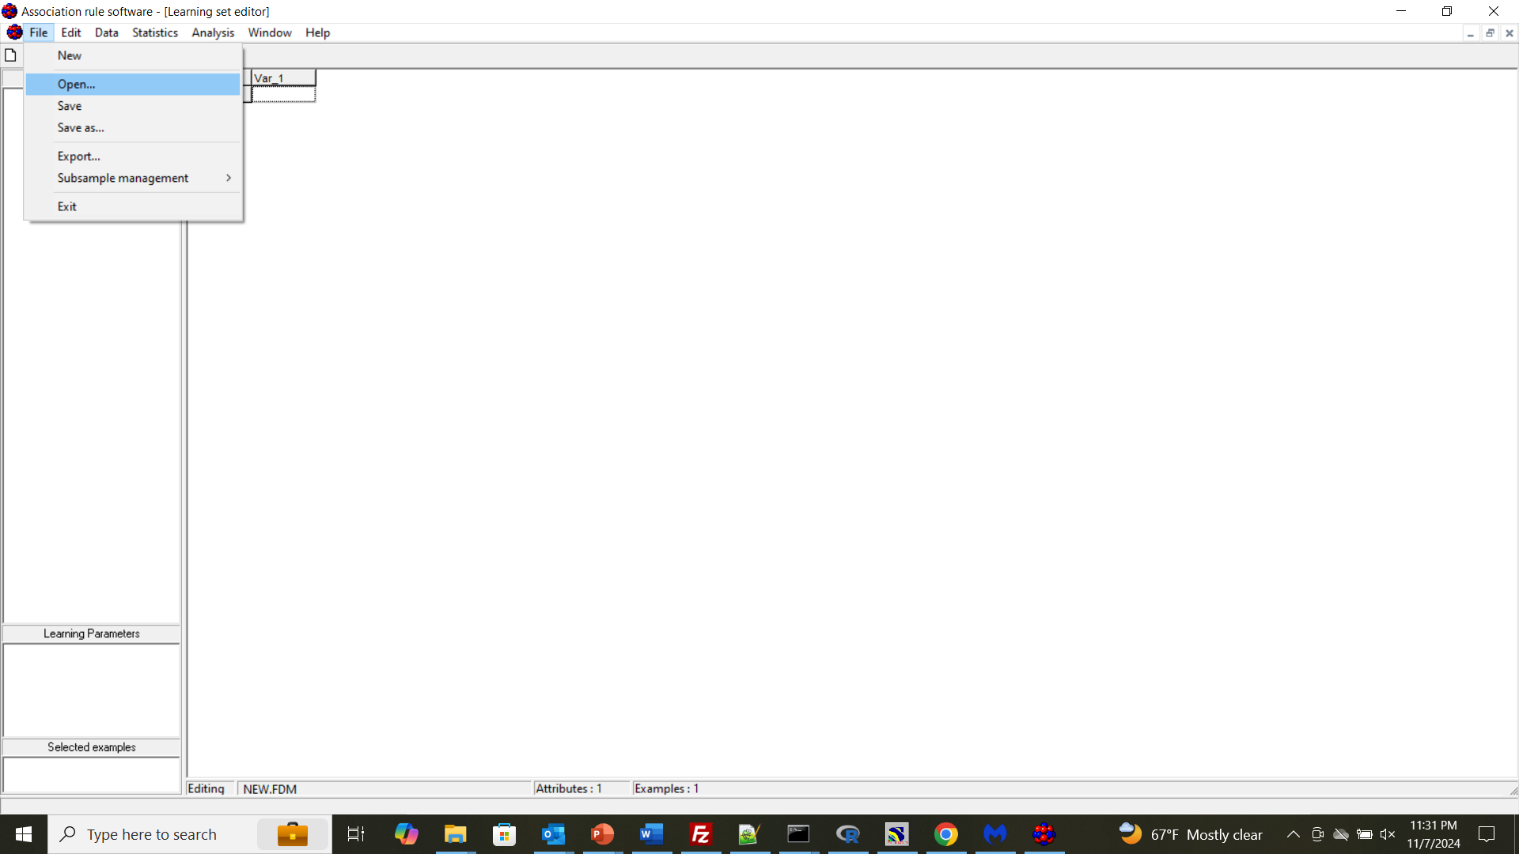
To open a data file…

Slide 10
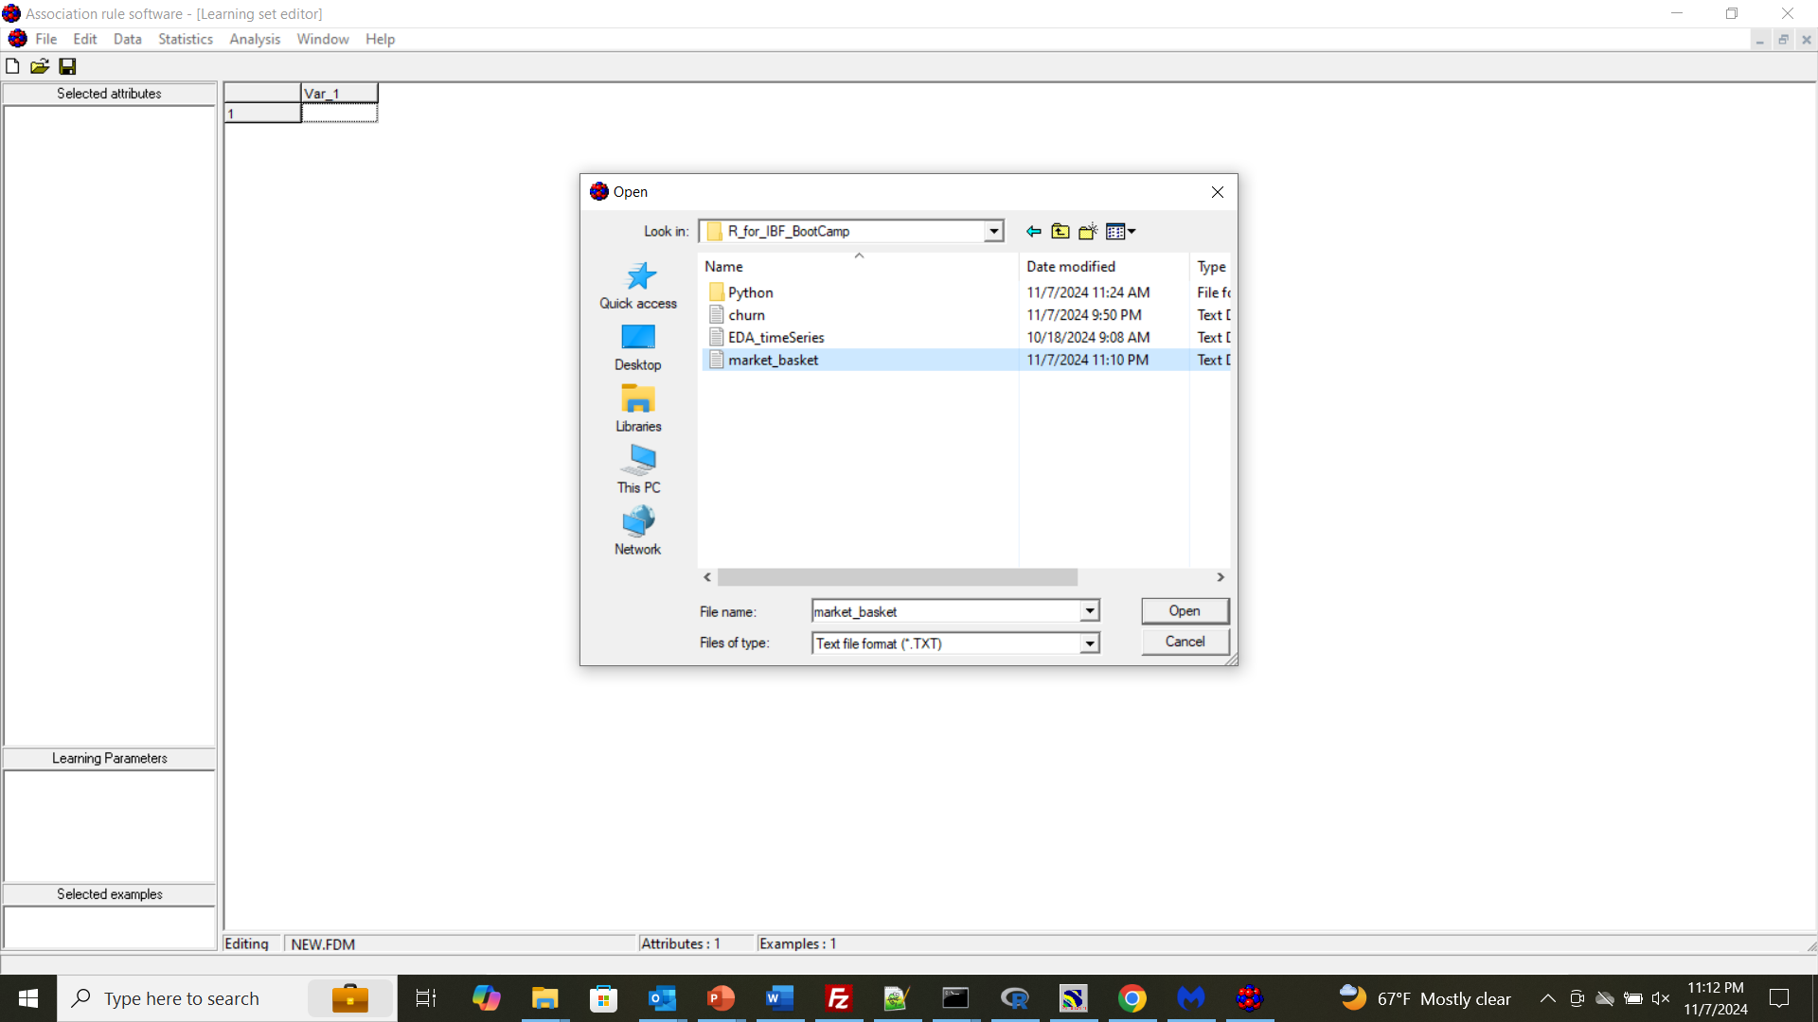

Slide 11
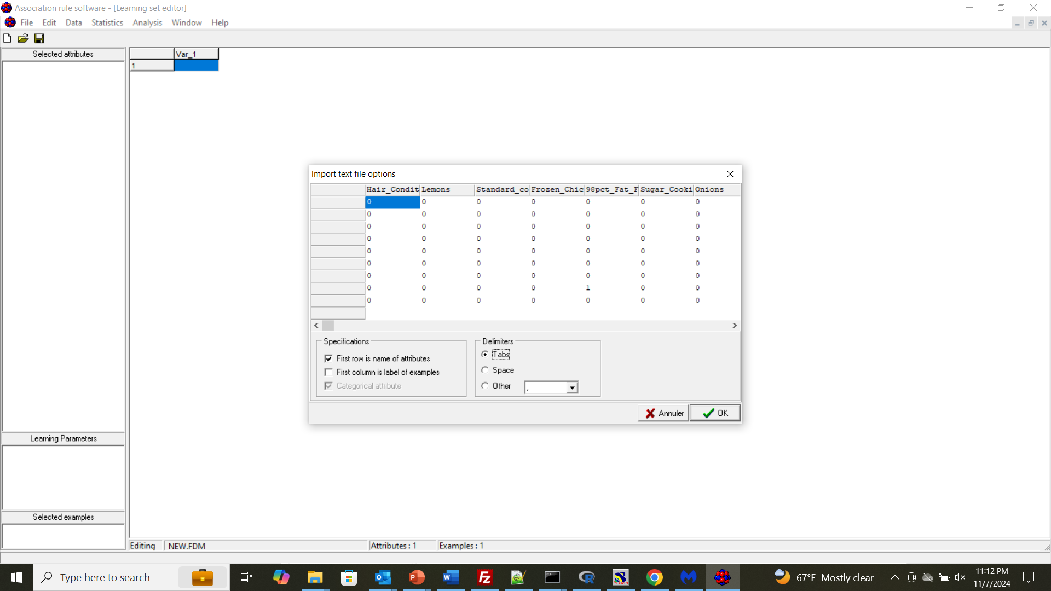

Slide 12
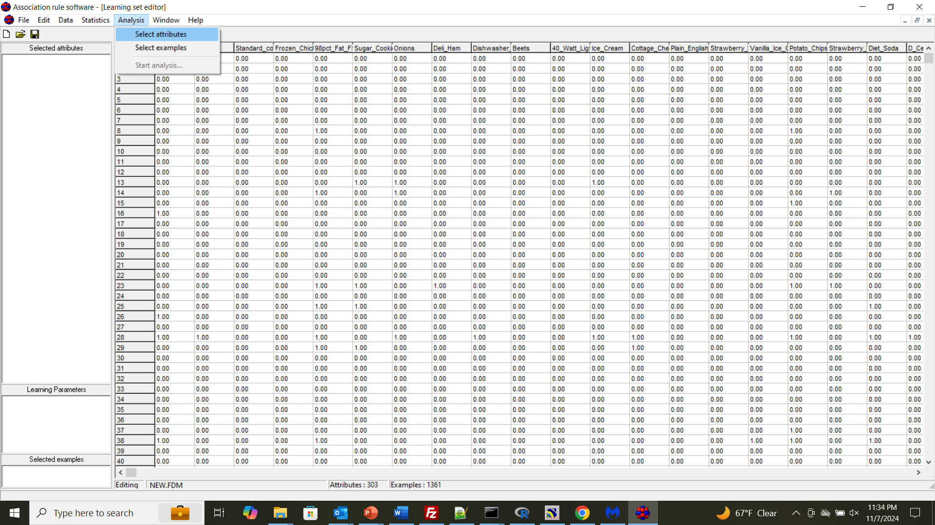

Slide 13
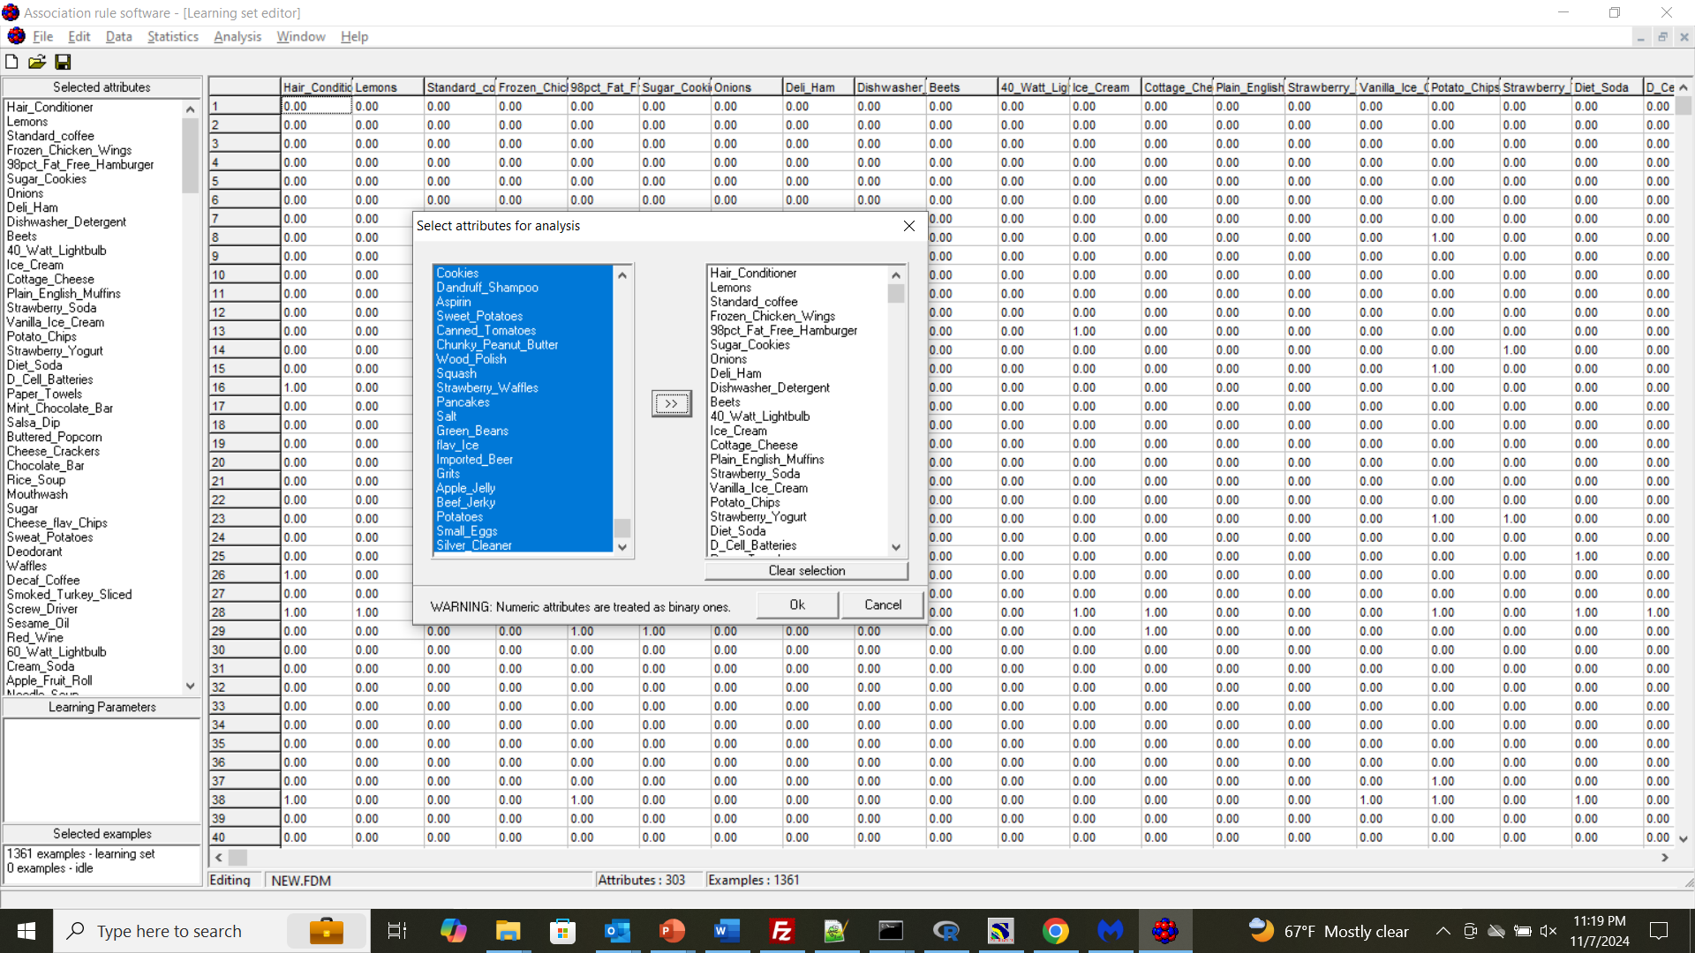
Select all on left (click on first, hold shift button, scroll down and select last)
Click on arrow
Then OK

Slide 14
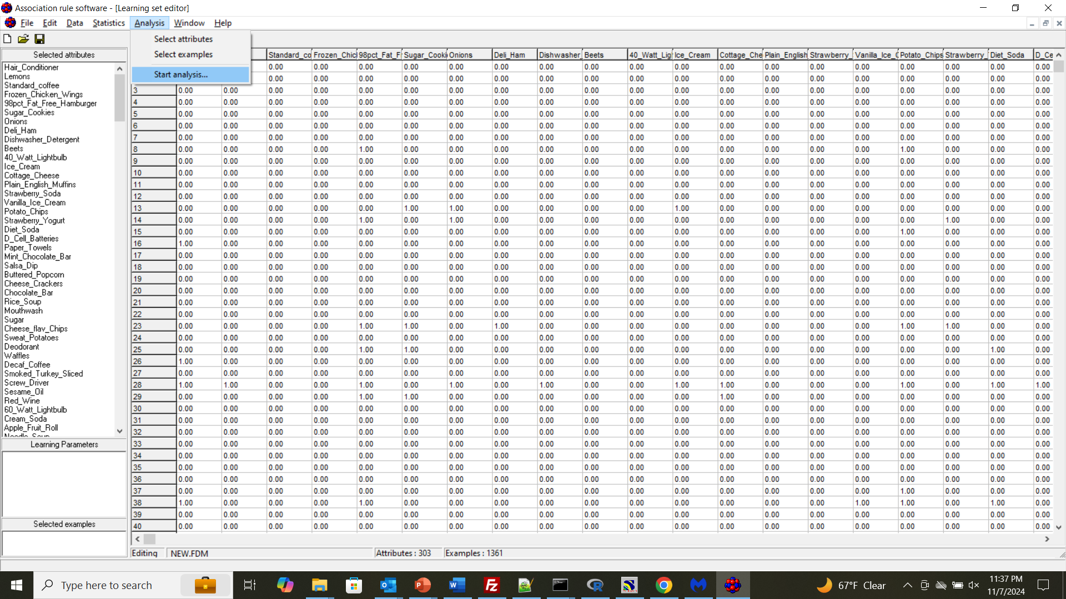

Slide 15
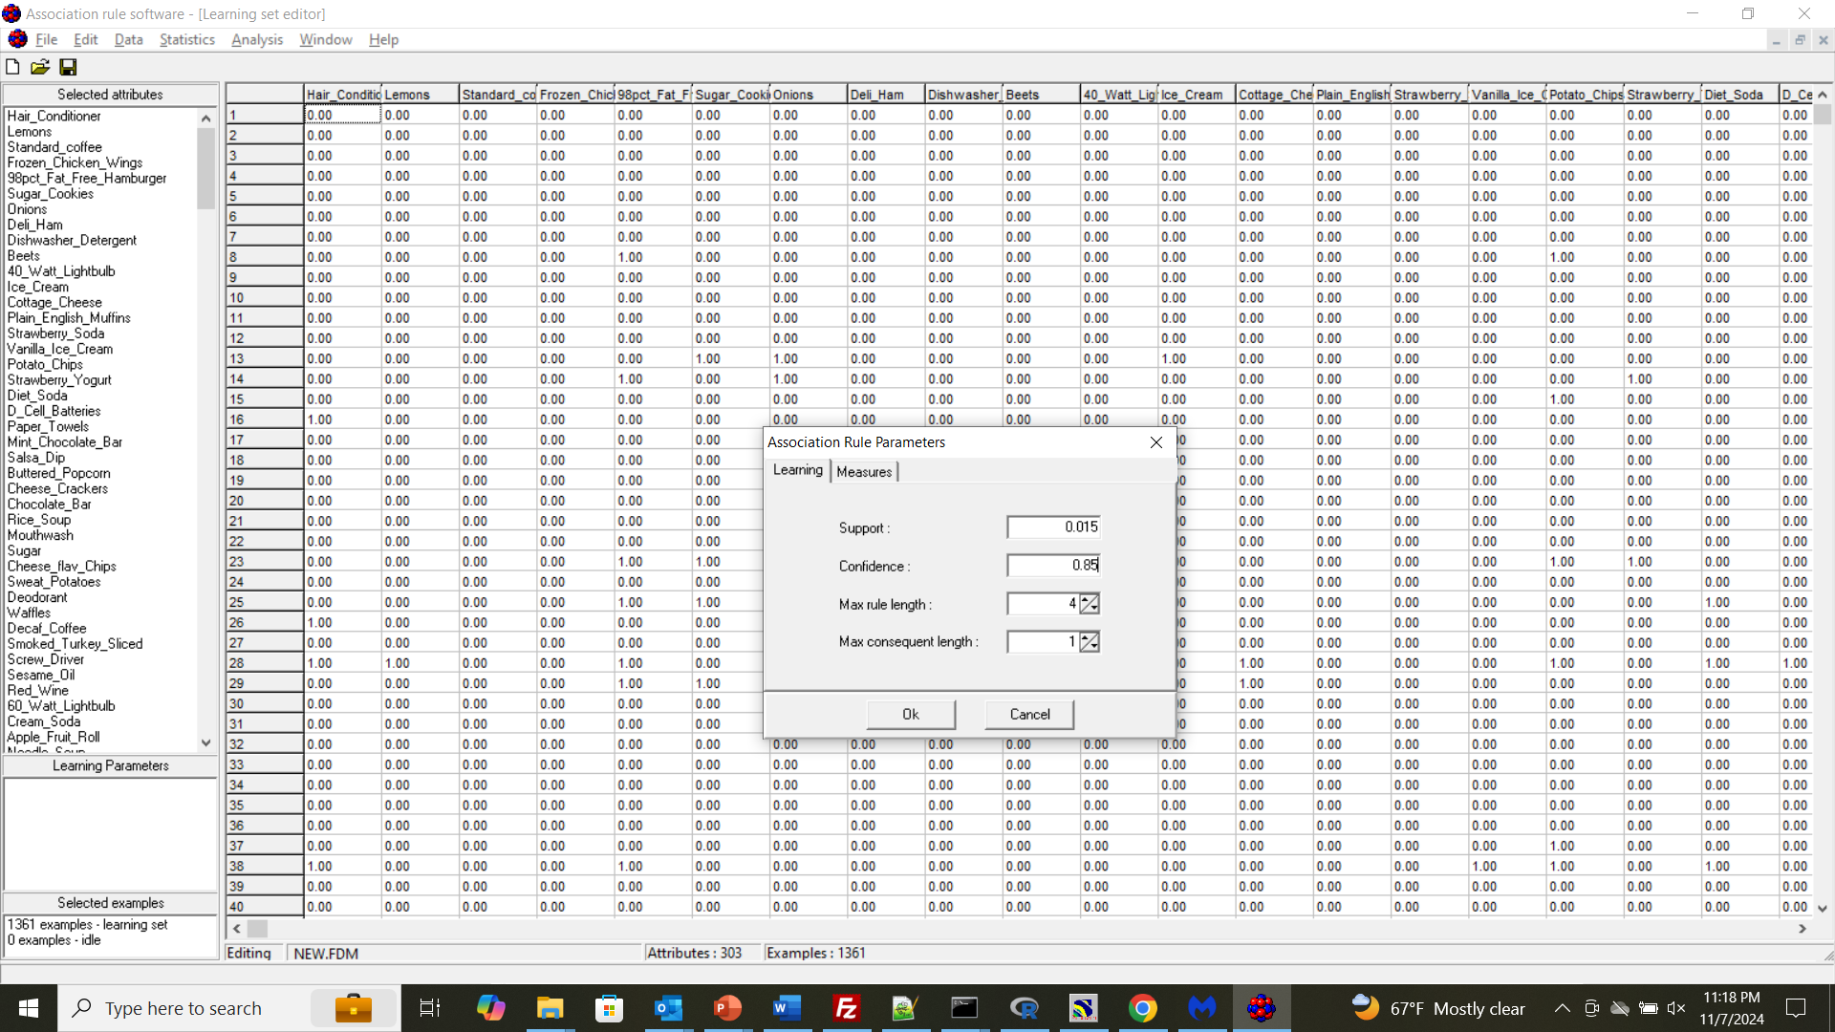

Slide 16
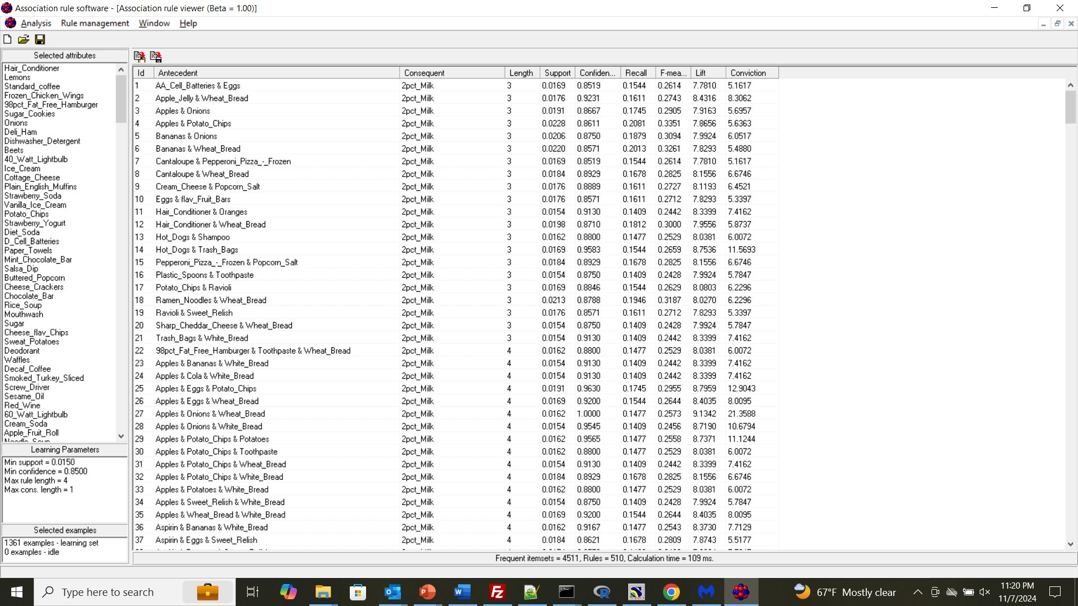

Slide 17
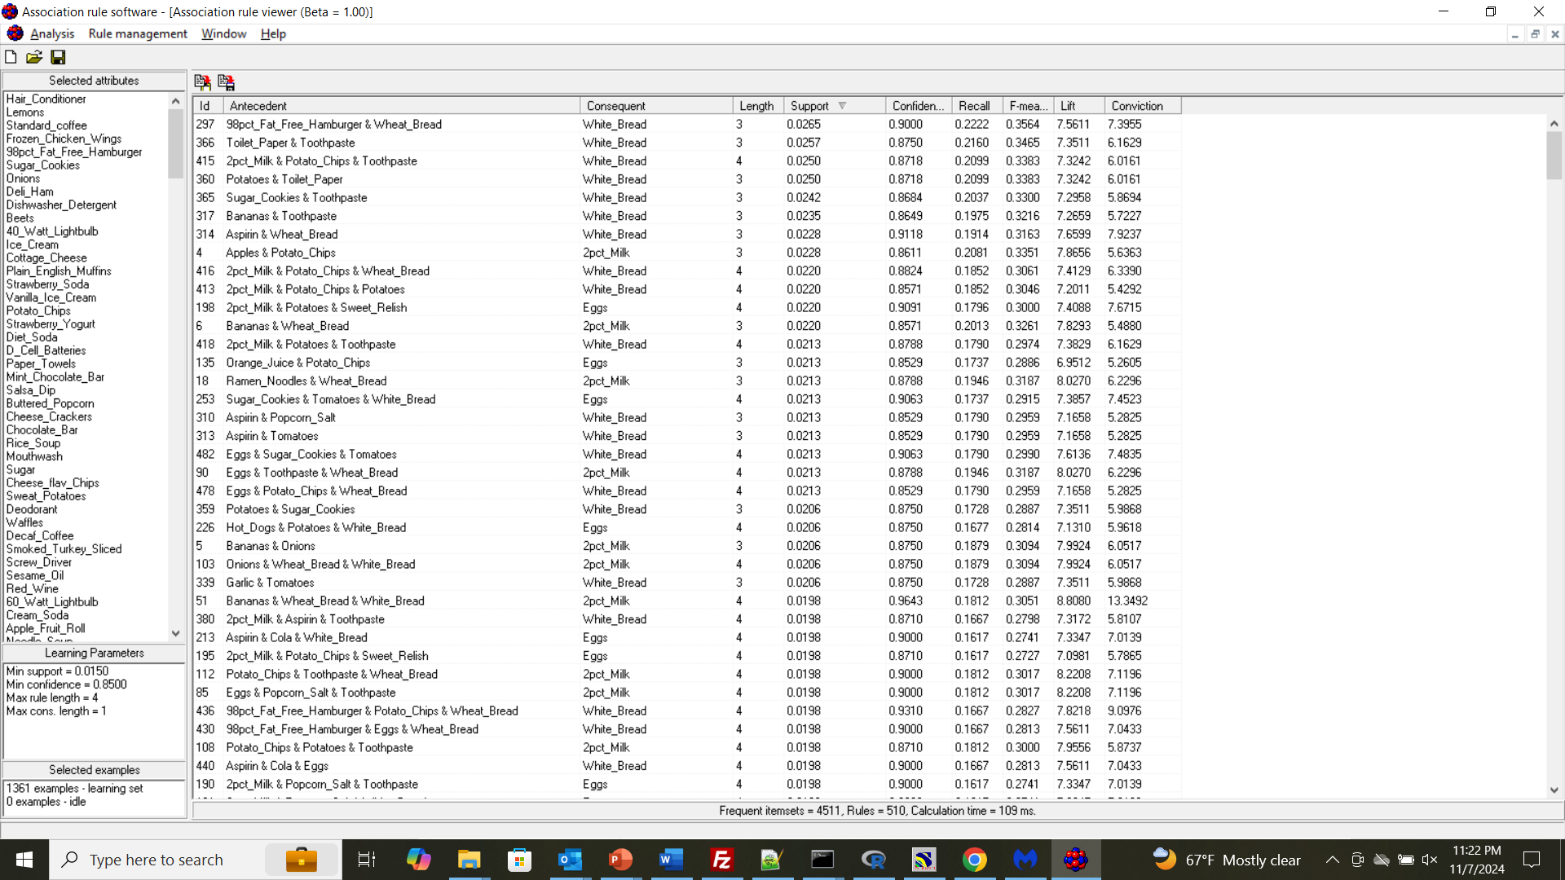
Click to sort by descending Support

Slide 18
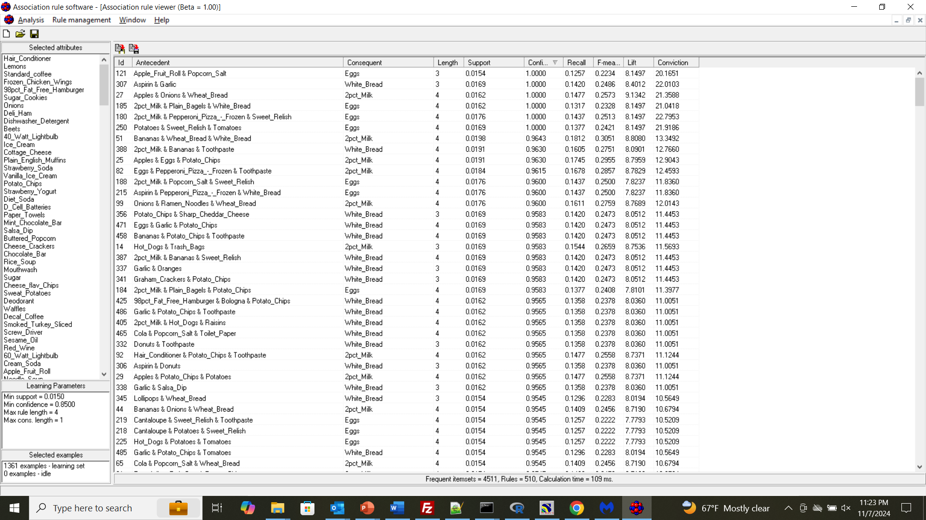
Click to sort by descending Confidence
Can do same for other measures

Slide 19
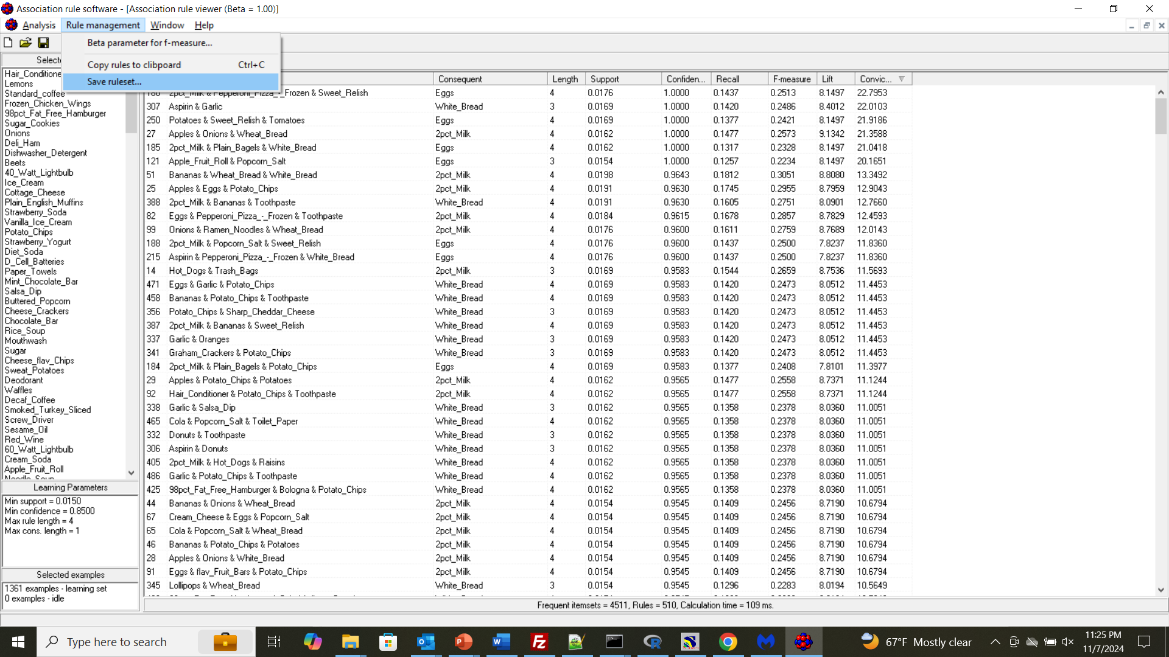
Can either save as text file or copy to clipboard for Excel

