Slide 1
Download/run Sipina
20231110

Slide 2
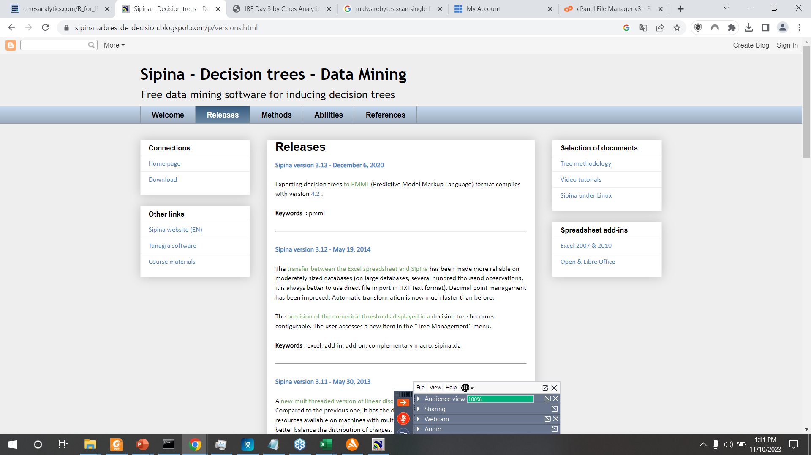
https://sipina-arbres-de-decision.blogspot.com/p/versions.html

Slide 3
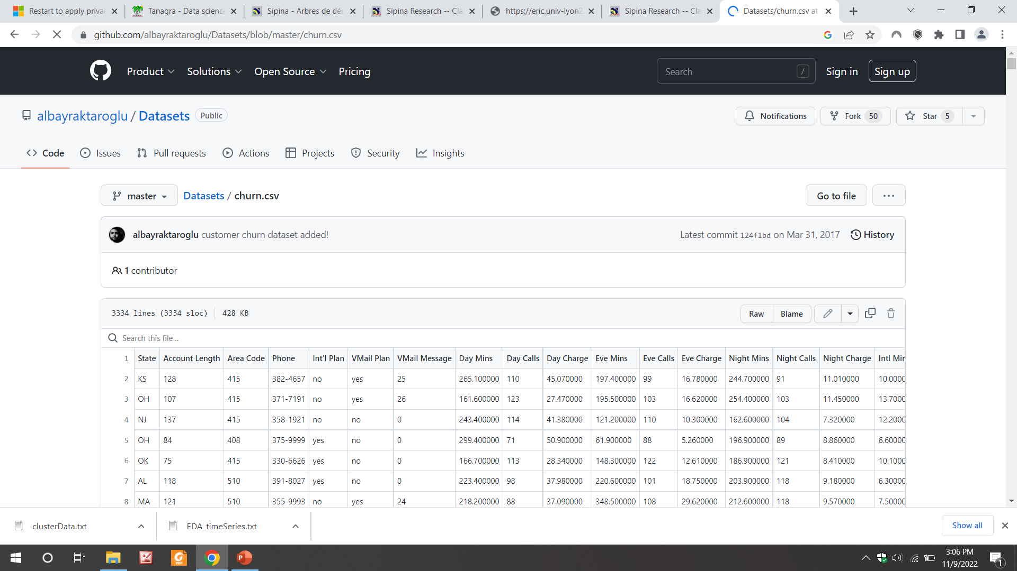
https://raw.githubusercontent.com/albayraktaroglu/Datasets/master/churn.csv OR

Slide 4
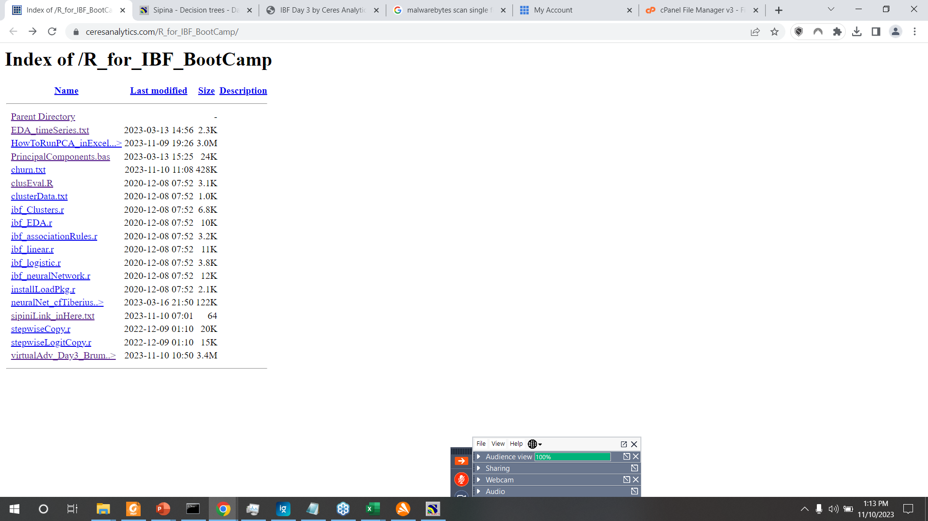
Right click, save as…

Slide 5
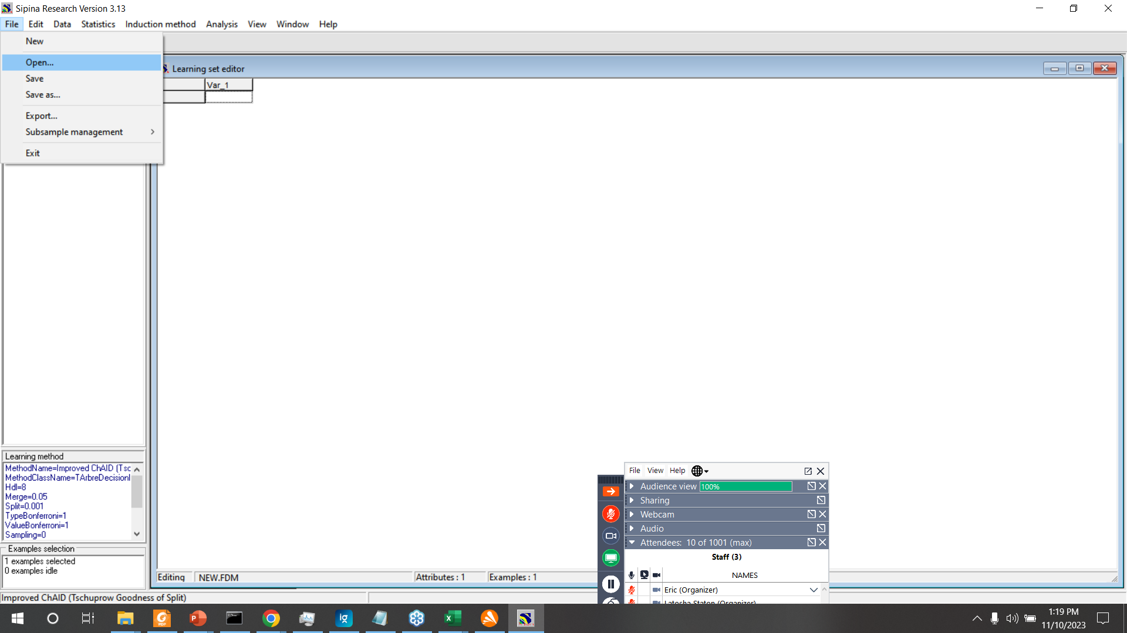

Slide 6
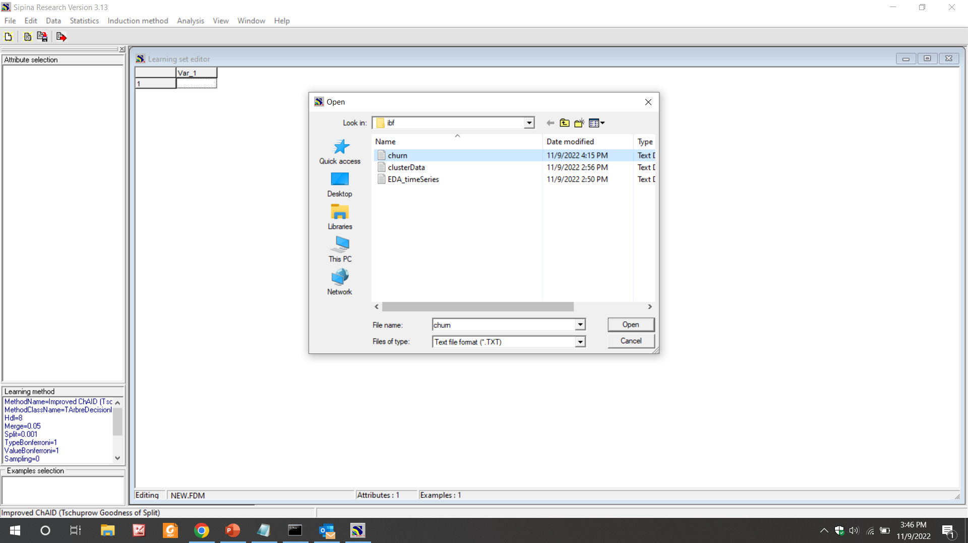

Slide 7
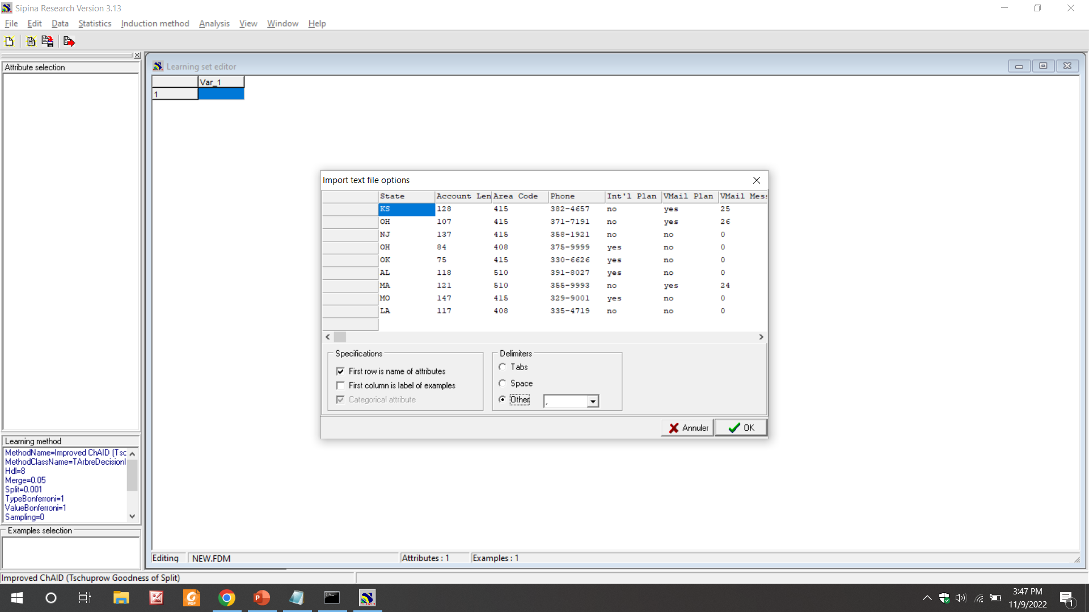

Slide 8
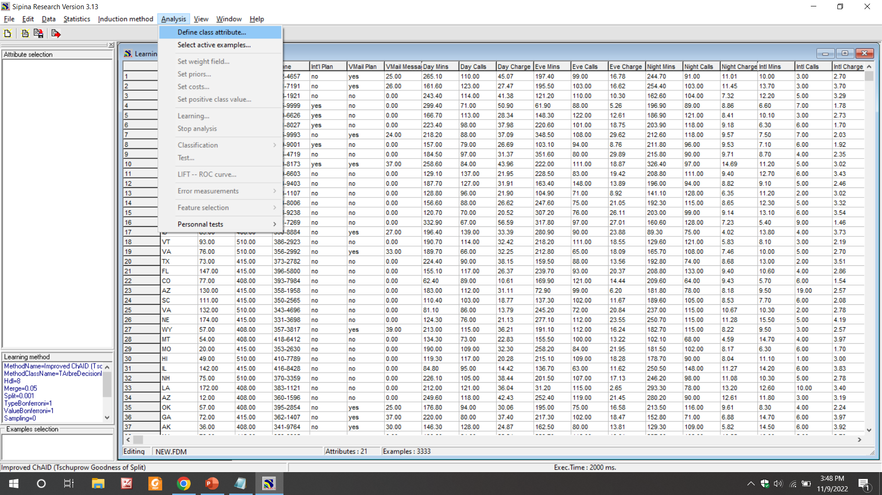

Slide 9
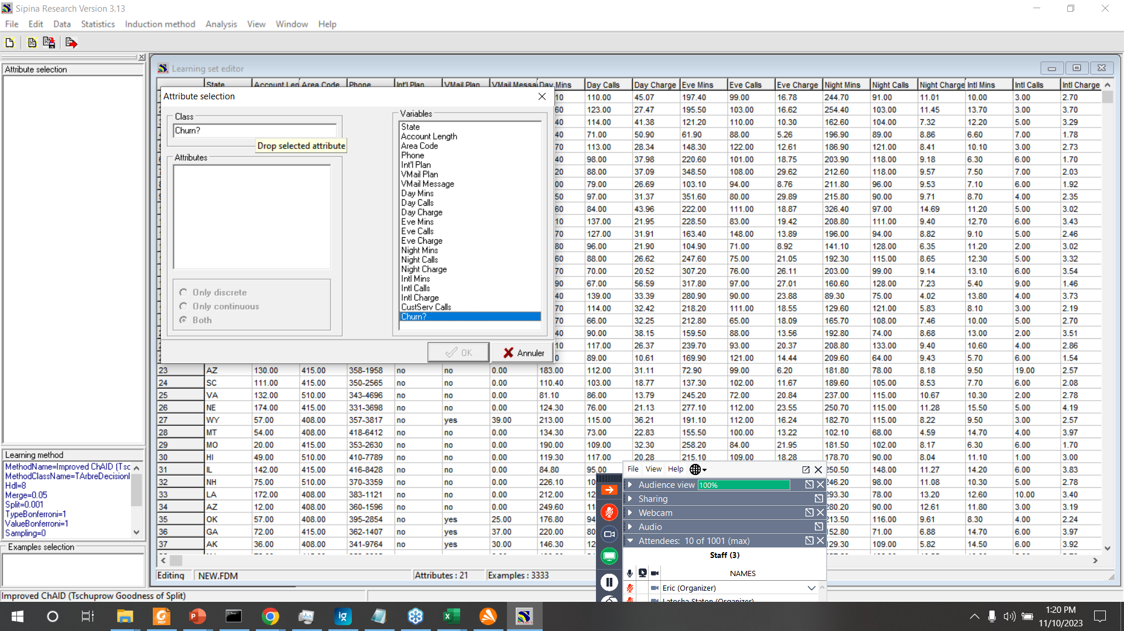

Slide 10
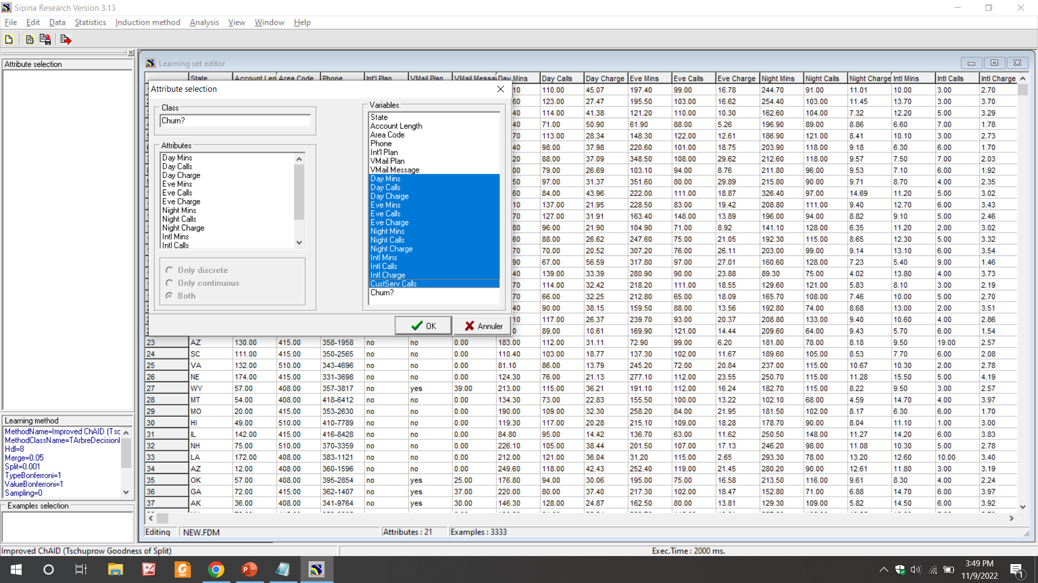

Slide 11
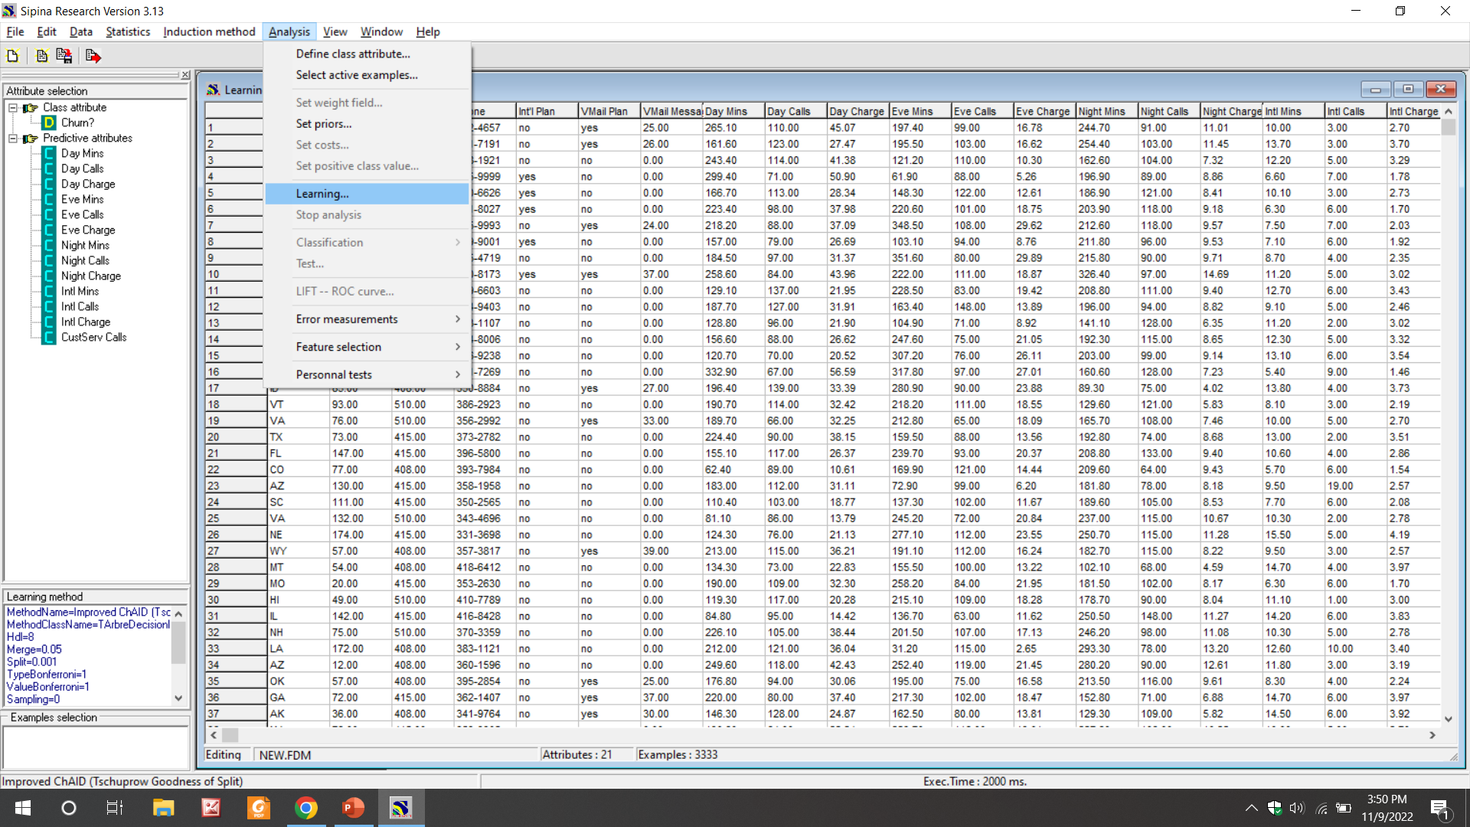

Slide 12
