Slide 1
How to Run PCA in Excel
Brumbaugh 20250602

Slide 2
1. Dowload and open the data file
From https://ceresanalytics.com/R_for_IBF_NextLevel/

Slide 3
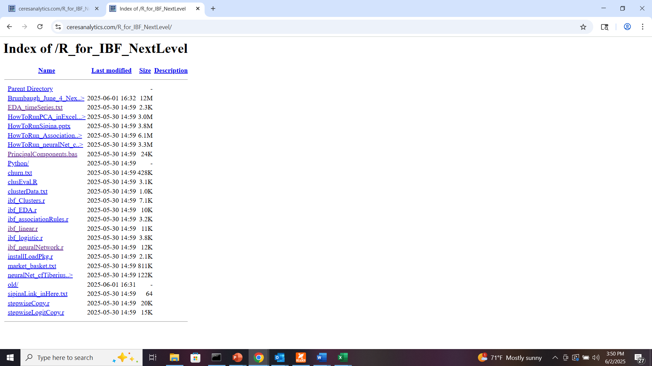
Go to
https://ceresanalytics.com/R_for_IBF_NextLevel/
Right click on “EDA_timeSeries.txt” and “Save as…” (in your preferred location)

Slide 4
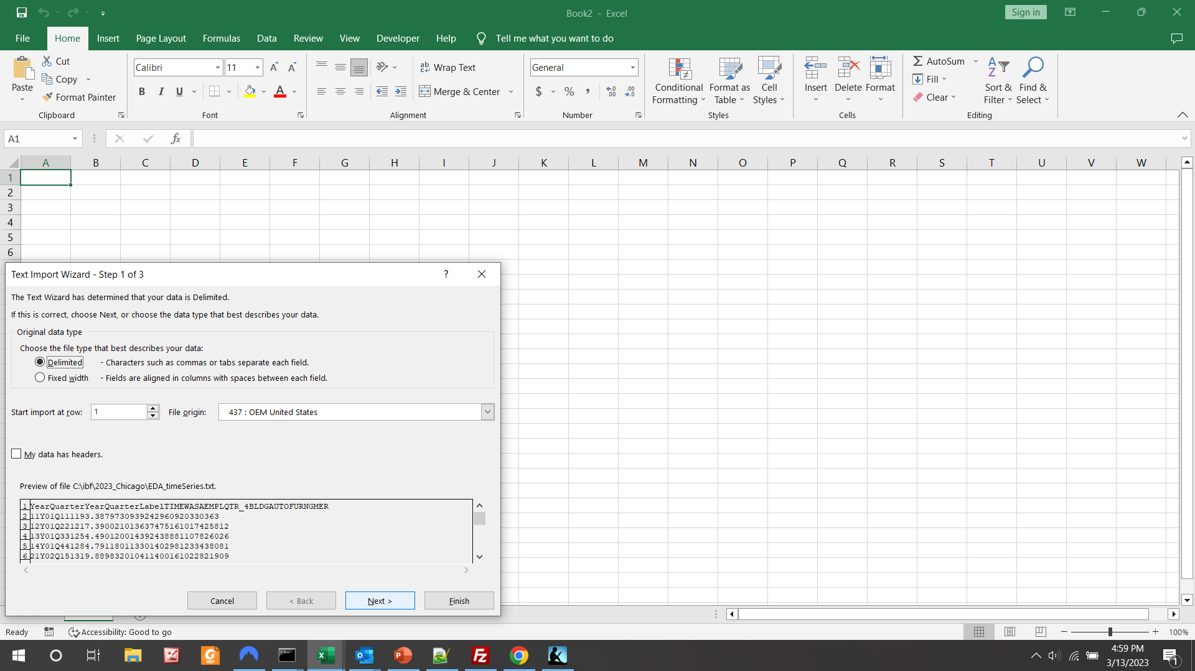
Open your saved file (File/Open) as Delimited…

Slide 5
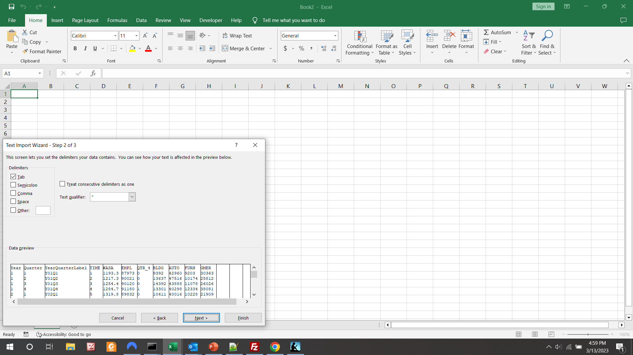
… by Tab

Slide 6
Observe aligned data, and click “Finish”

Slide 7
2. Show “Developer” Tab
And open VBA editor

Slide 8
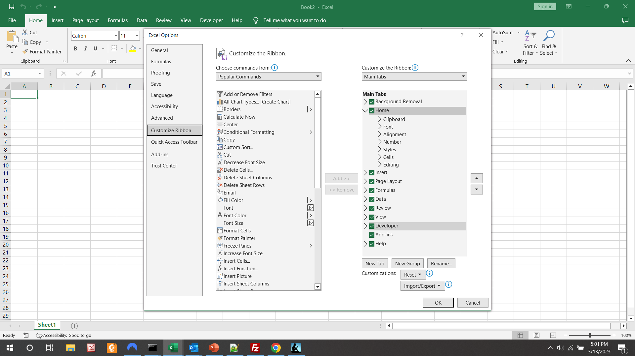
File/Options/Customize Ribbon
Check “Developer”

Slide 9
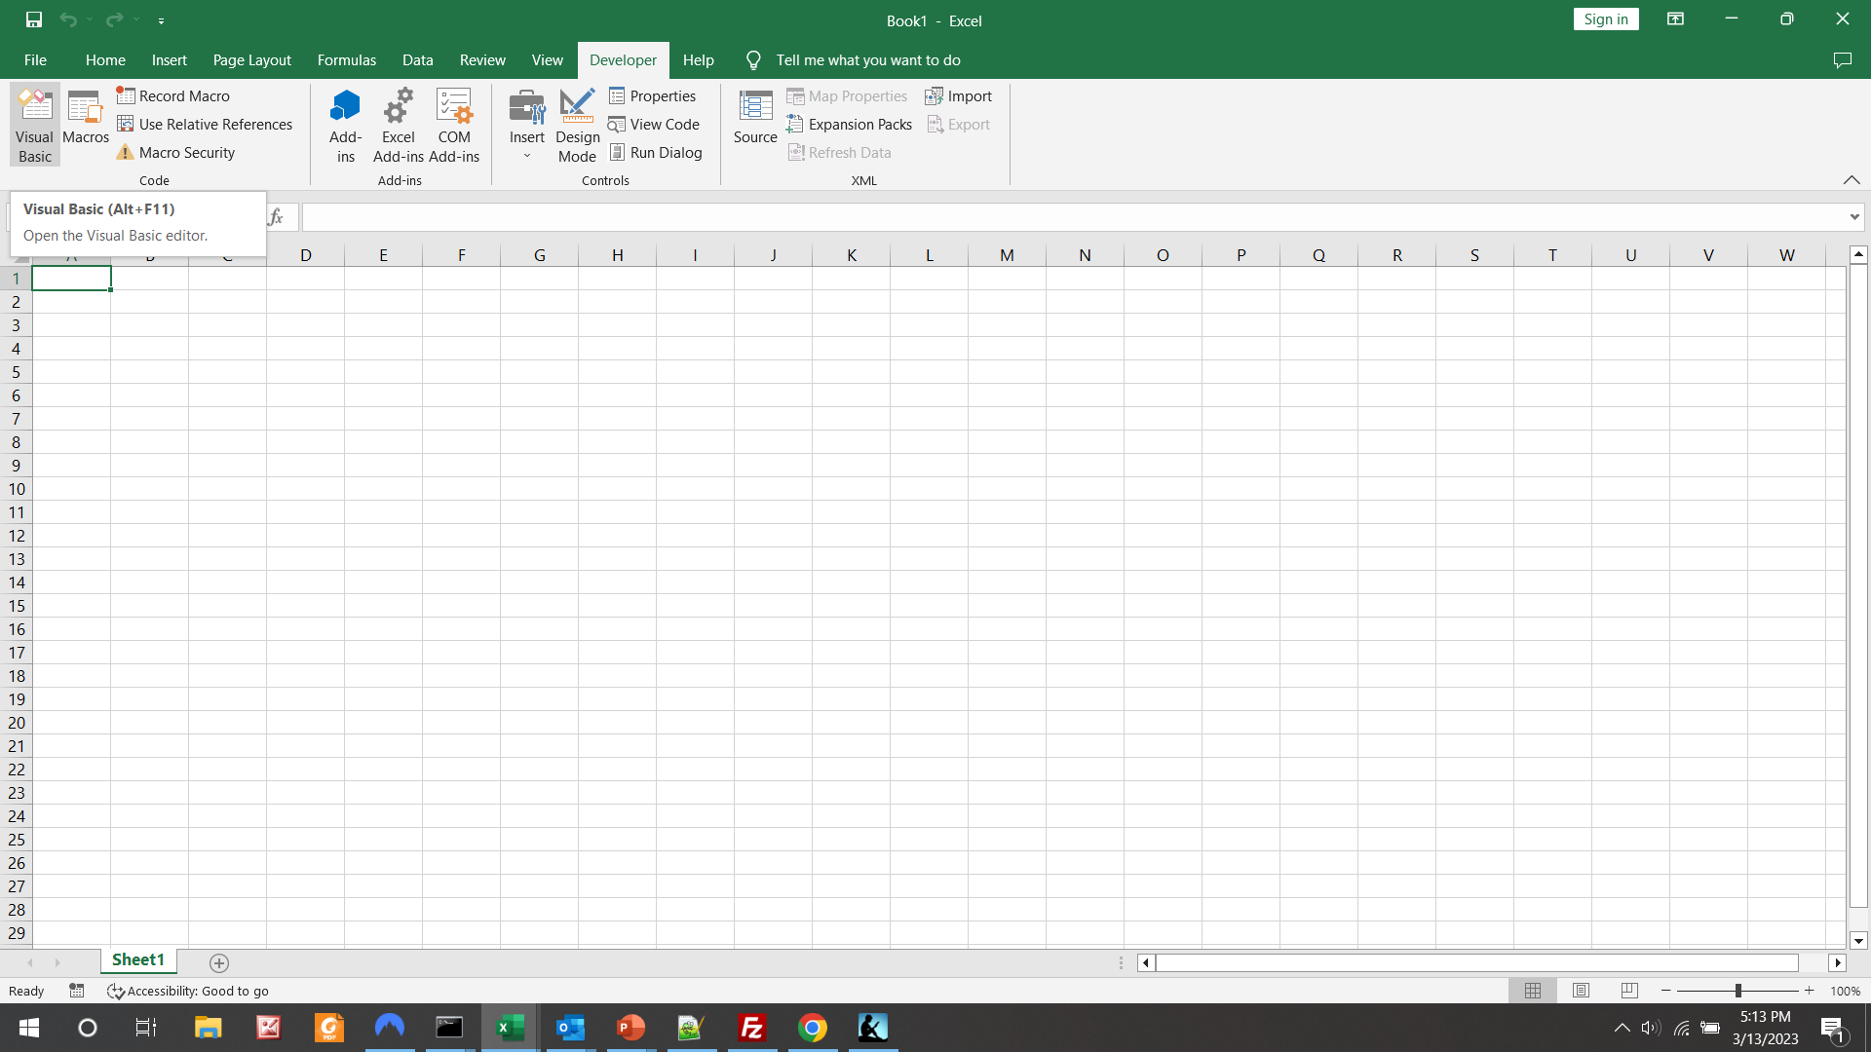

Slide 10
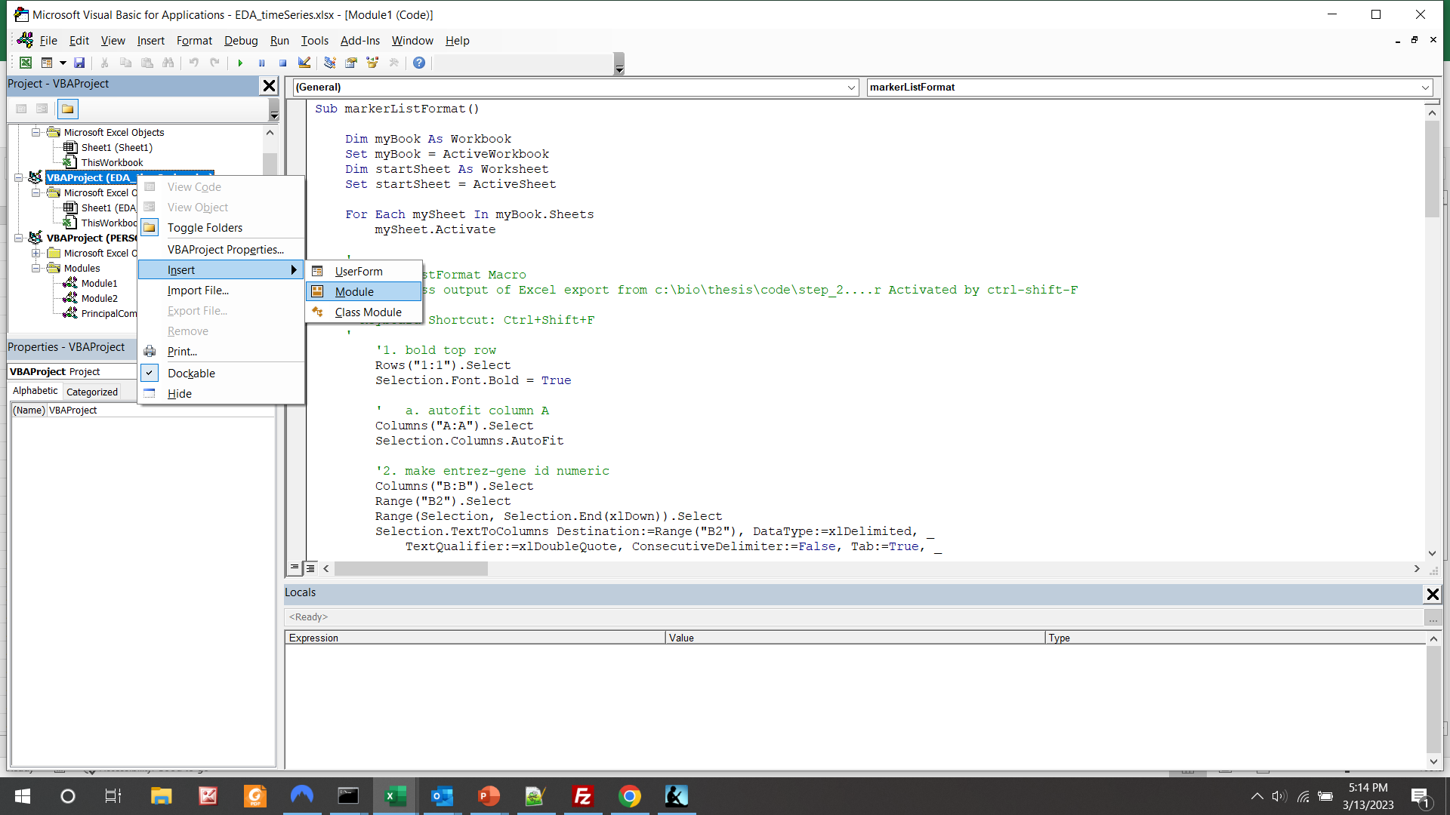
Find your workbook name and right-click to pop up the menu
Hover over “Insert” to pop up the next module
Then left-click“Module”

Slide 11
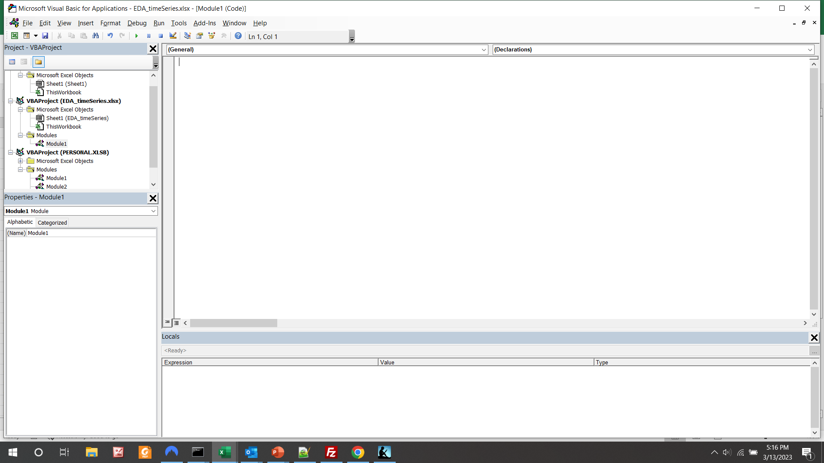
See blank “Module1”

Slide 12
3. Copy the PCA macro
From https://ceresanalytics.com/R_for_IBF_NextLevel/

Slide 13
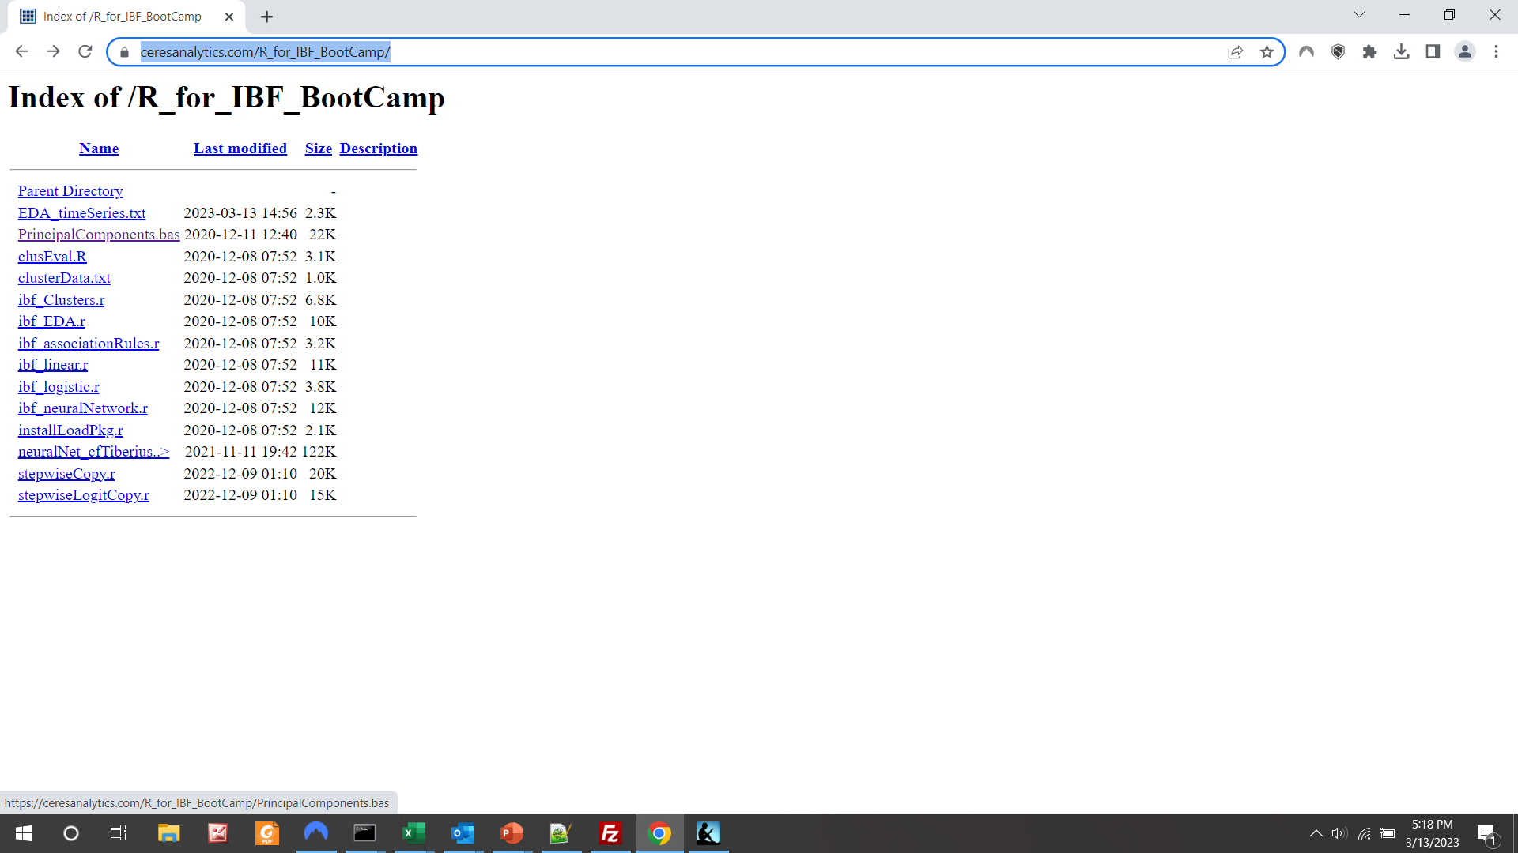
Click to open on web

Slide 14
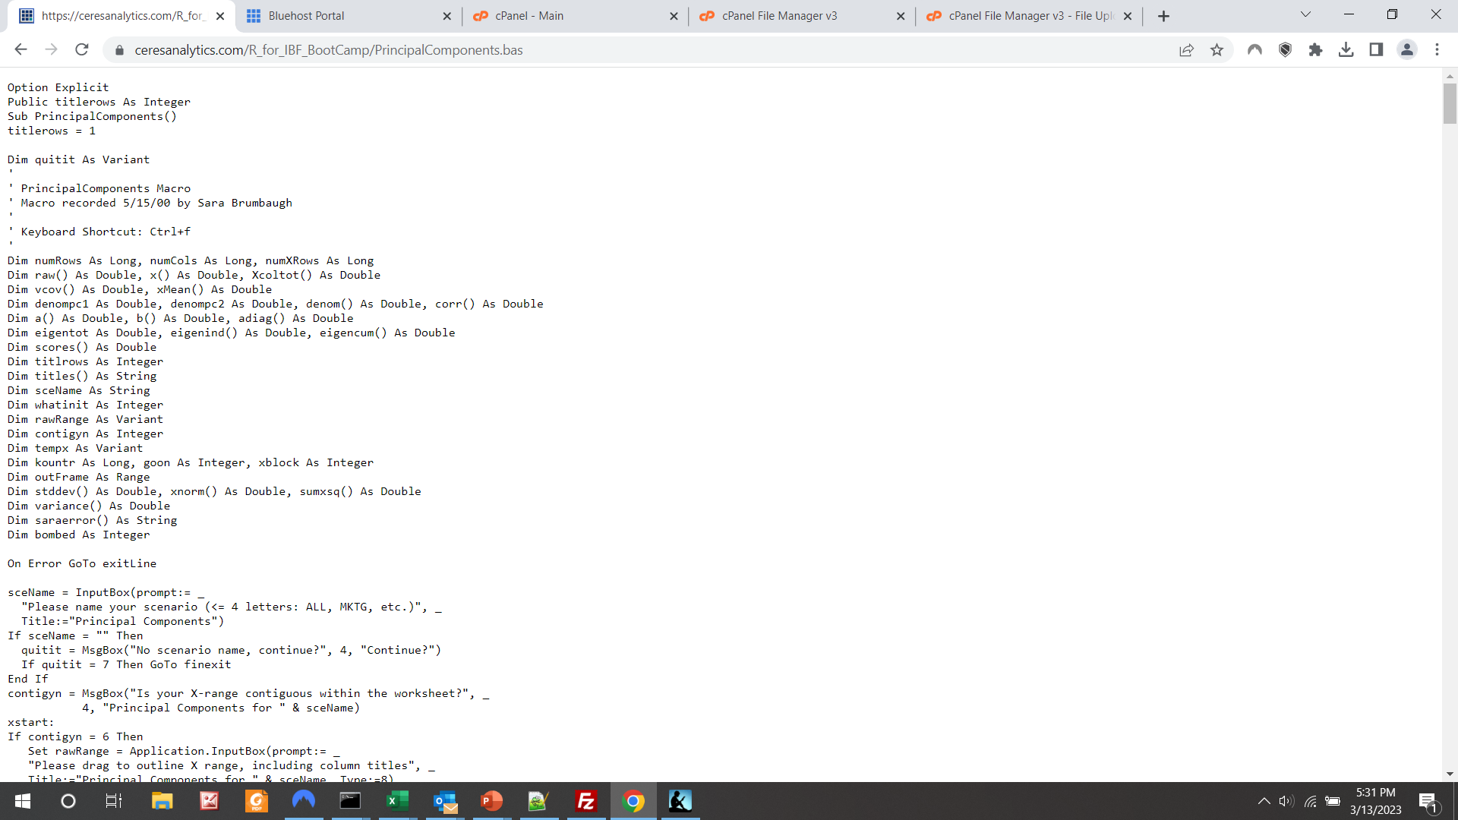
File will display
Ctrl A + Ctrl C to copy

Slide 15
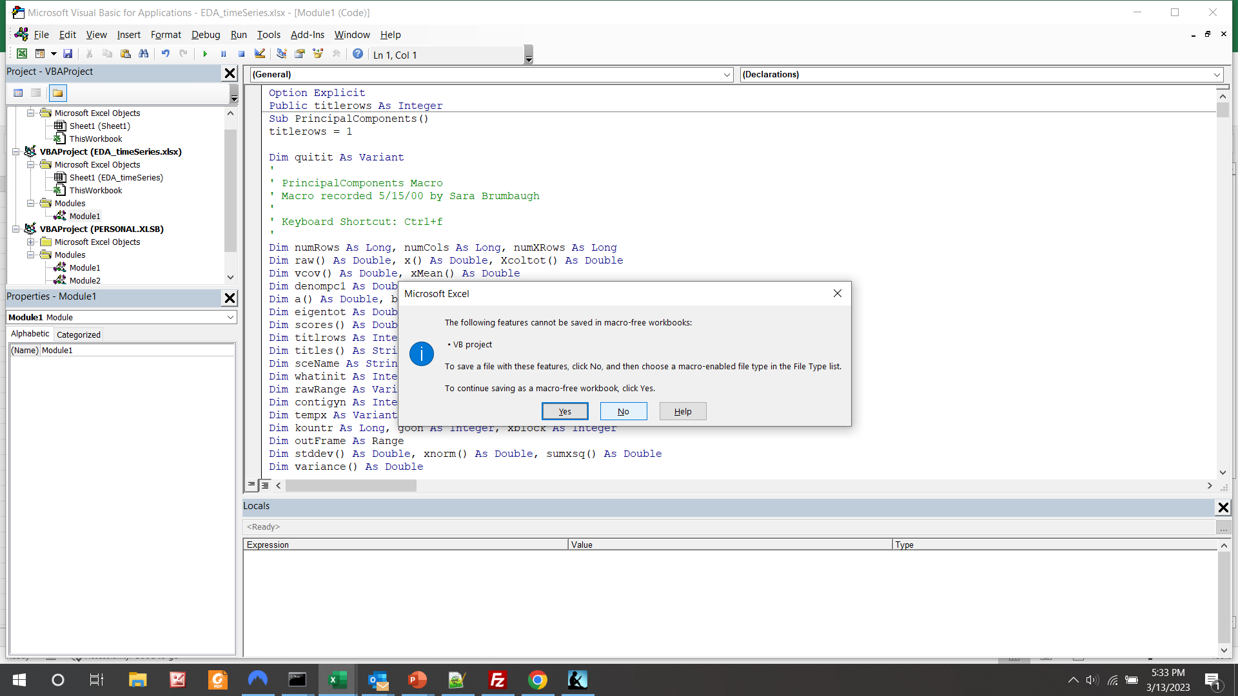
Ctrl V to paste
Ctrl S to save… choose “No” for macro-enabled workbook

Slide 16
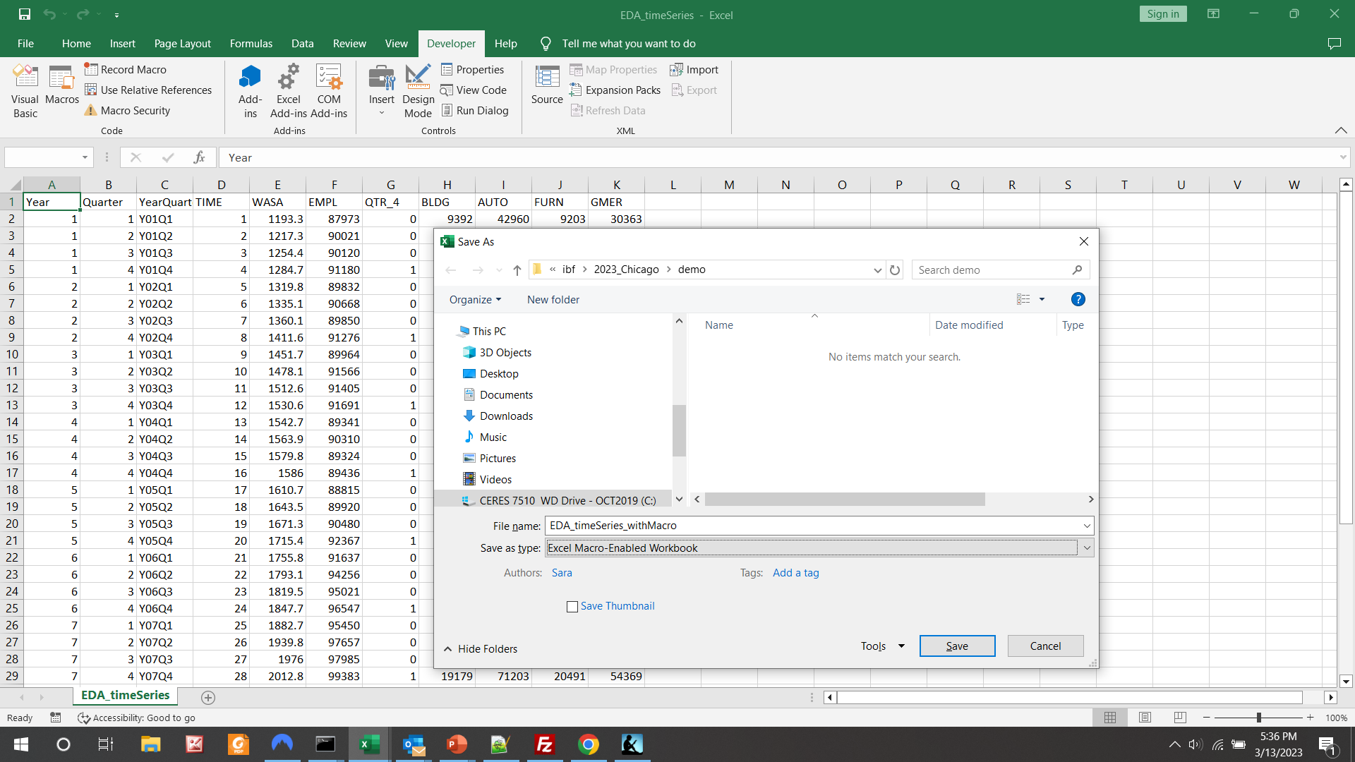
Enter your preferred name, choose type “Excel Macro-Enabled Workbook” and click “Save”

Slide 17
3. Run the macro

Slide 18
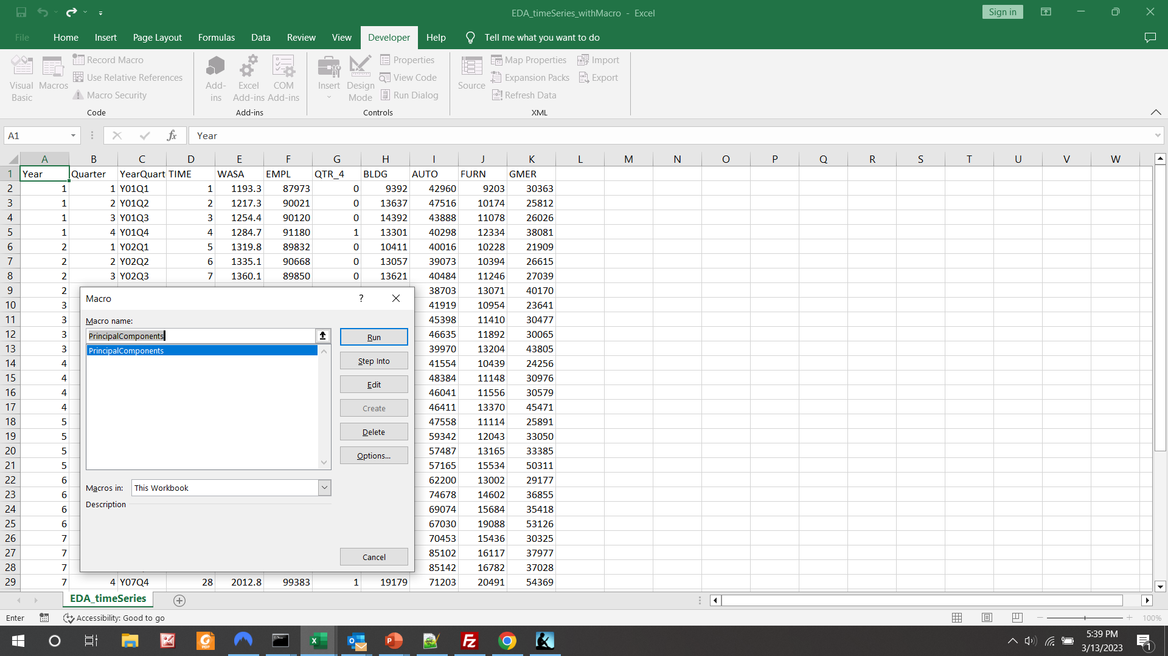

Slide 19
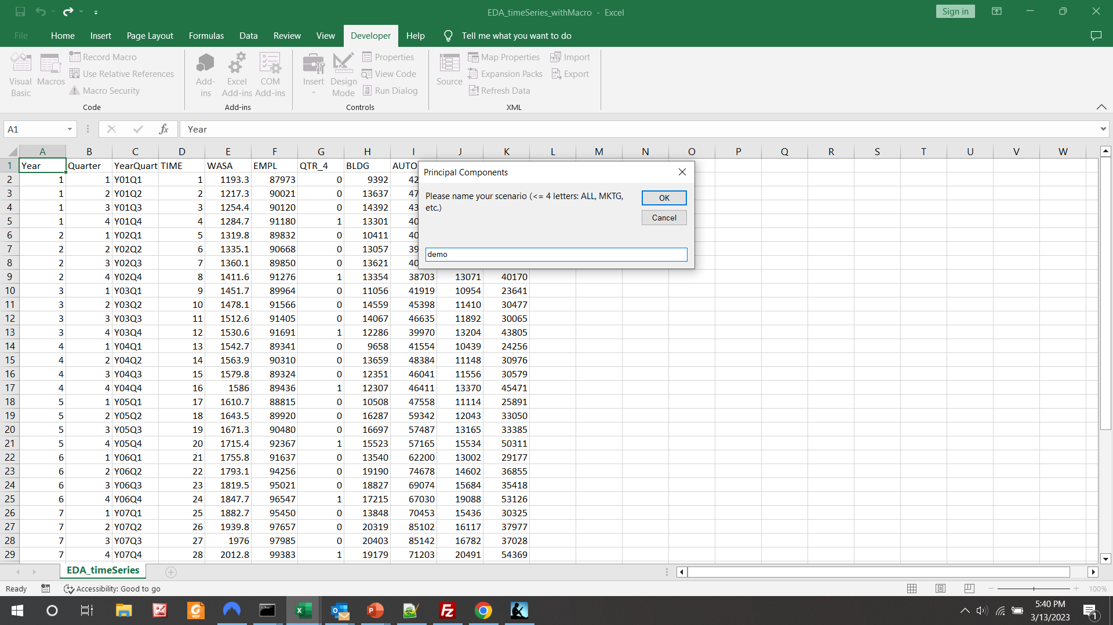

Slide 20
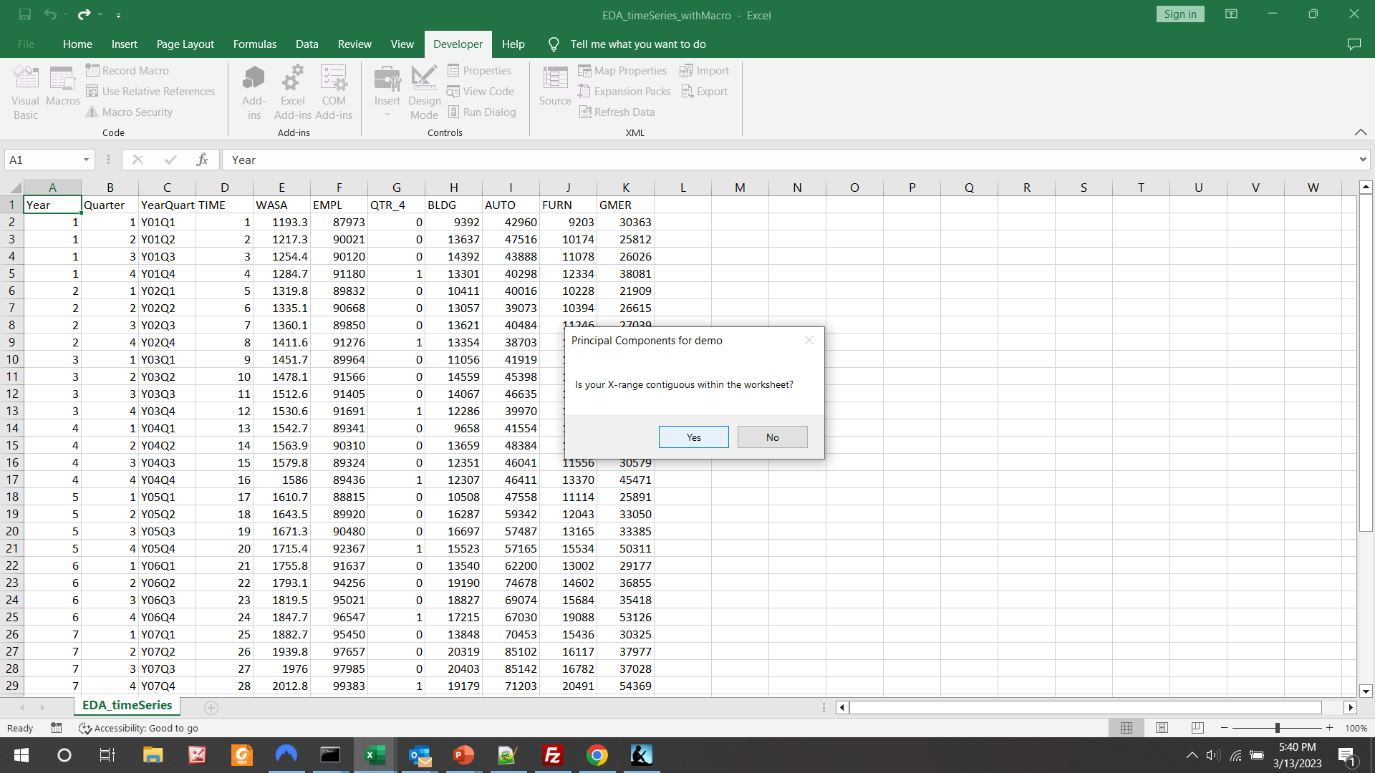

Slide 21
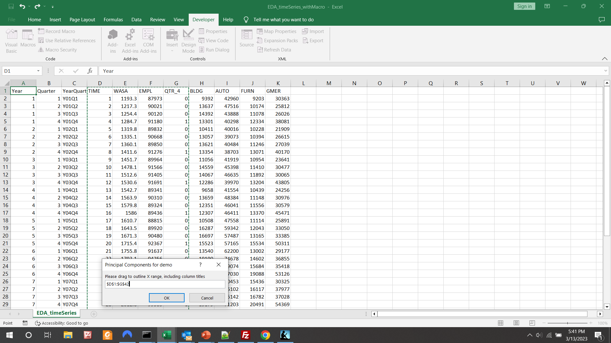

Slide 22
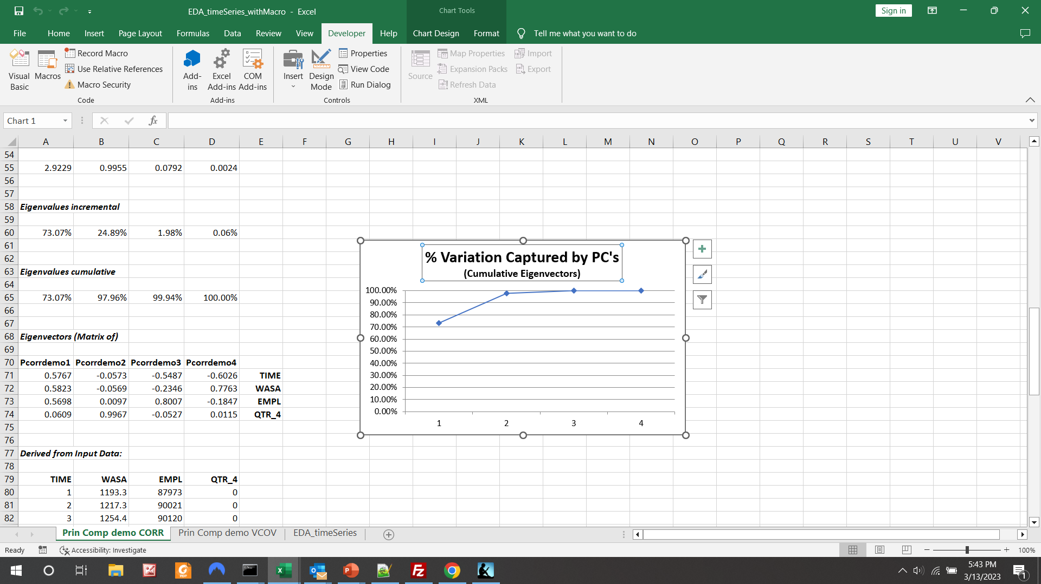

Slide 23
