Slide 1
Welcome
IBF Presents
Next-Level
Forecasting Analytics
Sara Brumbaugh
sara@ceresAnalytics.com
617-519-3151

Slide 2
overall
Agenda
1.A
The Quantitative Skill Set
Section 1
1.B
Databases, Data Extraction & Data Assembly
Section 2
2
Descriptive Techniques
Section 3
3
Predictive Techniques
(including Association Rules)
Section 4
4
Bonus: Scripting (time permitting)

Slide 3
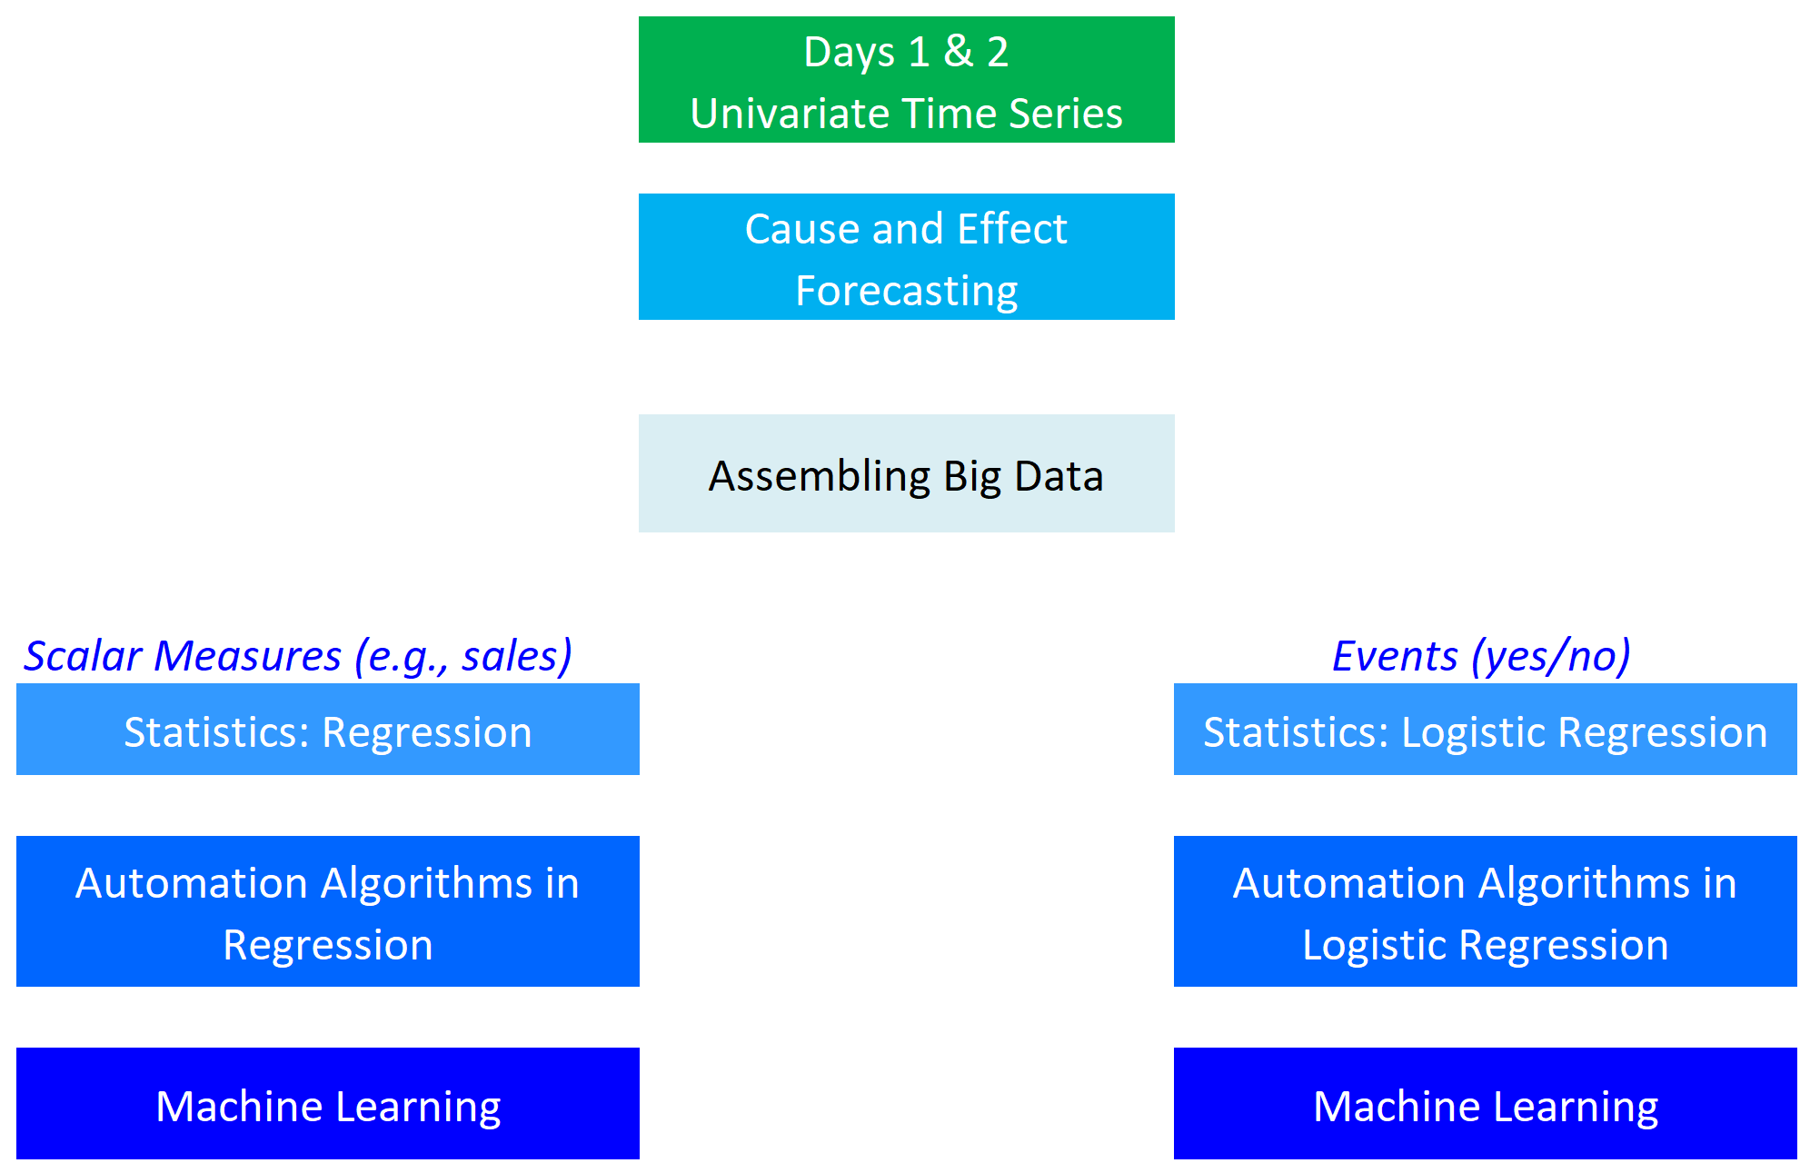
Univariate Time Series
Cause & Effect Forecasting
Anatomy
of
today’s
topics
Market/Product Segmentation
Association Rules

Slide 4
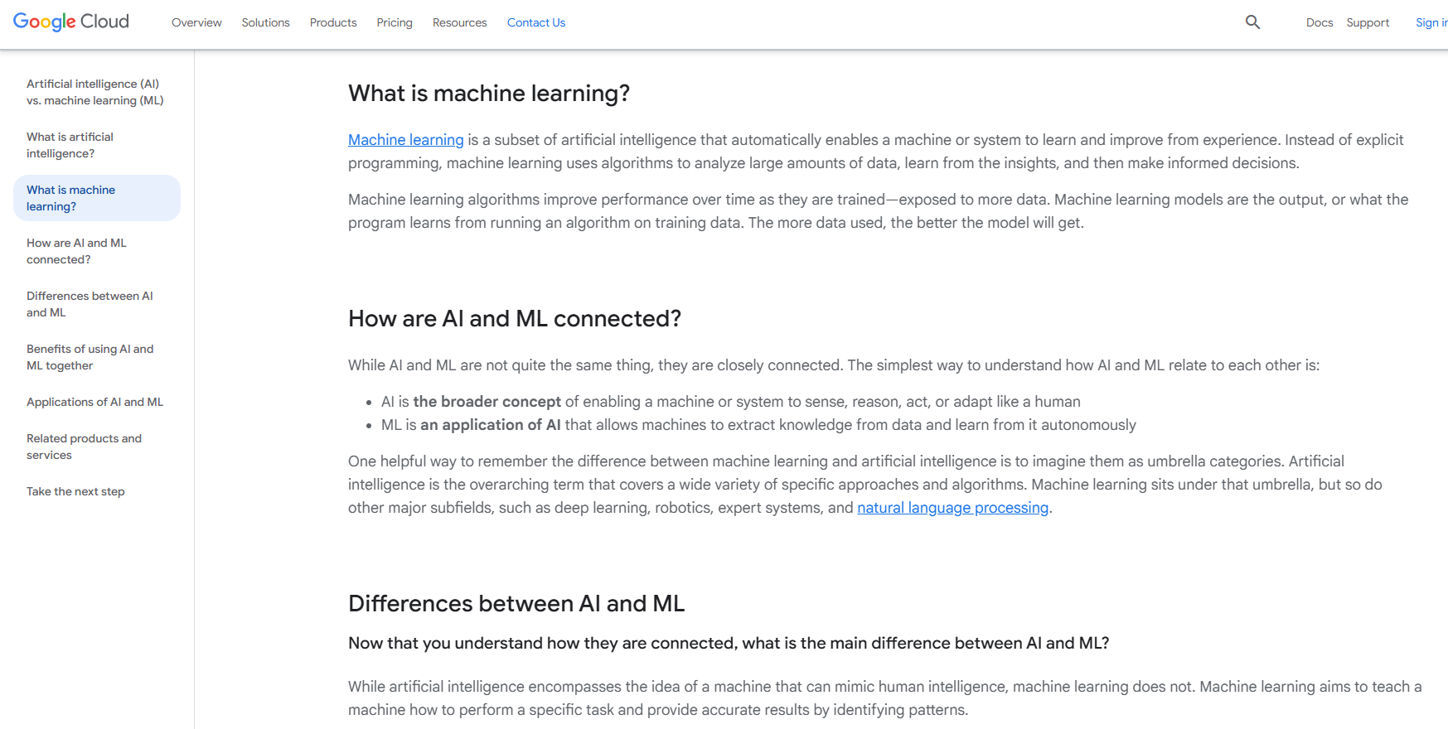
Background
Is Machine Learning AI?
https://cloud.google.com/learn/artificial-intelligence-vs-machine-learning#what-is-machine-learning

Slide 5
The Quantitative Skill Set
An Overview
1.A
Notes:
Why the forecasting job is the best in every company
Hands on data that drive the company
Interdepartmental working relationships
“Improving forecast” excuse to learn whatever you want

Slide 6


Forecasting the best job in an organization
  Opportunities for skills
  Data access
  Working relationships
  Answerable questions

Slide 7


Statistics vs. Machine Learning

Slide 8
Quantitative Analysis
Examples from Statistics
Quantitative Analysis
Descriptive
Predictive
Univariate
Multivariate
Univariate
Multivariate
Exploratory Data Analysis
Comparison
of means, medians or proportions
Coincidence
of categories
Distributions, Scalar
Mean, Standard Deviation
Distributions, Events (Yes/No)
Counts, Proportions or %
Linear Regression
Logistic Regression
Linear Discriminant Analysis
Cluster Analysis
Factor Analysis
Principal Components
Independent Components
Time Series Analysis
BTW: Machine Learning
Neural Networks
Decision Trees
Notes:
Domain=a specified sphere of activity or knowledge.
Don’t be intimidated by notion of machine learning…

Slide 9
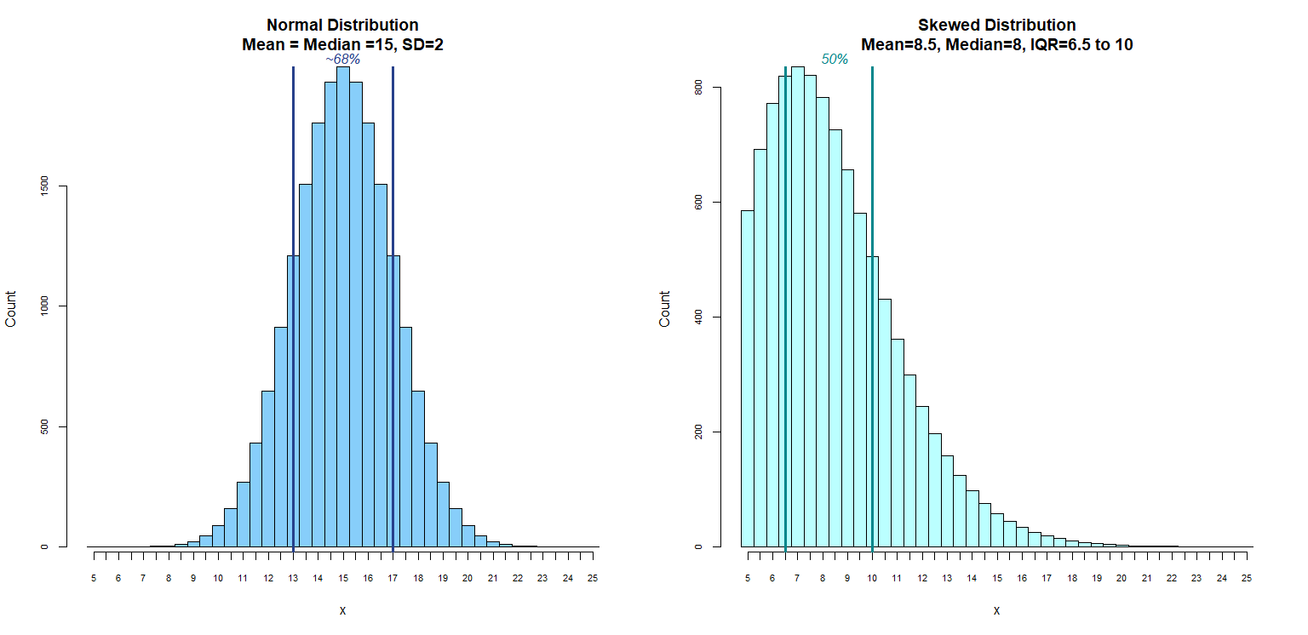
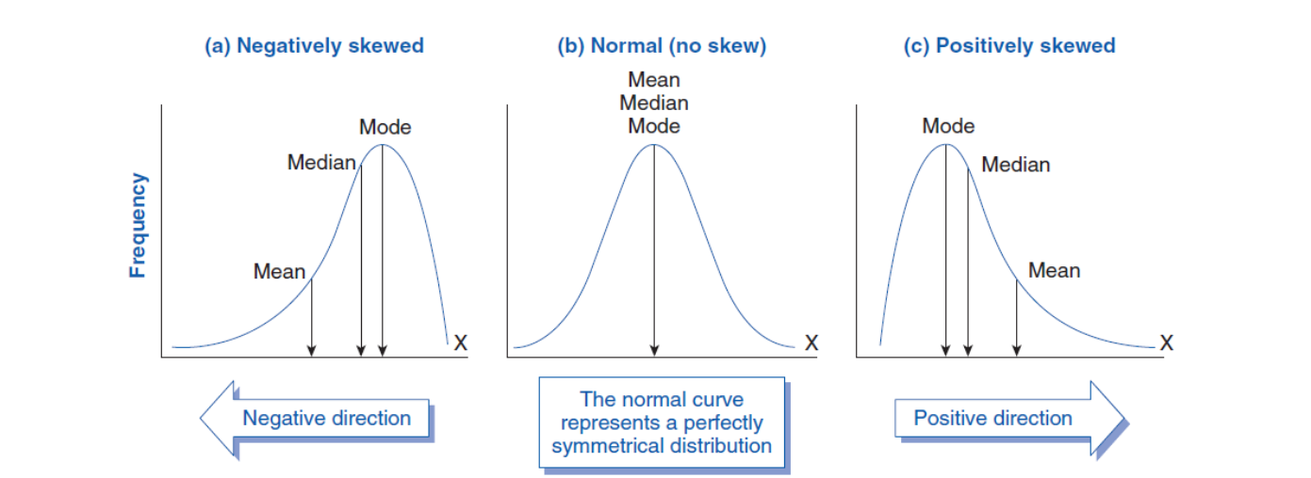
Distributions
Quantitative Analysis
Background: 1 of 3
https://www.biologyforlife.com/skew.html
Univariate, Scalar or Continuous Variable
Errata: distributed copy was slightly off in boundaries for +/-σ and IQR
Notes:
1. A frequency distribution will rank all the values from low to high, then lump them into bins and show how many fall in into each bin
2. At left is a normal distribution—say this is profit margin per unit for each and all of the products we sell
--the reason we might be looking at this is to learn whether we should manage our forecasting resources to focus on our company’s “big earners”
a. the horizontal axis indicate the approximate $ margin associated with each bin
b. the vertical axis labels show how many products fall into that bin
c. the highest bin in the middle represents the mode, which corresponds to a margin of about $15
--in fact, the bins here are 50 cents wide: if you look closely, you’ll see that the $15 bin runs from $14.75 to $15.25
d. the important thing about the normal distribution is that this “most popular” mode is the same as the mean, or average, which is also the same as the median
--the median is what we’d find if we took all of our rank-ordered values, which are counted in these bins, and count inwards from both the high and the low until we find the one value that is smack in the middle
e. while the mean, median and mode are all measures of central tendency, the standard deviation is a measure of dispersion
--when data are normally distributed, you’ll find about 68% of values within one standard deviation, and 95% of values within two
f. This distribution is so tightly packed that the 95% confidence interval (+/- 2 standard deviations) is unimpressive: it commences at only $19: only $4 off the average.
--ONE OF THE KEY THINGS WE WANT TO EMPHASIZE TODAY is that if a key concept makes sense (e.g., focus forecasting resources on big earners), and our analysis doesn’t support the conclusion, then re-frame the analysis! (e.g., look at the distribution of TOTAL margins: product margin x unit sales. See if THAT doesn’t change your mind!
--IN MANY COMPANIES, THERE’S A GAP between the people who formulate strategy and the data scientists who can and should guide that strategy. What we’re doing today is helping you to be the person who fills that gap
3. At right is a skewed distribution—it’s not symmetric like the normal one
a. this distribution is said to be “positively skewed” because there are extreme values out on the right tail
b. the most reliable measure of central tendency for a skewed distribution is the median, which--in a positively skewed distribution—will tend to be less than the mean
c. after all, the mean of a positively skewed distribution is biased high by all those extreme values out in the right tail
d. to describe dispersion in a skewed distribution, an accepted measure is the “interquartile range”, which is essentially the 25th and 75th percentiles—points within the rank-ordered values just like the median is the 50th percentile
4. More generally, here’s a “textbook” guide to distributions…

Slide 10
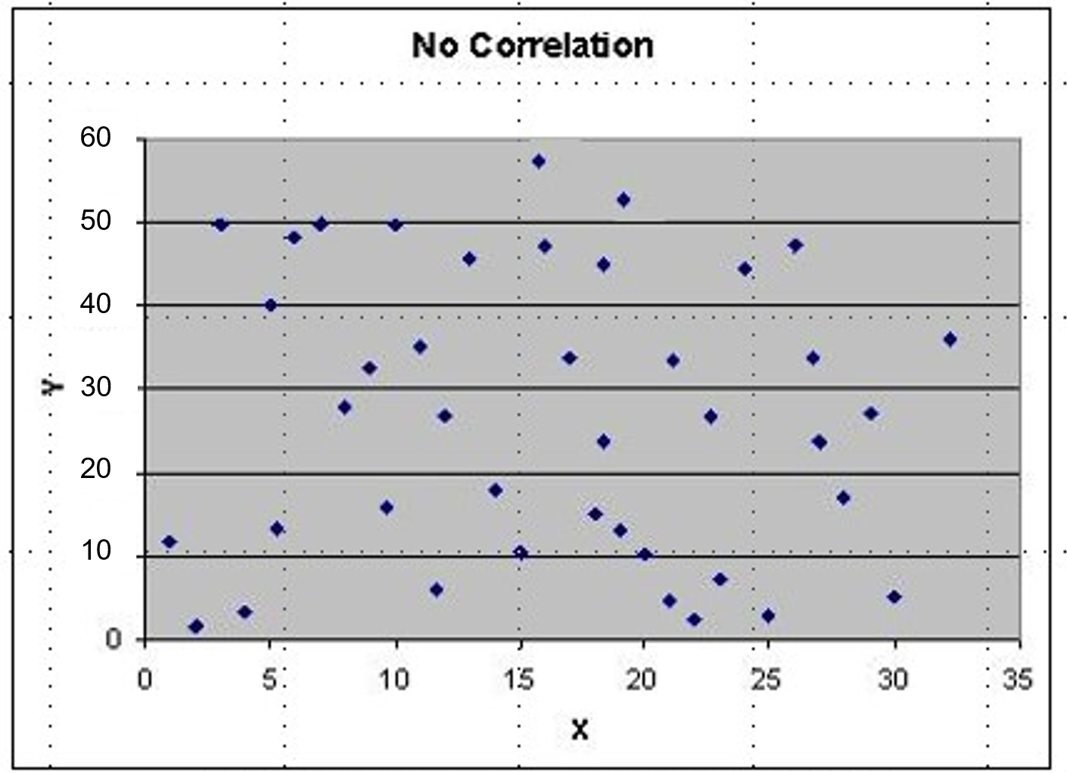
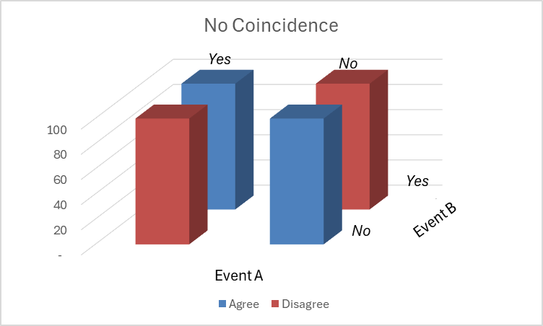
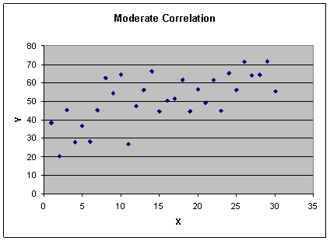
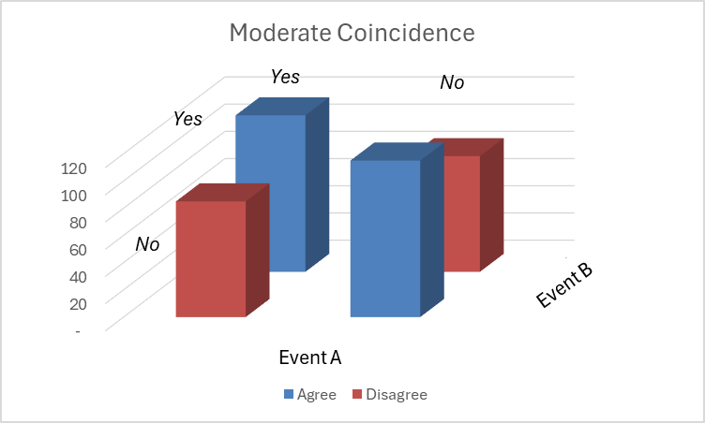
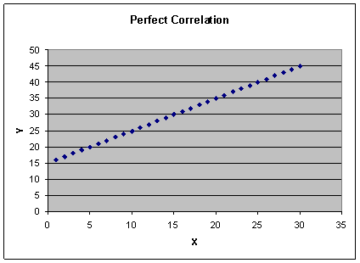
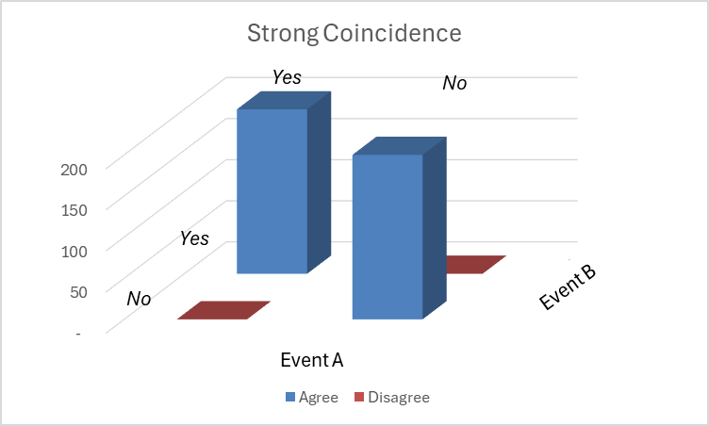
Correlation and Coincidence
Quantitative Analysis
Background: 2 of 3
Correlation
Coincidence
A: Purchase; B: Promo
Scalar or Continuous
Measure: r or “correlation coefficient”
Bivariate
Categorical
Measure: χ² or “Chi-square”
Errata: distributed Y axis labels for No Correlation
Notes:
1) No Correlation: No line will articulate the relationship between two variables
2) Moderate Correlation: They seem to drift together and suggest a line
3) Perfect Correlation:They line up perfectly
Coincidence: requires a bit more thought.
This example shows a 2 x 2 contingency table, in which
-- A is purchase of a good
--B is an underlying promotion
--So, say 200 customers received a promotion, and 200 did not
--And, for simplicity, say 200 customers purchased the promoted product, and 200 did not
NOW:
1)When there is no coincidence, the purchase does not depend on whether ithe good was promoted
a) In total, half of the customers bought the product
b) BUT, half of the PROMOTED customers bought the product JUST LIKE half of the UNPROMOTED customers bought the product… so what does that tell you about the promotion?
c) It was WORTHLESS!
2) When there is moderate coincidence, you can see that customers TENDED to buy the product if it was promoted, and tended NOT to buy the product if it was not promoted
a) note that, in total, 200 still bought and 200 did not, but the distribution WITHIN OUR 2 x 2 contingency table is STRONGER for the DIAGONAL ELEMENTS (with diagonal defined as top left to bottom right)
3) When there is strong—here, perfect, coincidence, you can see that everyone who was promoted bought, and everyone who was not promoted did not buy

Slide 11
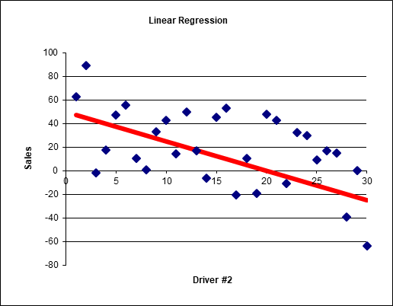
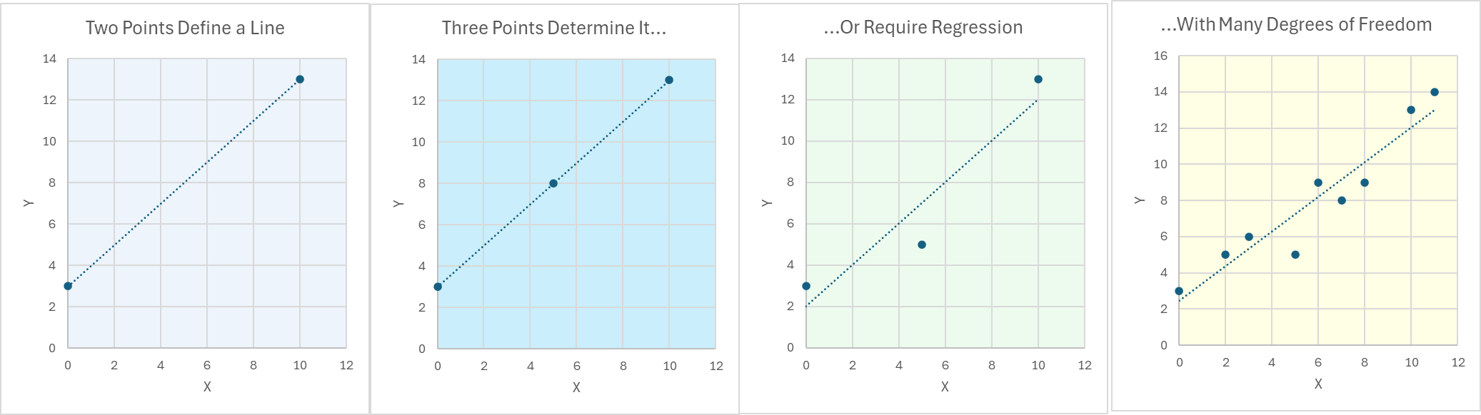
Regression Refresher
Quantitative Analysis
Background: 3 of 3
Simple Regression Analysis is a statistical technique to measure the relationship between what you would like to forecast (Y) and a measure that affects it (X)
b
e
ª {
You’ll forecast by the equation,
Y = a + bx
In this example,
Y = 8000 + 400X
Errata: distributed X coefficient 40, rather than 400
Notes:
Linear regression will essentially place a line as close to the data as it can
You might remember the equation for a line from middle-school algebra as “mx + b”, where “m” was the slope and “b” was the intercept…
Here, we’re just switching the arguments around, so that the intercept is now a and the slope is now b
But you’ll see that the slope is the familiar “rise over run” of your algebra class
In this example, the equation for the line is 8000 + 400X…

Slide 12
Quantitative Analysis
Vocabulary for Statistics vs. Machine Learning
Statistics | Machine Learning
Prediction | Supervised Learning
Description | Unsupervised Learning
Independent Variables (x) | Features, Inputs
Dependent Variable (y) | Target or Training Value
Predicted (Fitted) Dependent Variable (ŷ) | Output
Constant | Bias
Residuals | Errors
(predictors)
Some say that many of machine learning’s techniques are simply “borrowed” from statistics…
Notes:
The forecasting department is often central both to data collection and quantitative skills
Techniques of direct statistical forecasting are readily transferable to other areas of company interest
Consequently, the forecaster is often uniquely positioned to add substantial value by answering questions of strategy, market basket composition, customer quality, and more

Slide 13
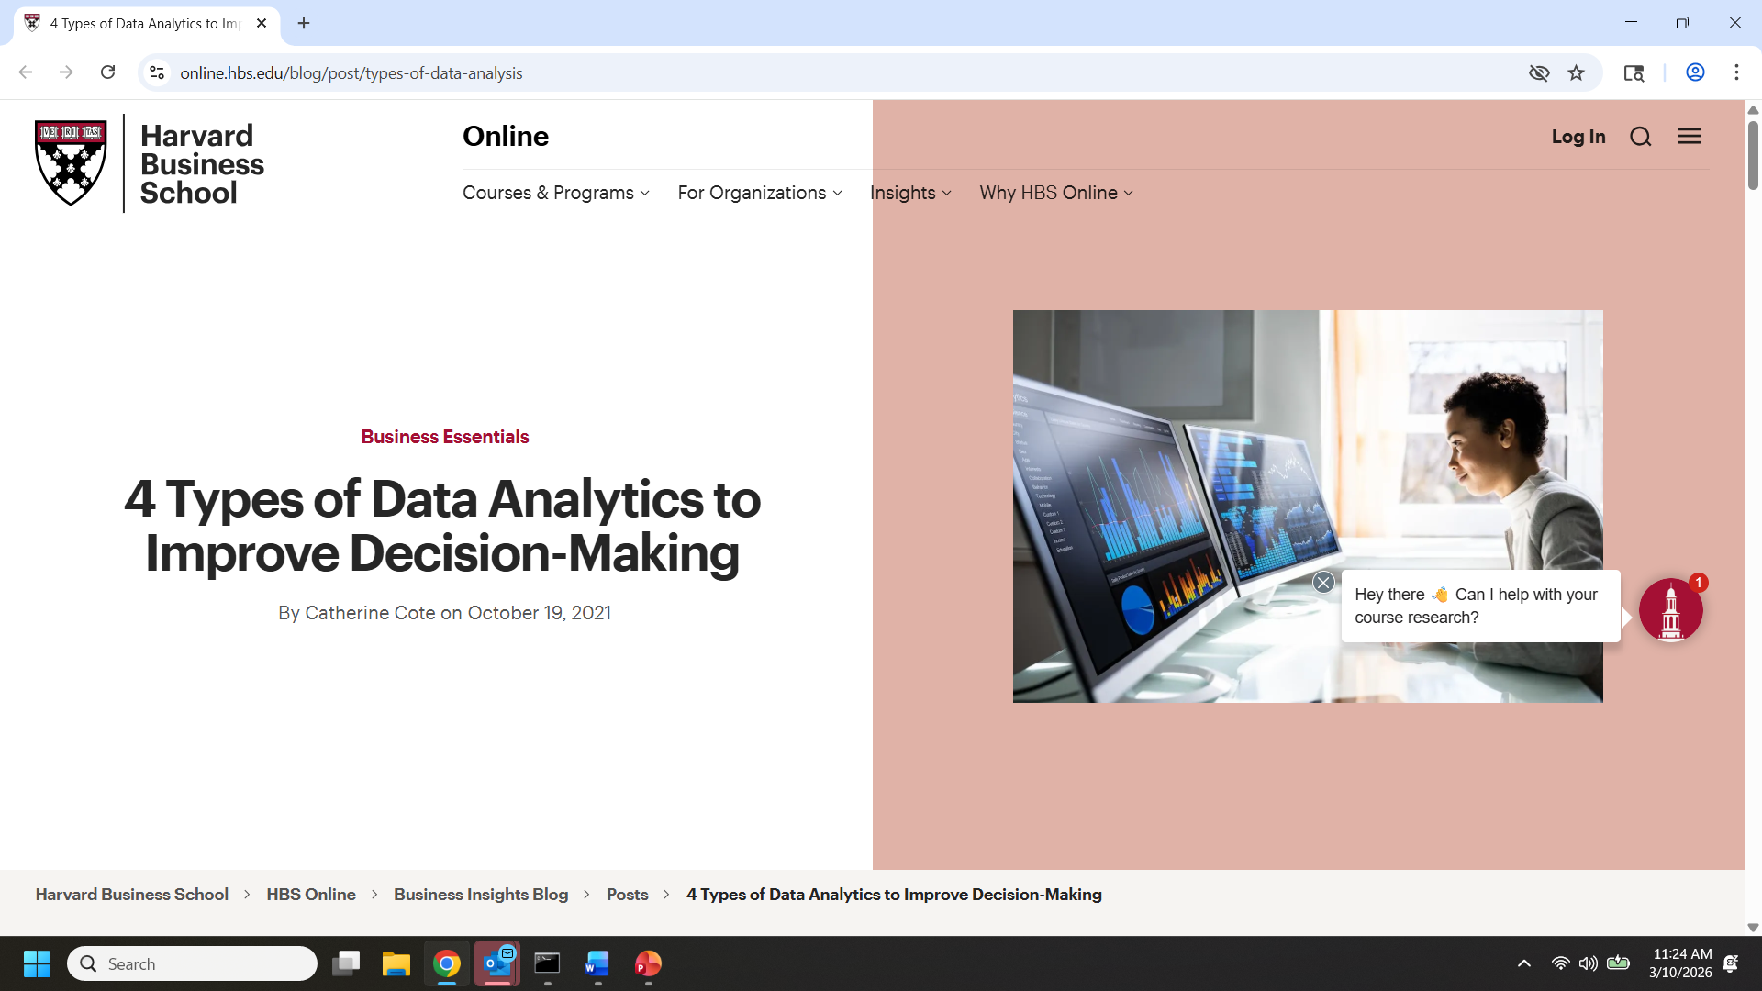
4 key types of analytics per https://online.hbs.edu/blog/post/types-of-data-analysis
Descriptive
Diagnostic
Predictive
Prescriptive
What happened
Why did it happen
What might happen in the future
What should we do next
Notes:
Descriptive—what happened
Diagnostic—why did this happen
Predictive—what might happen in the future
Prescriptive—what should we do next

Slide 14

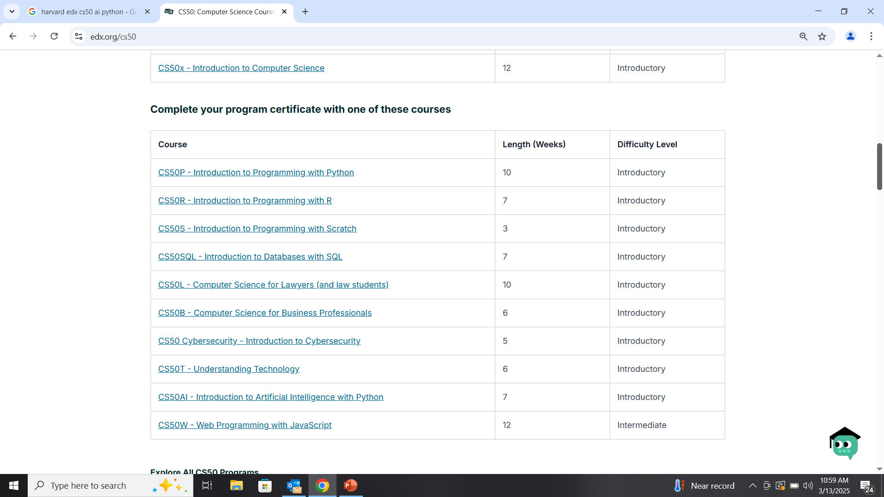

How do these 4 key types of analytics relate to AI?
https://www.edx.org/cs50
(then CS50 AI / Audit course / Register / Create account / Access this course)
Descriptive analytics
Prescriptive analytics
Predictive analytics -> Diagnostic analytics
*

Slide 15

Given a wealth of data…
How do I predict a metric?
  (sales, market return, or weight loss)
How do I predict a yes/no event?
  (response to a promotion, probability of attrition)
How do I know what will drive or predict a result?
  (… all of the above!)
  How do I identify products that need extra attention in forecasting?
How can I construct market segments?
  (customers or patients or portfolios)
What products are purchased together?
  (or events occur together)

Slide 16
Cross-disciplinary applications
Example: regression analysis
 | Forecasting Linear regression | Marketing Logistic regression | Market Research Conjoint Analysis
Type of dependent variable | Continuous | Yes/No Category | Category Rank
Dependent variable | Sales Orders Shipments Revenues | Promotion response Customer attrition | Rating scale (linear) Discrete choice (logistic)
Predictors | Prior sales Economic drivers Promotions | From transactions, “RFM” (next slide) Customer Attributes | Product attributes (slide after next)
Notes:
Domain=a specified sphere of activity or knowledge.
Don’t be intimidated by notion of machine learning…

Slide 17



The Marketing Perspective
“RFM”
Recency
How recent was the last purchase?
Frequency
How often does the customer purchase?
Monetary
How much does the customer spend?

Slide 18
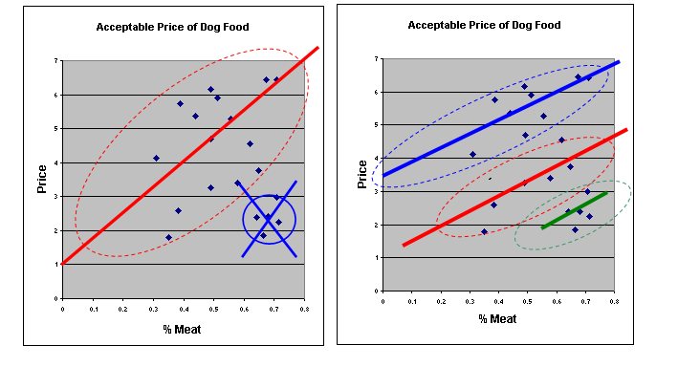

The Market Research Perspective
“Part Worths”
“Confounding factors”:
EFA’s for healthy joints and coat (premium)
Everyday adult
The packaging just might be unappealing?

Slide 19
Cross-Disciplinary Applications in Forecasting Process
From…. | Found by… | Use for … | Applied as …
Customer groups | Cluster Analysis | More certain forecast by customer class | Bottom-up forecast assembly
Product-line groups | Cluster Analysis | More certain forecast by product class | Top-down forecast allocation OR Application of special methods
Probability of customer attrition | Logistic Regression | Number of customers | Forecast driver or judgmental add factor
New product market shares | Conjoint-based market simulator | New product forecast | Judgmental add factors
Customer-level purchases | Association Rules | Product forecast | Add-factor in response to marketing initiatives
Notes:
In cross-functional collaborations, you can be the one who brings the tools to the table

Slide 20
Databases, Data Extraction, and Data Assembly
Databases, SQL, and Handling Big Data
1.B
Notes:
Why the forecasting job is the best in every company
Hands on data that drive the company
Interdepartmental working relationships
“Improving forecast” excuse to learn whatever you want

Slide 21
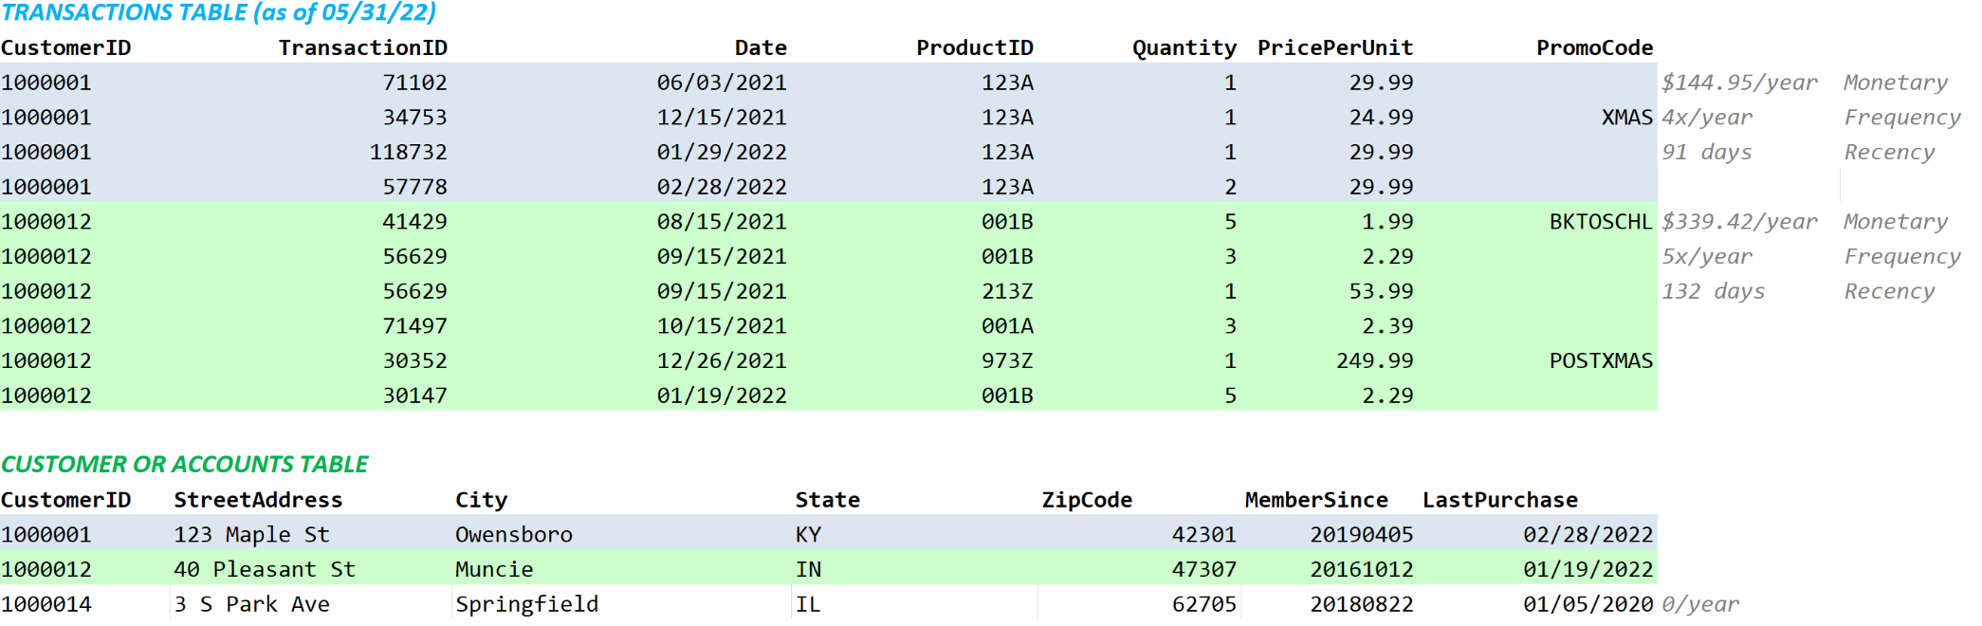
Customer-level Data: Data Preparation
Databases
One record per customer, as may be available in a Customer Relationship Management System (CRMS) or relational database
Customer-level measures may require aggregation from individual transactions, e.g.:
“Database Normalization” avoids redundancy by separating descriptive (lookup/master) data from transactional data
Notes:
Key to effective customer-level measurements is that you either find them as-is or aggregate from transactions
Key to effect higher-level forecasts is that you aggregate the results of applying these customer-level measurements

Slide 22
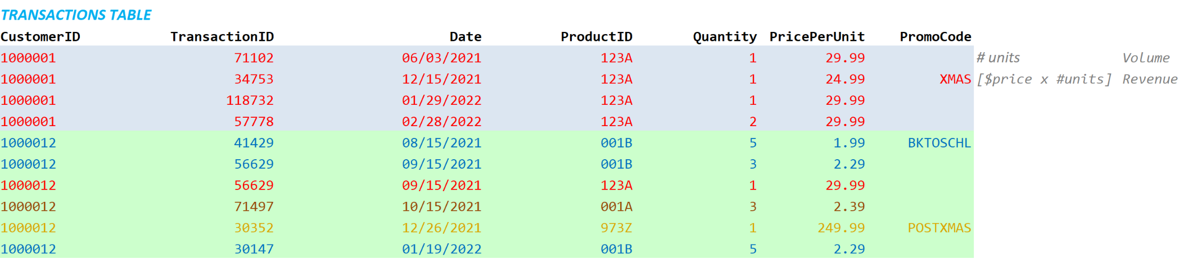
Product-level Data: Data Preparation
1 of 2
Databases
One record per product, as may be available in a Customer Relationship Management System (CRMS) or relational database
Like Customer-level data, Product-level measures may require aggregation from individual transactions, e.g.:
Notes:
Key to effective customer-level measurements is that you either find them as-is or aggregate from transactions
Key to effect higher-level forecasts is that you aggregate the results of applying these customer-level measurements

Slide 23
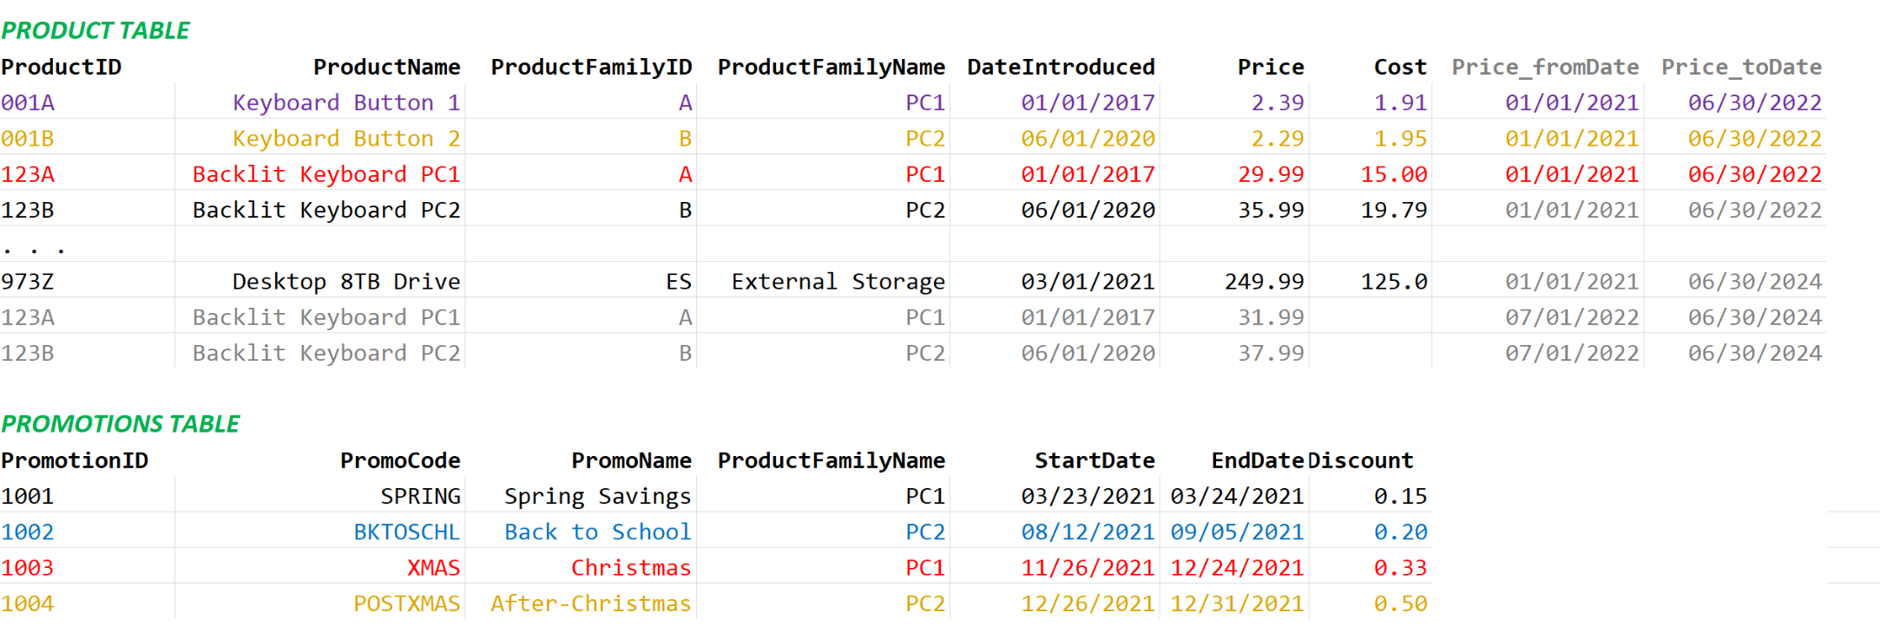
Product-level Data: Data Preparation
2 of 2
Databases
Similarly, data for products and promotions may supplement aggregation of transactions
Notes:
Key to effective customer-level measurements is that you either find them as-is or aggregate from transactions
Key to effect higher-level forecasts is that you aggregate the results of applying these customer-level measurements

Slide 24
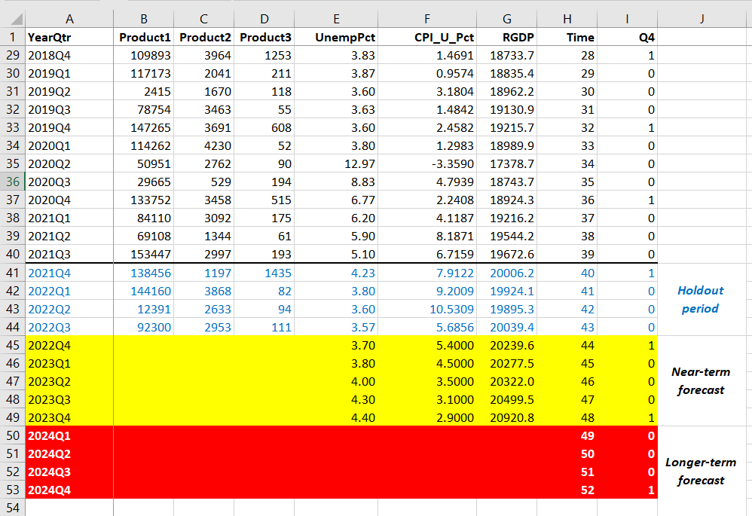
Before you collect any Data what you need to know
Databases
For cause-and-effect forecasting, drivers (independent variables, predictors) must be available for both the historical AND the forecast periods
✓
✓
X
Notes:
Key to effective customer-level measurements is that you either find them as-is or aggregate from transactions
Key to effect higher-level forecasts is that you aggregate the results of applying these customer-level measurements

Slide 25
SQL--Basics
SQL
Extract data through a query
Basic query elements:
SELECT: fields to choose (* for all)
FROM: table to choose from
WHERE: filter results
ORDER BY: sort results
SELECT *
FROM customerTable
WHERE customerClass=‘HOME OFFICE’
ORDER BY customerID

Slide 26
SQL—Aggregation
SQL
Product-level measures from transactions
Aggregation functions:
          COUNT
SUM
AVG
MIN
MAX
With
GROUP BY
HAVING
SELECT productID,
sum(purchaseAmount) as amountSpent
FROM transactionsTable
WHERE year(transactionDate)=2018
GROUP BY customerID
ORDER BY customerID

Slide 27
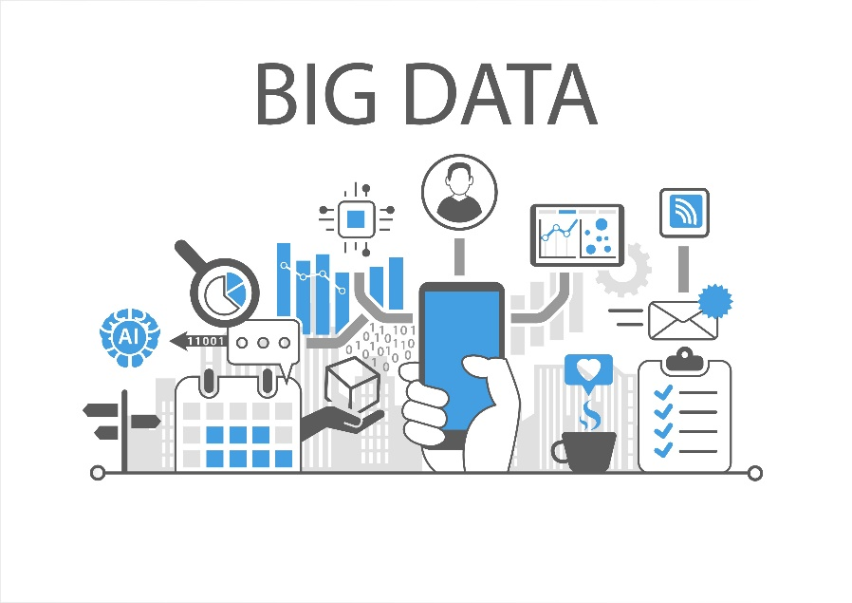
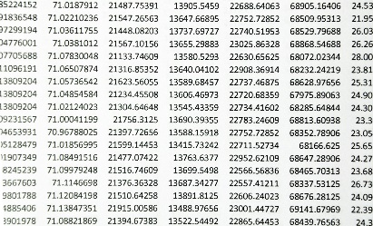
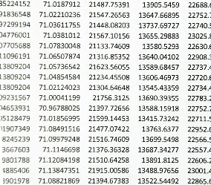
Handling Big Data
Row-wise and Column-wise Operations
Data tables as “Least Common Denominator”
2
3
Tables might be very wide…
… or very tall

Slide 28
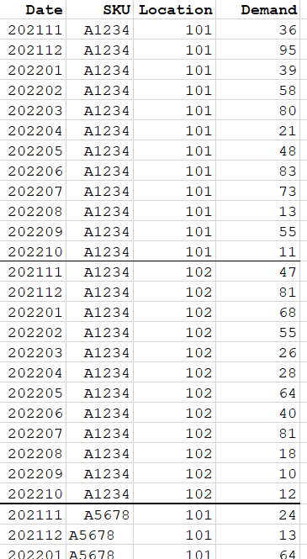
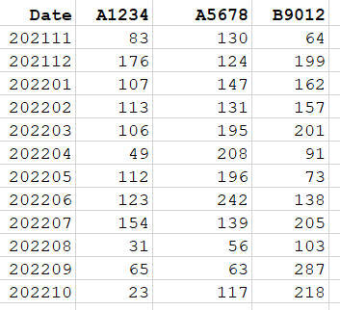
Handling Big Data
Descriptive and Predictive Techniques
Row-wise vs. Column-wise operations
2
3
Time series data
  Usually in a column, with one row per time period
  Might be found as rows identified by combinations of sku (column), location (column) and time period (column), then demand (column)
  Might be found aggregated, with rows identified by time period, and values named by SKU, product class, business entity, etc.

Slide 29
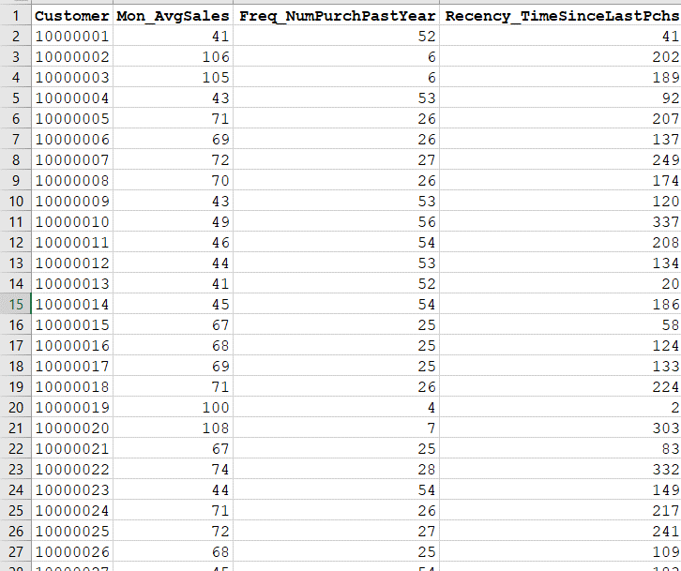
Handling Big Data
Descriptive and Predictive Techniques
Row-wise vs. Column-wise operations
2
3
Customer-level data
  Rows are observations (customers)
Columns are measures that pertain to the customer, e.g.:
  Monetary: how much they spend per month
  Frequency: number of purchases in past year
  Recency: how many days since last purchase

Slide 30
Handling Big Data
Descriptive and Predictive Techniques
Row-wise and Column-wise operations
Where | Why | Transactions Data | Attribute Records
Row-wise (data prep) | Obtain Customer-level Measures (Big Data too tall) Obtain product class aggregates for forecasting | Aggregate: Sum (Σ) Average (μ) Variability: standard deviation ( σ) Coefficient of Variation (σ/μ) | Define level of aggregation (e.g., customer, product, product family)
Column-wise (analytics) | Obtain predictors (Big Data too wide: too many variables for meaningful analysis) | Given many possible predictors: Select important ones Combine them
Row-wise (analytics) | Group customers, products (Big Data too tall) | Find product groups that forecast well because they’re alike in patterns Find groups of customers that respond to different demand stimuli
Row-wise (analytics) | Construct test/training datasets (Big Data FORTUNATELY tall) | Sample records to balance attributes among datasets

Slide 31
Handling Big Data
Column-wise Operations
Select Predictors
Goal | Statistics | AI/Machine Learning
Evaluate each independent variable (predictor, feature), either: by itself vs. other predictors vs. the dependent variable | EDA Univariate distributions Correlations (continuous) Chi-square test (“correlation among categories”) | “Filter Methods” EDA by Large Language Model (LLM), e.g. ChatGPT (“Deep learning”)
Search for best set of predictors | Automated Variable Selection Stepwise Regression Backwards Stepwise Regression All-possible subsets regression | “Wrapper Methods” Best-first search Recursive Feature Elimination Heuristics
Learn which features improve model accuracy the most | Variable “Importance” (compare accuracy lost when each variable is left out of model) | “Embedded Methods” Regularization (penalization) which constrains the optimization of an algorithm toward less complexity (LASSO, Ridge Regression, Elastic Net)
Machine Learning per https://machinelearningmastery.com/an-introduction-to-feature-selection/

Slide 32
Begin from
Exploratory Data Analysis (EDA)
Conventional techniques
LLM Contribution (ChatGPT)
2
Notes:
Why the forecasting job is the best in every company
Hands on data that drive the company
Interdepartmental working relationships
“Improving forecast” excuse to learn whatever you want

Slide 33
Note: Use of Online LLM’s
Proprietary data should not be exposed, such as by entry or uploading, into an online tool unless company management has authorized such exposure, having made provisions to assure confidentiality of data and their analyses
Even if de-identified, non-proprietary data are to be entered online, company policies may prohibit use of online tools, even if the IT department has not blocked access to them
In other words, if you wish to enter data online into websites
like https://sbthesis.com/shiny_IBF/ or https://chatgpt.com/ ,
please assure that your company approves
Here’s what ChatGPT advises (next slides):

Slide 34
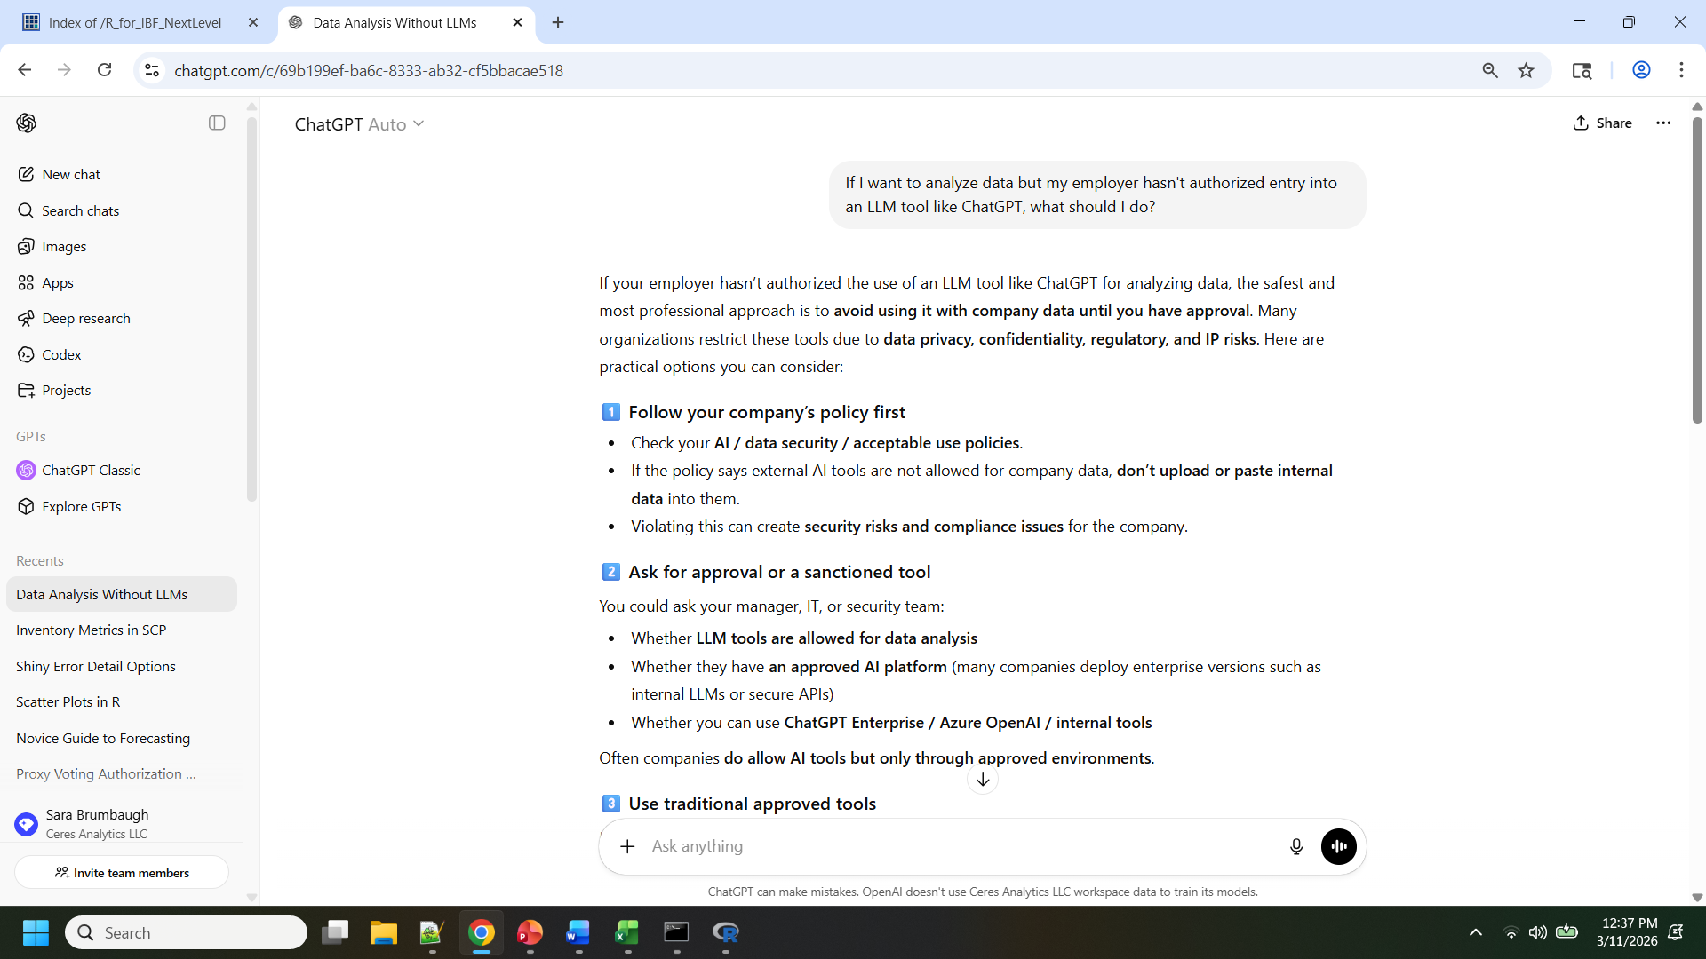
ChatGPT advises…
(1 of 3)

Slide 35
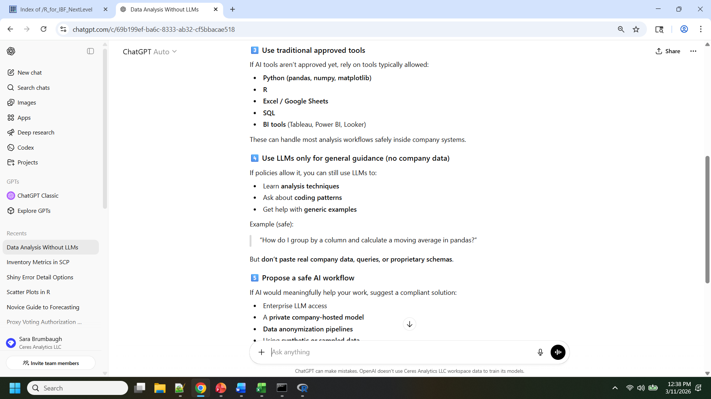
ChatGPT advises…
(2 of 3)

Slide 36
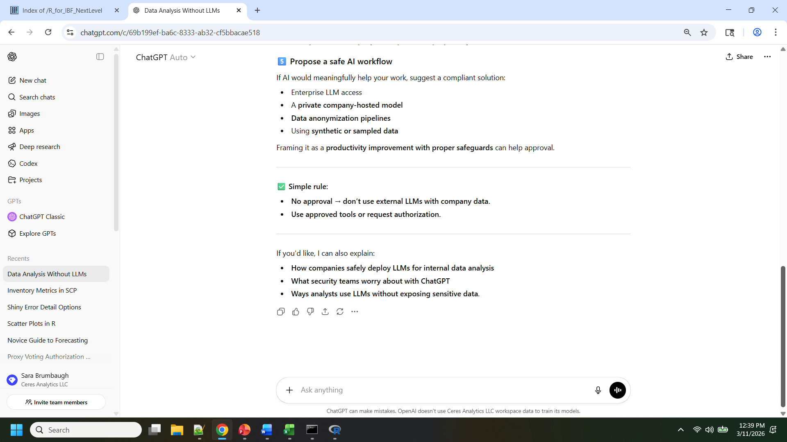
ChatGPT advises…
(3 of 3)

Slide 37

Demo: Exploratory Data Analysis
Web app: https://sbthesis.com/shiny_IBF/
LLM: https://chatgpt.com/
Example

Slide 38
SEGUE…
For those who wish to code
2
Notes:
Why the forecasting job is the best in every company
Hands on data that drive the company
Interdepartmental working relationships
“Improving forecast” excuse to learn whatever you want

Slide 39


If you want to learn to code
in python, free Harvard course through edX platform
https://www.edx.org/learn/python/harvard-university-cs50-s-introduction-to-programming-with-python
Notes:
First graph: though within shown, other metrics used, including:
___
___
___
Second graph: to see a 2-d plot, you need two dimensions that are composites of “most” of your data. Hence, principal components as covered earlier
Third graph: Silhouette. Higher and more concave-down = better. Often evaluated as an average

Slide 40
Sample programs for techniques shown
https://ceresanalytics.com/R_for_IBF_NextLevel/
“How to” decks and references
Data
Excel macro or app
Python example(s)
Where to find free decision tree software
Remainder =R examples, slides
Notes:
First graph: though within shown, other metrics used, including:
___
___
___
Second graph: to see a 2-d plot, you need two dimensions that are composites of “most” of your data. Hence, principal components as covered earlier
Third graph: Silhouette. Higher and more concave-down = better. Often evaluated as an average

Slide 41
Descriptive & Predictive
Techniques
2
3

Slide 42
Today’s Approach to Techniques
2
3
Notes:
Why the forecasting job is the best in every company
Hands on data that drive the company
Interdepartmental working relationships
“Improving forecast” excuse to learn whatever you want

Slide 43
Each technique
What it is/how it works
Statistical Methods | Machine Learning
How to evaluate results
How to apply results
Example Some web app, some Excel macros, some links to R or Python programs
Notes:
Though these are “big data” techniques, for purposes of applying them for first time, small datasets

Slide 44
Descriptive Techniques
Cluster Analysis
Note re Principal Component Analysis
Association Rules at end
2
Notes:
Why the forecasting job is the best in every company
Hands on data that drive the company
Interdepartmental working relationships
“Improving forecast” excuse to learn whatever you want

Slide 45
Segmentation:
Cluster Analysis
2
Notes:
Key: train/test/extrapolate datasets

Slide 46
How can I construct market segments?
Examples
Statistics: Cluster Analysis
Machine Learning: Cluster Analysis

Slide 47
Cluster Analysis
What it is/how it works
  Descriptive technique that—through either statistics or machine learning—finds groups in data for which observations are as similar as possible, while groups are as different as possible
  Statistics vs. Machine Learning—different approaches to same task
How to evaluate your results
  Key measures, visualization (color the clusters)
How to apply your results
  Name them and learn from their profiles
  Aggregate by segment to create class-level history and forecasts
Examples
  Web app; Script in R

Slide 48
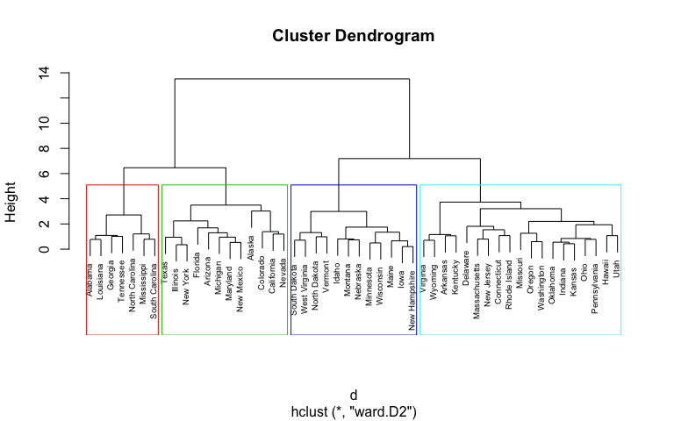
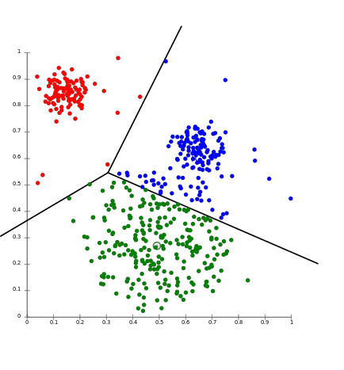
What it is/how it works
Cluster Analysis
Agglomerative (Hierarchical) vs. Partitioning Methods
https://stats.stackexchange.com/questions/146339/what-does-cluster-size-mean-in-context-of-k-means
https://uc-r.github.io/hc_clustering

Slide 49
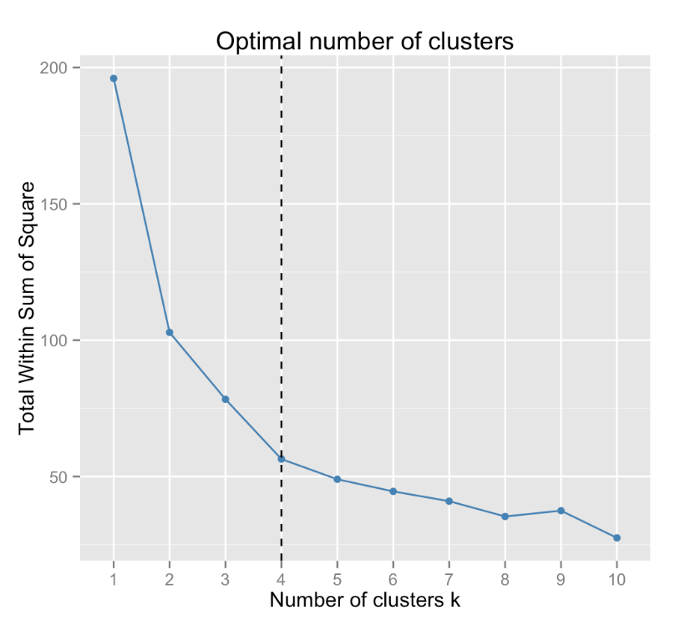
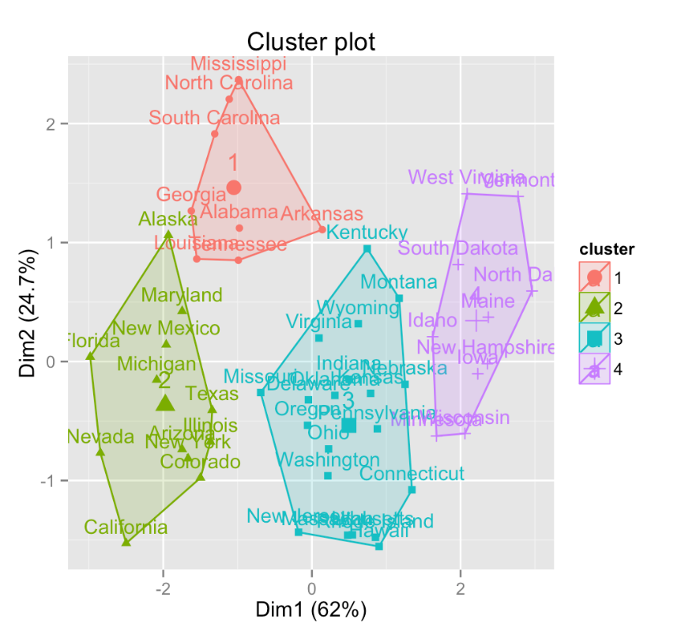
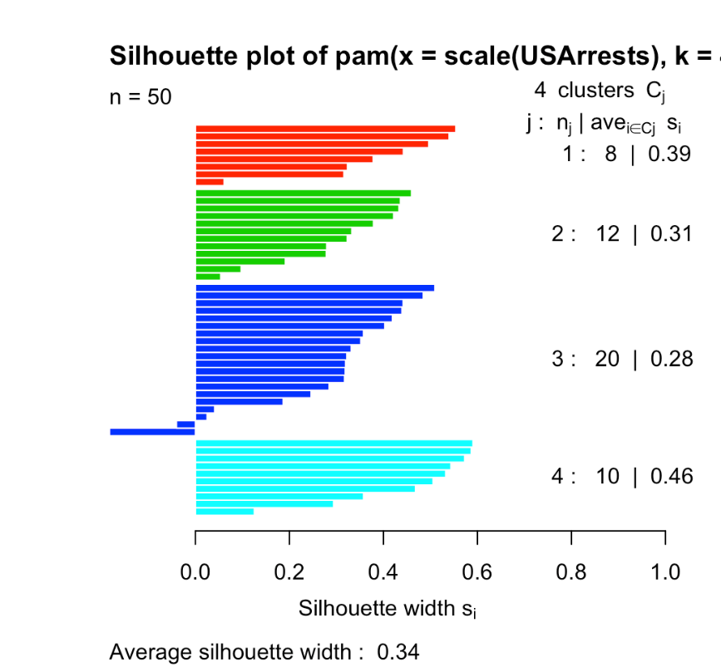
How to Evaluate Results
Cluster Analysis
Evaluation of Results
Source (with silhouettes modified): http://www.sthda.com/english/wiki/print.php?id=236
Notes:
First graph: though within shown, other metrics used, including:
___
___
___
Second graph: to see a 2-d plot, you need two dimensions that are composites of “most” of your data. Hence, principal components as covered earlier
Third graph: Silhouette. Higher and more concave-down = better. Often evaluated as an average

Slide 50
How to apply it
How to apply it
Cluster Analysis
Process
Concept | Considerations
Identify the purpose of the cluster analysis | To construct new aggregates for forecasting? To learn about/isolate group(s) from customer base? To learn about/isolate group(s) from products?
Identify what will be clustered | Identify customer segments? Segregate products by key sales characteristics? Characterize unprofitable time periods?
Assemble data | One row per observation (e.g., customer, product) Columns are measures that will define groups (e.g., RFM, inventory and profit metrics)
Notes:
First graph: though within shown, other metrics used, including:
___
___
___
Second graph: to see a 2-d plot, you need two dimensions that are composites of “most” of your data. Hence, principal components as covered earlier
Third graph: Silhouette. Higher and more concave-down = better. Often evaluated as an average

Slide 51
How to apply it
How to apply it
Cluster Analysis
e.g., Aggregate to class-level by assigned cluster #
Notes:
First graph: though within shown, other metrics used, including:
___
___
___
Second graph: to see a 2-d plot, you need two dimensions that are composites of “most” of your data. Hence, principal components as covered earlier
Third graph: Silhouette. Higher and more concave-down = better. Often evaluated as an average

Slide 52
Demo: Cluster Analysis
R code: https://ceresanalytics.com/R_for_IBF_NextLevel/ibf_Clusters.r
Web app: https://sbthesis.com/shiny_IBF/
Example

Slide 53
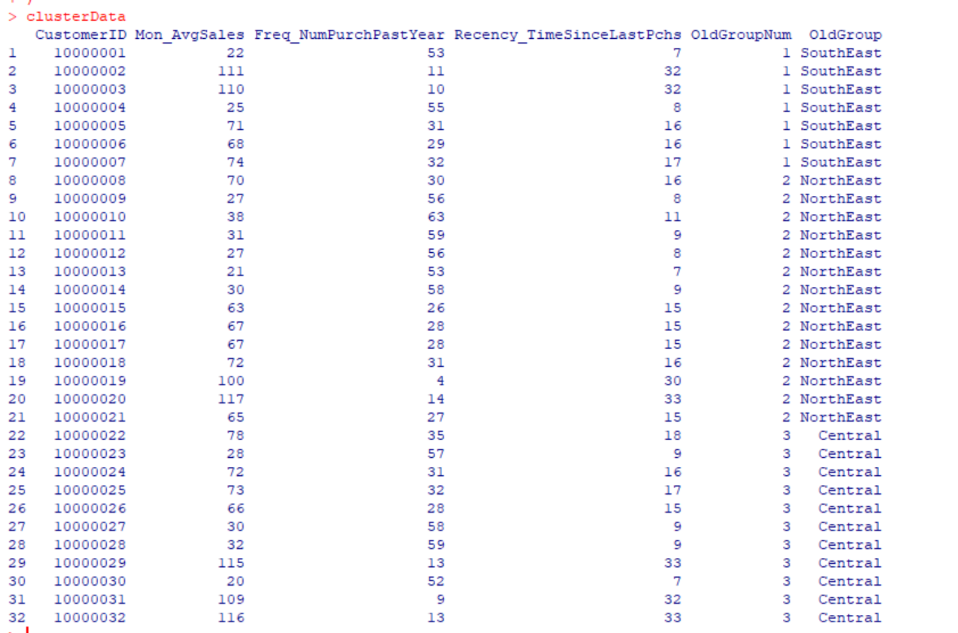
Test Data

Slide 54
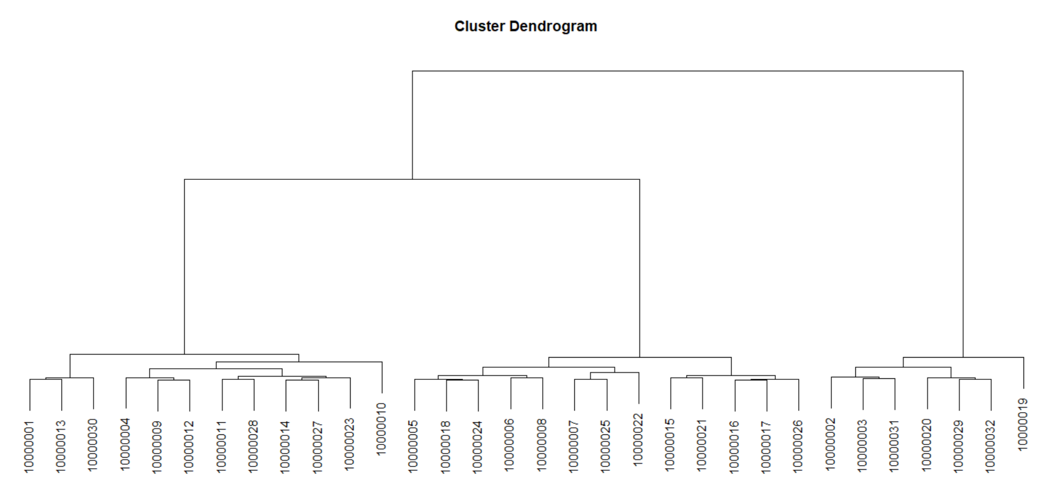
Test Data
Long branches mean clusters are distinct

Slide 55
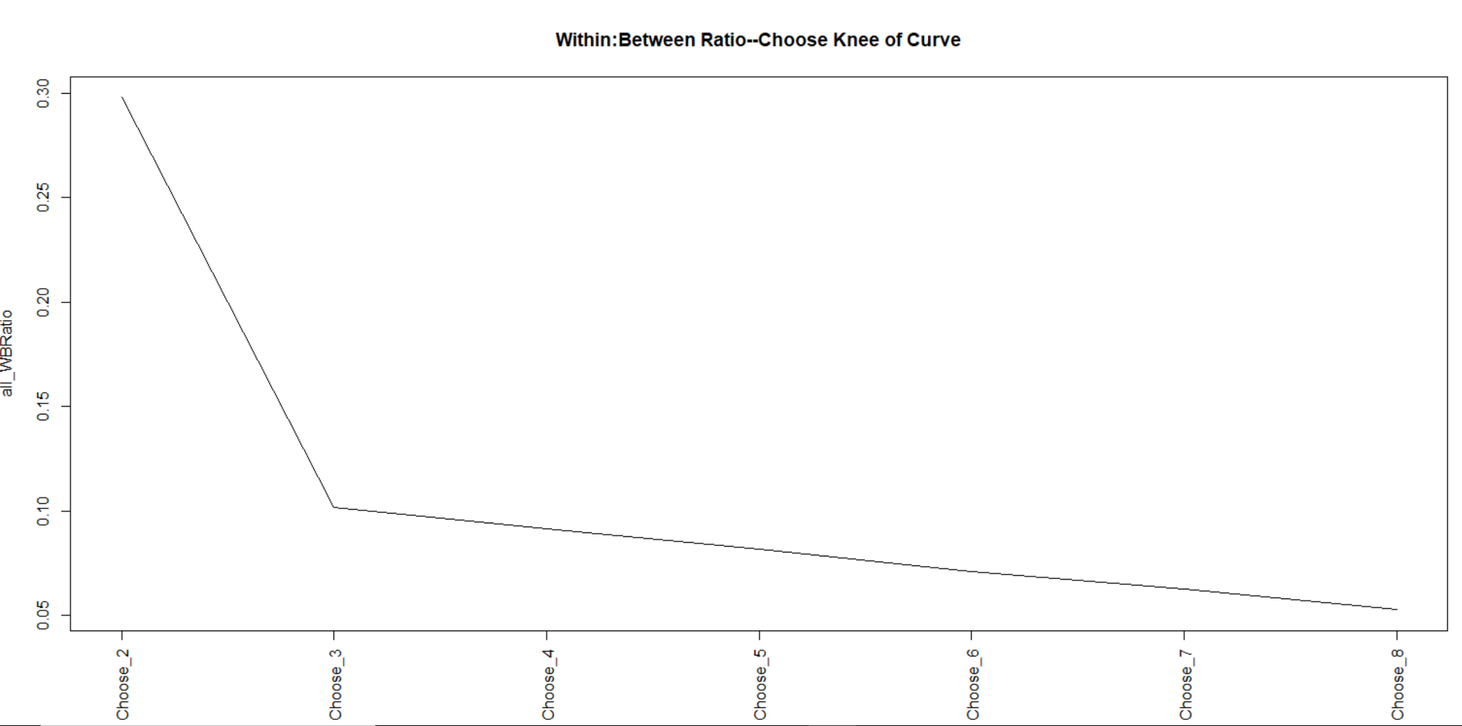
Within:Between Ratio

Slide 56
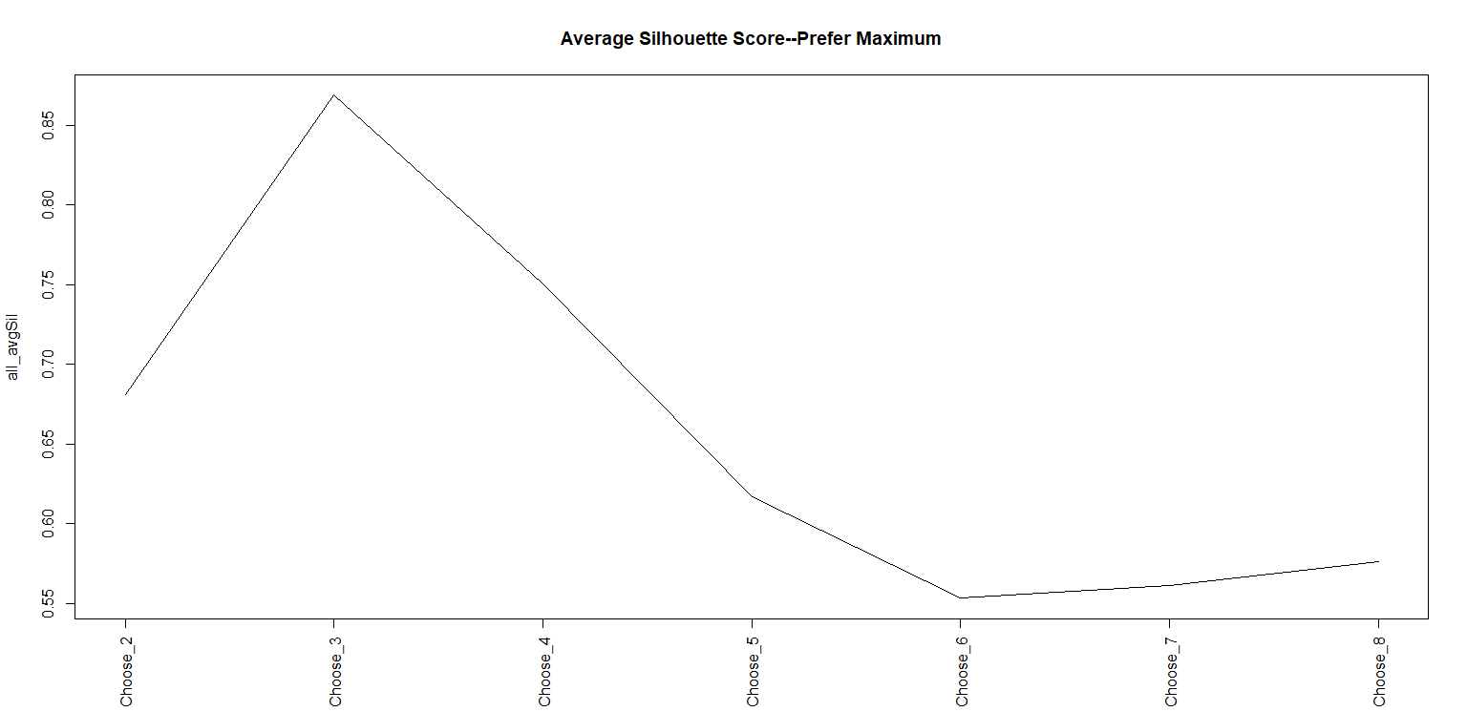
Average Silhouette Score

Slide 57
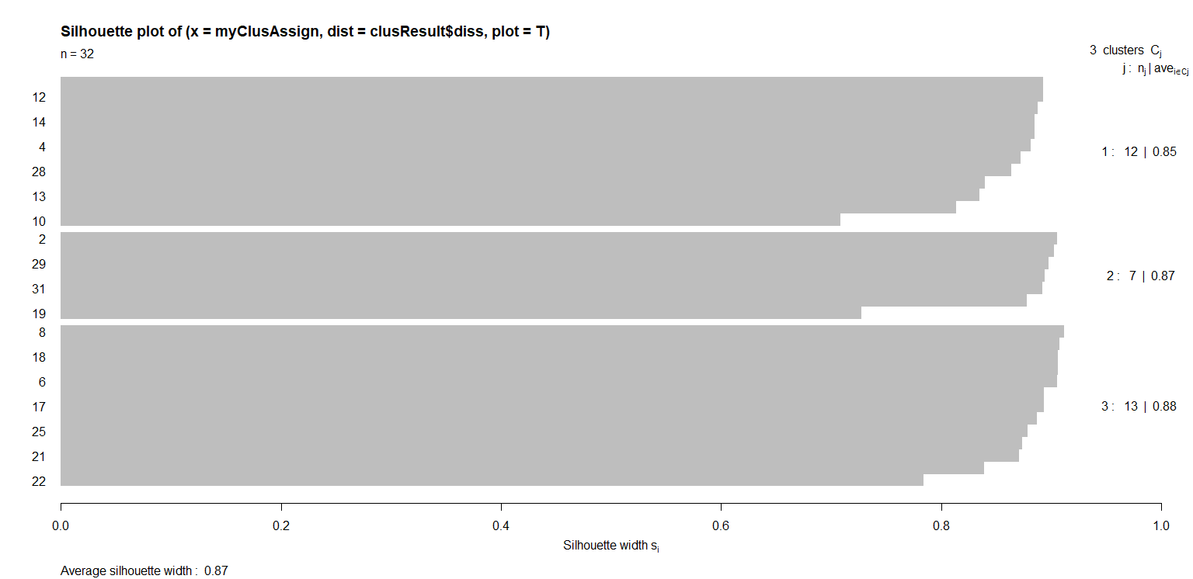
Individual Silhouette Scores

Slide 58
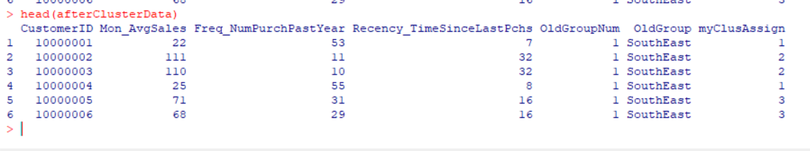
Cluster Assignment
The cluster assignment can be used like any other data element…

Slide 59
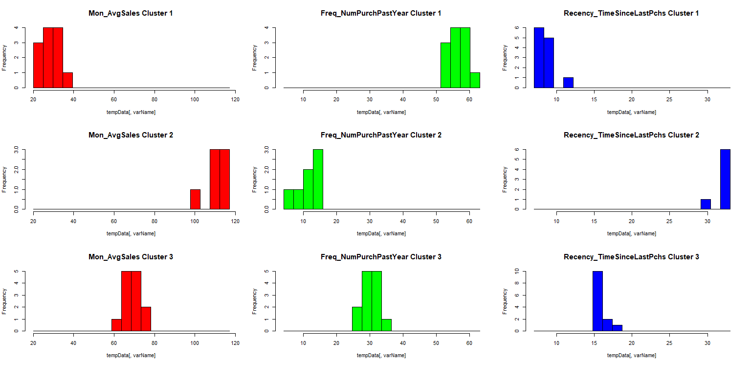
Compare and Contrast
Cluster 1
Low average sales
High frequency
Low recency
Cluster 2
High average sales
Low frequency
High recency
Cluster 3
Medium average sales
Medium frequency
Medium recency

Slide 60
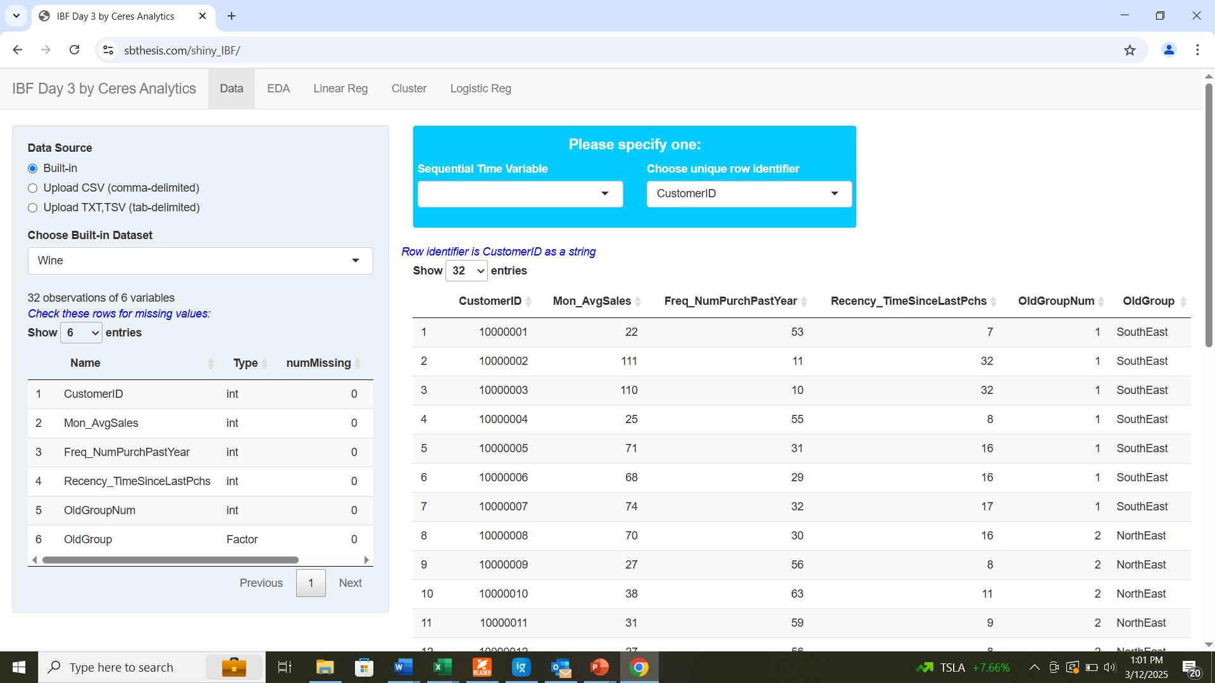
SETUP
Try it!
https://sbthesis.com/shiny_IBF/
(no username or password)

Slide 61
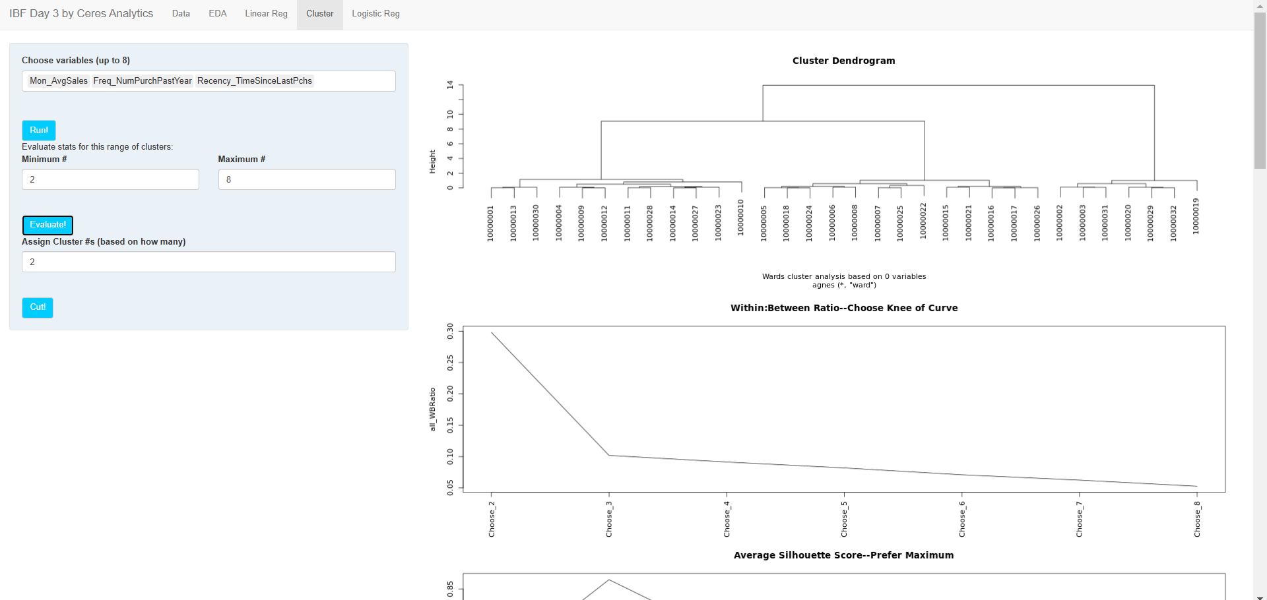
SETUP RESULTS
Try it!

Slide 62
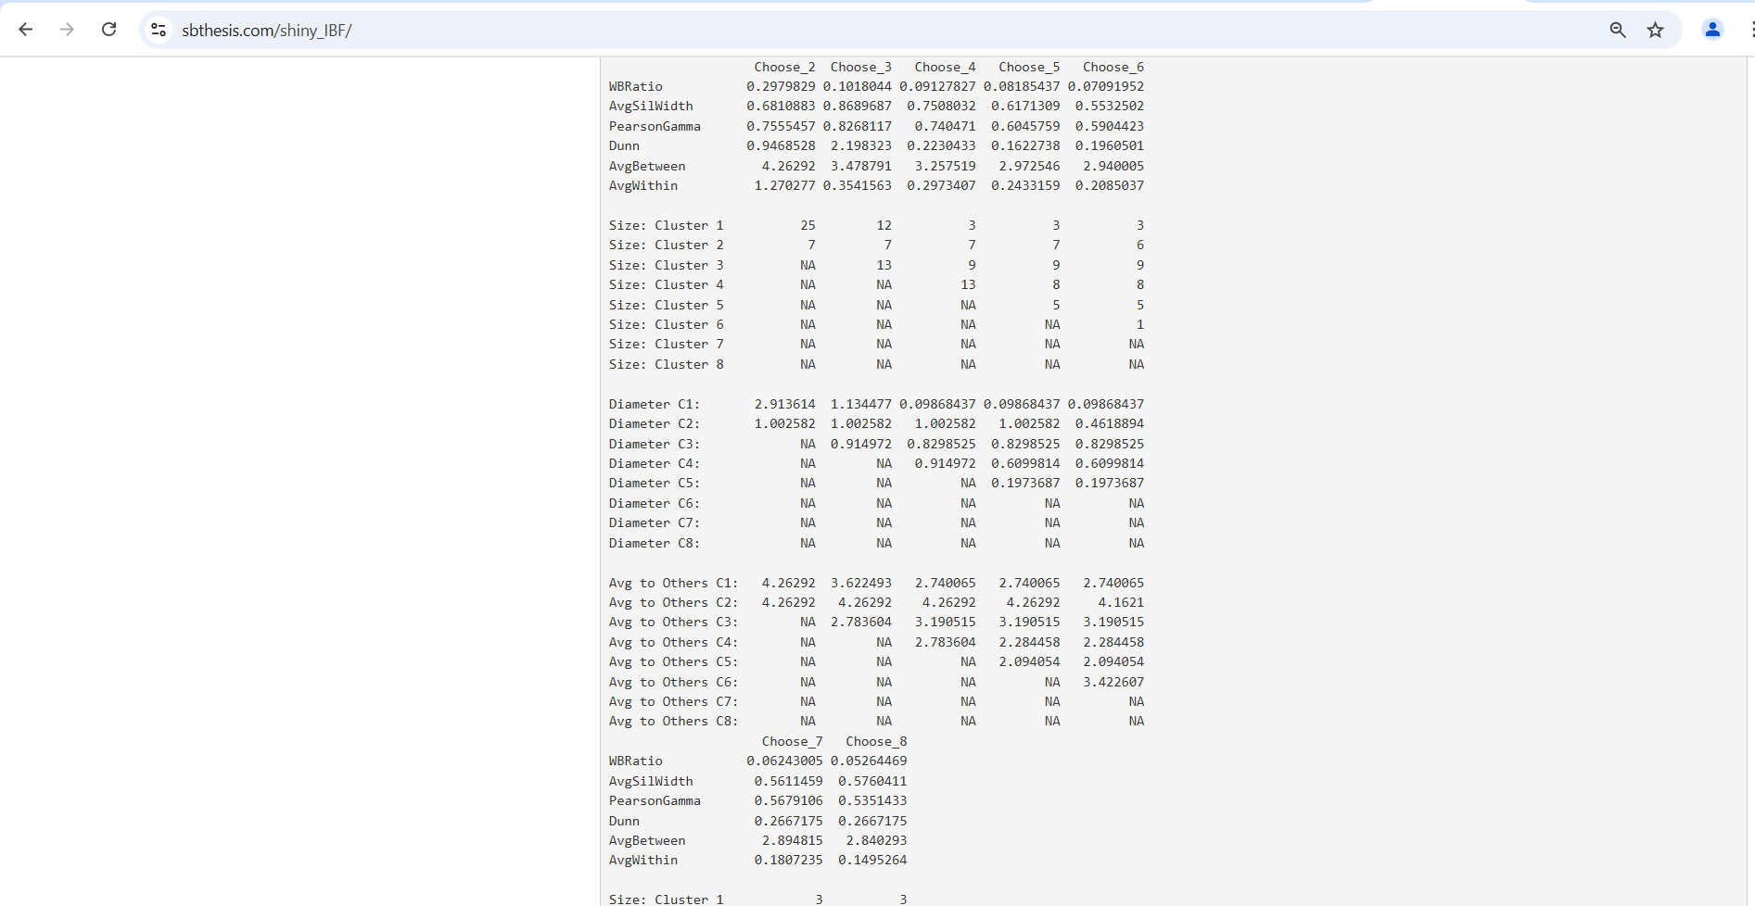
RESULTS, continued
Try it!

Slide 63
Product Segmentation:
Alternative
2
Notes:
Key: train/test/extrapolate datasets

Slide 64
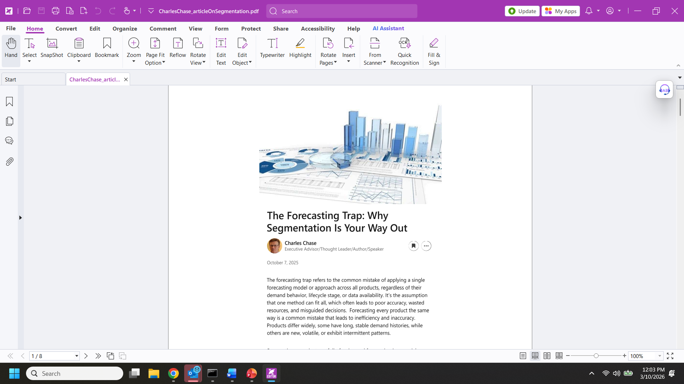
Why would I construct product segments? https://www.linkedin.com/pulse/forecasting-trap-why-segmentation-your-way-out-charles-chase-71vde/

Slide 65

Why would I construct product segments? https://www.linkedin.com/pulse/forecasting-trap-why-segmentation-your-way-out-charles-chase-71vde/
Differing Historical patterns -> Differing Forecast patterns
Type of forecast required
(slow-moving, durable)
Strategic Importance
Notes:
“Segmentation transforms forecasting from a generic exercise into a strategic capability, one that aligns models with product behavior and business priorities”
Use lower-level SKU forecasts to dynamically allocate higher-level aggregate forecasts down to the SKU level. In practice, this means leveraging bottom-up forecasts from individual SKUs to distribute the parent-level forecast, whether it's a brand, product group, or category, across and down to its component SKUs.
Once distributed, reconcile back up the hierarchy to ensure consistency with the middle-down forecast. This approach requires technology capable of performing aggregations not just from the top down or bottom up, but from any middle-out level, enabling flexible, multi-directional forecasting across the entire hierarchy.

Slide 66
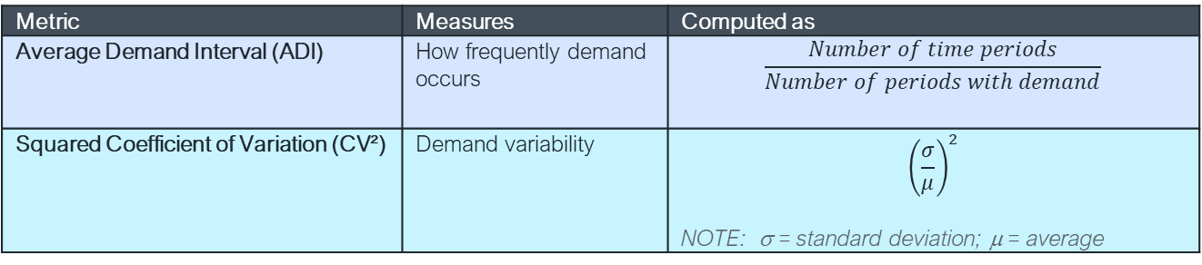
Do I need cluster analysis to identify product segments?
Alternative: Demand Pattern Classification Framework based on ADI and CV²
Segment w/o Clusters
1 of 2
Metric | Measures | Computed as
Average Demand Interval (ADI) | How frequently demand occurs | $$\frac{Number of time periods}{Number of periods with demand}$$
Squared Coefficient of Variation (CV²) | Demand variability | $${\left(\frac{σ}{μ}\right)}^{2}$$ NOTE: σ = standard deviation; μ = average
Source: Syntetos, A. A., Boylan, J. E., & Croston, J. D. (2005). On the categorization of demand patterns. Journal of the operational research society, 56(5), 495-503.

Slide 67

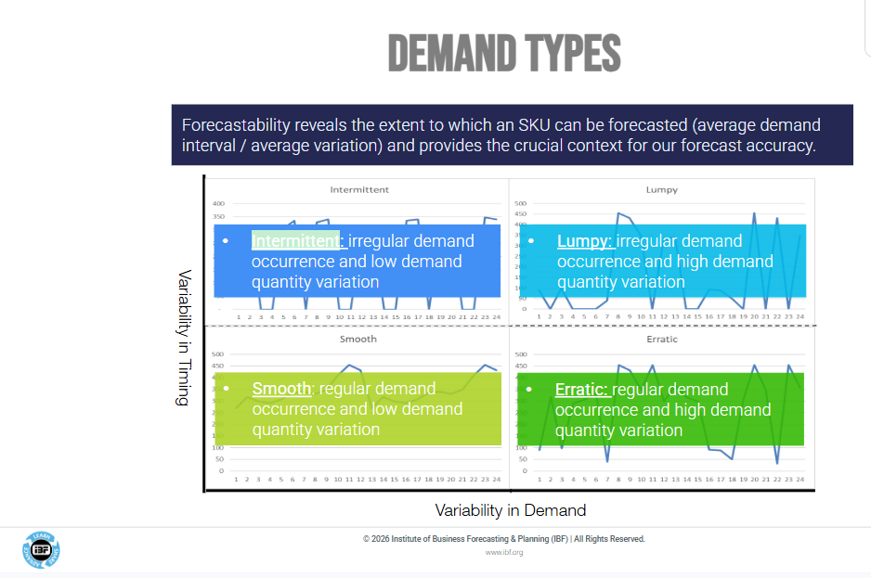

Slide 68
Consider Demand Pattern Classification Framework based on ADI and CV²
Segment w/o Clusters
2 of 2
i.e.,
>= .7 * μ
 |  | Demand Variability (CV²)
 |  | Low CV² < 0.49 | High CV² ≥ 0.49
Demand Frequency (ADI) | Frequent ADI < 1.32 | SMOOTH Stable volume Frequent demand | ERRATIC Variable volume Frequent demand
 | Infrequent (ADI ≥ 1.32) | ITTENT Stable volume Gaps between orders | LUMPY Variable volume Gaps between orders
i.e.,
> ¼ of time periods have non-zero demand
Source: Syntetos, A. A., Boylan, J. E., & Croston, J. D. (2005). On the categorization of demand patterns. Journal of the operational research society, 56(5), 495-503.

Slide 69
Demo: Demand Pattern Classification (Syntetos-Boylan)
Excel file with macro: https://ceresanalytics.com/R_for_IBF_NextLevel/makeProductSegments_withMacro.xlsm
Excel file without macro: https://ceresanalytics.com/R_for_IBF_NextLevel/makeProductSegments.xls
VBA code for macro: https://ceresanalytics.com/R_for_IBF_NextLevel/productSegments.bas
Excel how-to: https://ceresanalytics.com/R_for_IBF_NextLevel/HowToRun_productSegments.pptx
Example

Slide 70
Cluster Analysis for product segments?
(Beyond ADI & CV²: Consider Key Performance Indicators (KPI’s))
Category | Metric
Service | Fill rate Service level Stockout rate
Inventory efficiency | Inventory turnover (COGS/Average Inventory) Days of inventory Weeks of supply
Supply | Lead time Order cycle time
Financial | Carrying cost Obsolete inventory Gross margin
Forecast quality | Forecast accuracy (MAPE) Forecast bias
Other (“Advanced”) | Demand volatility Safety stock vs target service level Inventory health (excess / shortage / optimal) SEE NEXT SLDE

Slide 71
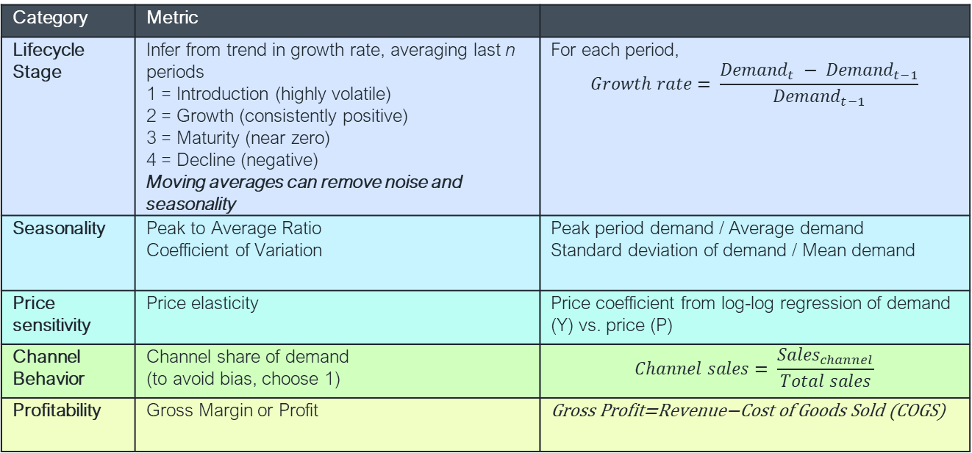
How do I compute more advanced metrics for product clustering?
Category | Metric
Lifecycle Stage | Infer from trend in growth rate, averaging last n periods 1 = Introduction (highly volatile) 2 = Growth (consistently positive) 3 = Maturity (near zero) 4 = Decline (negative) Moving averages can remove noise and seasonality | For each period, $$Growth rate= \frac{{Demand}_{t} − {Demand}_{t−1}}{{Demand}_{t−1}}$$
Seasonality | Peak to Average Ratio Coefficient of Variation | Peak period demand / Average demand Standard deviation of demand / Mean demand
Price sensitivity | Price elasticity | Price coefficient from log-log regression of demand (Y) vs. price (P)
Channel Behavior | Channel share of demand (to avoid bias, choose 1) | $$Channel sales= \frac{{Sales}_{channel}}{Total sales}$$
Profitability | Gross Margin or Profit | Gross Profit=Revenue−Cost of Goods Sold (COGS)

Slide 72
NOTE:
Principal Components Analysis
(details in Technical Appendix 3)
2
Notes:
Key: train/test/extrapolate datasets

Slide 73
Predictive Techniques
Linear regression analysis
Logistic regression analysis
Neural Network
Association Rules
3
Notes:
Key: train/test/extrapolate datasets

Slide 74
Linear Regression
3
Notes:
Key: train/test/extrapolate datasets

Slide 75
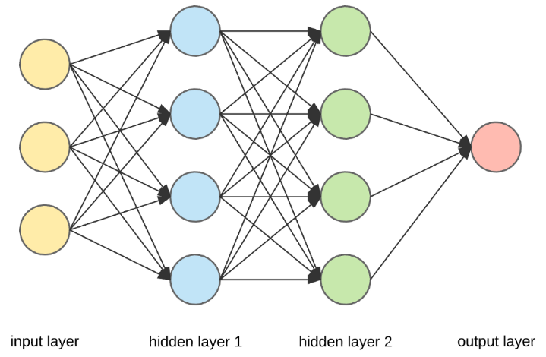
How do I predict a metric?
Examples
Statistics: Linear Regression Analysis
Machine Learning: Neural Network
https://towardsdatascience.com/applied-deep-learning-part-1-artificial-neural-networks-d7834f67a4f6

Slide 76
How do I know what will drive a result?
Examples
Statistics: Automated variable selection (stepwise, all possible subsets)
Machine Learning: Filter Methods, Wrapper Methods, Embedded Methods
http://compneurosci.com/wiki/images/4/42/Intro_to_PCA_and_ICA.pdf

Slide 77
Linear Regression Analysis
What it is/how it works
  Predictive technique that articulates a linear relationship between predictors (independent variables) and the level of an outcome (dependent variable)
  Statistics vs. Machine Learning—variable selection algorithms, optimization algorithms
How to evaluate your results
  R², Adjusted R², t-statistics, outliers, RMSE, ex-post forecasts
How to apply your results
  Extrapolate with equation
Example
  R (today), Excel

Slide 78
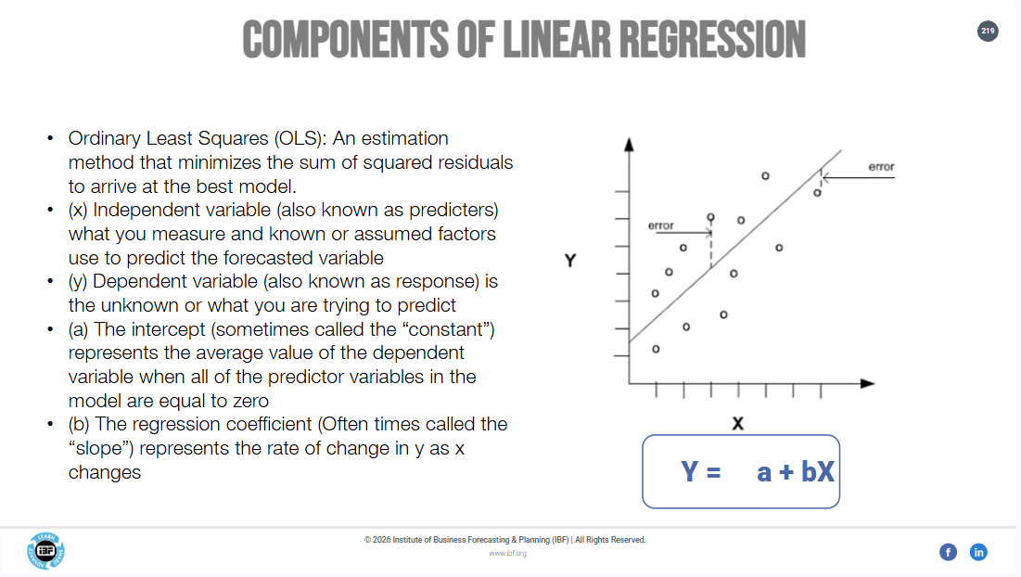

Slide 79
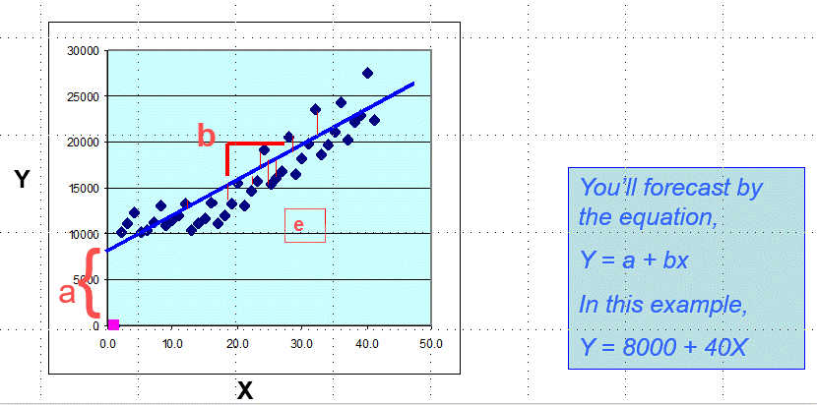

What it is/how it works
Linear Regression
Estimate an equation to predict Y from one or more X’s
x₂
x₁
In this example,
Y = a + b₁X₁ + b₂X₂ + e
modified from
https://stackoverflow.com/questions/47344850/scatterplot3d-regression-plane-with-residuals

Slide 80

What it is/how it works
Calculation of Regression Coefficients
straightforward application of matrix algebra
Source: https://online.stat.psu.edu/stat462/node/132/

Slide 81
How to Evaluate Results
Linear Regression
A few key measures
Concept | Measures
Overall Fit | R² and Adjusted R² F –Statistic RMSE
Each predictor’s fit | Coefficients (+ or -) and their t-statistics Error patterns
Other (depends on software) | Standard error of the equation Durbin-Watson (error tracks itself through time) More

Slide 82


How to Evaluate Results
Predictive Model Performance
Mean Average Percent Error (MAPE)
For ittent demand (many Actuals=0), consider Mean Absolute Deviation (MAD)$=\frac{\sum{|A−F|}}{N}$; see https://robjhyndman.com/papers/foresight.pdf

Slide 83
How to apply it
How to apply it
Linear Regression
Forecast by applying the equation
# | Step | Details
1 | Assemble data… | …for what you wish to forecast (dependent variable) and the predictors that you think are associated
2 | Separate “ex post” holdouts | “training” and “test” data Be wary how a model fits vs. how it forecasts (MAPE, MAD) Historic random variation can be mistaken for “the real thing” Hence, a predictive model should be tested on data that did not create it
3 | Fit the model with “training” and “test” | And see what it did with those ex post holdouts!
4 | Re-fit … | … with training and test data combined
5 | Forecast (extrapolate) | Given future estimates of predictors
Notes:
First graph: though within shown, other metrics used, including:
___
___
___
Second graph: to see a 2-d plot, you need two dimensions that are composites of “most” of your data. Hence, principal components as covered earlier
Third graph: Silhouette. Higher and more concave-down = better. Often evaluated as an average

Slide 84
Demo: Linear Regression https://ceresanalytics.com/R_for_IBF_NextLevel/ibf_linear.r
Web app: https://sbthesis.com/shiny_IBF
Example

Slide 85


Exploratory Data Analysis
Correlations:

Slide 86

Example Data

Slide 87

Statistical Fit

Slide 88

Ex post Forecast

Slide 89


Final Fit

Slide 90

Try it!

Slide 91
Machine Learning Alternative
Neural Network
3
Notes:
Key: train/test/extrapolate datasets

Slide 92
How do I predict a metric?
Examples
Statistics: Linear Regression Analysis
Machine Learning: Neural Network
https://towardsdatascience.com/applied-deep-learning-part-1-artificial-neural-networks-d7834f67a4f6

Slide 93
How do I know what will drive a result?
Examples
Statistics: Automated variable selection (stepwise, all possible subsets)
Machine Learning: Filter Methods, Wrapper Methods, Embedded Methods
http://compneurosci.com/wiki/images/4/42/Intro_to_PCA_and_ICA.pdf

Slide 94
Neural Network
What it is/how it works
  An algorithm meant to mimic the attributes of the human brain, which uses interconnected processing nodes to recognize patterns among inputs and one or more outputs...
  Statistics vs. Machine Learning—This is a Machine Learning technique, which relies on interactions and nonlinearities
How to evaluate your results
  Much like performance of a regression model (ex post forecast)
How to apply your results
  Apply fitted model after train/test/extrapolate
Example
  Script in R or Excel macro workbook
Notes:
Like both multiple and logistic regression, it is used when an outcome is considered to result from impacts of a number of predictors
Unlike multiple regression, a neural network’s key structure relies on non-linearity and interaction of predictors

Slide 95
What it is/how it works
Neural Network
Comparison with Brain
Brain | Neural Network
100,000,000,000 neurons | Neurons number from few to hundreds or thousands
Pattern recognition | Pattern recognition
Vast amount of perceptions | Vast amount of data (or signals)
Learns relatively quickly | Learns relatively slowly
Parallel processing of multiple inputs is aggregated through synapses between cells | Parallel processing of multiple inputs is aggregated through arithmetic combinations between nodes

Slide 96

Preface: Neural Network in Regression Context
What it is/how it works

Slide 97
Two Applications of Regression
Prediction of Levels or Classes (Events)
What it is/how it works
Levels Classes (Events)

Slide 98
The Perceptron Neuron
Can compute a linear combination like linear regression…
What it is/how it works
Start with a linear weighted sum, where the weights are just like regression’s β...
X₁
w₁X
w₁
X₂
w₂X
P_{i}
w₂
X₃
w₃X
w₃
Or w₁X₁ + w₂X₂ + w₃X₃

Slide 99
The Perceptron Neuron
…or apply a nonlinear twist to act as a classifier
What it is/how it works
Start with a linear weighted sum, where the weights are just like regression’s β...
X₁
w₁X
w₁
X₂
w₂X
P_{i}
arcTan
w₂
X₃
w₃X
w₃
Or arcTan(w₁X₁ + w₂X₂ + w₃X₃₎

Slide 100
Neural Net: Forward Propagation make a guess about the weights, which—in turn—makes a guess about the output (Y)
What it is/how it works
^
X₁
Σw_{i}X_{i}
X₂
Σw_{i}X_{i}
Reference: https://becominghuman.ai/basics-of-neural-network-bef2ba97d2cf
X₃
Σw_{i}X_{i}

Slide 101
Neural Net: Backward Propagation
Recognize the extent of the error, to allow adjustment of the weights
What it is/how it works
X₁
Σw_{i}X_{i}
X₂
Σw_{i}X_{i}
Reference: https://becominghuman.ai/basics-of-neural-network-bef2ba97d2cf
X₃
Σw_{i}X_{i}

Slide 102
Neural Net: Nuts and Bolts
What it is/how it works
Partial derivatives essentially tell you how changing the error can be attributed to the weights
Cost function—like linear regression’s minimizing the sum of squared errors—is how those errors should be interpreted for optimization
Learning rate is how big an adjustment you allow when a weight changes
Activation function is how you process output that would otherwise be linear (e.g., to separate classification tasks)
Reference: https://becominghuman.ai/basics-of-neural-network-bef2ba97d2cf

Slide 103
What it is/how it works
Conventional Depiction
3-input network with 1 hidden layer of 3 nodes
X₁
Σw_{i}X_{i}
X₂
Σw_{i}X_{i}
X₃
Σw_{i}X_{i}

Slide 104
What it is/how it works
Conventional Depiction
3-input network with 2 hidden layers of 3 nodes each
X
Σw_{i}X_{i}
Σw_{i}P_{i}
X
Σw_{i}X_{i}
Σw_{i}P_{i}
X
Σw_{i}X_{i}
Σw_{i}P_{i}

Slide 105
Demo: Neural Network
Examples
https://ceresanalytics.com/R_for_IBF_NextLevel/ibf_neuralNetwork.r
https://ceresanalytics.com/R_for_IBF_NextLevel/neuralNet_cfTiberius.xlsm
https://ceresanalytics.com/R_for_IBF_NextLevel/HowToRun_neuralNet_cfTiberius.pptx

Slide 106




Excel-based example
Tiberius original code by Phil Brierley, PhD
…Then vs. Now (www.philbrierley.com ) …

Slide 107

Excel-based example
Try it!
https://ceresanalytics.com/R_for_IBF_NextLevel/neuralNet_cfTiberius.xlsm

Slide 108

R-based example
Same Data as Regression

Slide 109

Scale Variables

Slide 110

Network Fit
Random seed = 2

Slide 111

Compare fit vs. actual

Slide 112
Compare MAPE with Regression
Neural Network
Linear Regression

Slide 113

Must use caution, especially with collinear predictors!
Randomization of weights can lead to “local optimization”, which means that the apparent importance is biased by the nearest solution to the initial weights
When predictors are near-perfect substitutes, additional bias can result because it doesn’t make much difference which of the substitutes’ weights is adjusted
Variable Importance
Random seed = 2

Slide 114
Predicting Events
An introduction
3
Notes:
Key: train/test/extrapolate datasets

Slide 115

How do I predict a yes/no result?
Examples
Statistics: Logistic Regression Analysis
Machine Learning: Neural Network, CHAID(Decision Tree), Support Vector Machine
(MPG)
No
Yes
> 320
No
Yes
Modified from within https://www.youtube.com/watch?v=NYigVROC-qs

Slide 116
PREDICTING EVENTS
“Limited Dependent Variables”
Limited

Slide 117
PREDICTING
Levels vs. Events
Level: Scalar or Continuous
Limited: Event Yes/No

Slide 118

The “Confusion Matrix”

Slide 119

Risk vs. Reward
Cheap E-mail Promotion
✓
✓-
✓
X

Slide 120

Risk vs. Reward
Expensive luxury gift promotion
✓
X
✓
✓-

Slide 121
The “Confusion Matrix”
Supports business strategy
Risk this if:
Cost of failing is high (“it costs a lot to try for those customers”)
Cost of missed opportunity is low
Risk this if:
Cost of failing is low (“e-mail is cheap”)
Cost of missed opportunity is high

Slide 122

WHICH STRATEGY IS EMBRACED?
By the lottery ticket buyer
Is the cost of failing high?
Is the cost of a missed opportunity low?
Which to risk
?
Is the cost of failing low?
Is the cost of a missed opportunity high?
Source: AP Photo/Charlie Neibergall

Slide 123
Logistic Regression Analysis
3
Notes:
Key: train/test/extrapolate datasets

Slide 124
How do I predict a yes/no result?
Examples
Statistics: Logistic Regression Analysis
Machine Learning: Neural Network, CHAID(Decision Tree), Support Vector Machine
(MPG)
No
Yes
> 320
No
Yes
Modified from within https://www.youtube.com/watch?v=NYigVROC-qs

Slide 125
Logistic Regression Analysis
What it is/how it works
  Predictive technique that articulates an S curve based on predictors (independent variables) and a yes/no outcome through its log-of-odds (which can be transformed to probability)
  Statistics vs. Machine Learning—variable selection algorithms, optimization algorithms
How to evaluate your results
  roughly similar to linear regression
How to apply your results
  Extrapolate with equation and/or apply fraction of yes/no’s to add-factor forecast
Example
  R (today), Excel

Slide 126
What it is/how it works
Logistic Regression
Compare with Linear Regression…

Slide 127
What it is/how it works
Logistic Regression
Odds and Probabilities
Odds: as in horse racing (“odds of winning”)
Odds and odds ratios
Relationship of Odds to Probability
  Odds = P/Q = P/(1-P)
  P = Odds/(1 + Odds)

Slide 128




Maybe you can add a predictor that explains these points!

Slide 129

How to Evaluate Results
Logistic Regression
ROC Curve
AUC (Area Under Curve): higher curve is better
Choice between False Positives and False Negatives can be trade-off between relative risks
              TPR=TP/(TP+FN)
          FPR=FP/(FP+TN)
--- Perfect (in theory)
http://gim.unmc.edu/dxtests/RoC3.htm

Slide 130
How to apply it
How to apply it
Logistic Regression
Applications in Forecasting
Goal | Process
To forecast event | Estimate logit (log-odds) model Use the logit (log-odds) equation to “score” out-of-sample records Convert log-odds predicted value to probability of event
To apply probability of event as forecast driver | e.g., for customer attrition model: Aggregate customers in class to get average probability of event Apply aggregate: --If assembled or scored over history, as a class-level explanatory variable in cause/effect forecasts --If static analysis suggests departure from a trend, as a class-level adjustment to forecast values
Notes:
First graph: though within shown, other metrics used, including:
___
___
___
Second graph: to see a 2-d plot, you need two dimensions that are composites of “most” of your data. Hence, principal components as covered earlier
Third graph: Silhouette. Higher and more concave-down = better. Often evaluated as an average

Slide 131
Demo: Logistic Regression https://ceresanalytics.com/R_for_IBF_NextLevel/ibf_logistic.r
Web app: https://sbthesis.com/shiny_IBF
Example

Slide 132

Challenger
count of O-ring failures

Slide 133

Challenger
Change count to binary

Slide 134

Logistic regression fit

Slide 135

What does fit look like?

Slide 136
What does fit look like?
TP
6
FN
0
FP
12
TN
5

Slide 137

ROC Curve

Slide 138

How to apply it
How to apply it
JUST IN CASE
YOU NEED THE MATH…
Notes:
First graph: though within shown, other metrics used, including:
___
___
___
Second graph: to see a 2-d plot, you need two dimensions that are composites of “most” of your data. Hence, principal components as covered earlier
Third graph: Silhouette. Higher and more concave-down = better. Often evaluated as an average

Slide 139

Try it!

Slide 140
Machine Learning Alternative
Decision Trees (CHAID)
4
Notes:
Key: train/test/extrapolate datasets

Slide 141
How do I predict a yes/no result?
Examples
Statistics: Logistic Regression Analysis
Machine Learning: Neural Network, CHAID(Decision Tree), Support Vector Machine
(MPG)
No
Yes
> 320
No
Yes
Modified from within https://www.youtube.com/watch?v=NYigVROC-qs
https://www.crondose.com/2016/07/easy-way-understand-decision-trees/

Slide 142
Decision Tree
What it is/how it works
  Predictive technique that—through machine learning—identifies combinations of criteria that distinguish class categories (CHAID: yes/no, e.g. customer attrition, credit card default) or a range of scalar levels (C&RT: historical demand for forecasting)
  Statistics vs. Machine Learning—generally accepted as machine learning
How to evaluate your results
  “Node purity” (classification), forecast error rate (scalar), other
How to apply your results
  Often a tree can simply be informative in understanding your data, e.g.
    For classifications:
      the probability of an outcome (e.g., 70% yes, 30%no) or
      assign a value based on a breakpoint (e.g., 70% yes means the predicted value is yes)
    For predictive modeling of scalar values (demand) the average for the categories can be a reasonable forecast
Example
  CHAID for telecom churn

Slide 143
Decision Tree Method: CHAID *
What it is/how it works
CHAID (CHi-square Automated Interaction Detector) is a decision tree method of statistics
The dependent variable (or outcome to be explained) is usually categorical, like a yes/no event or group classification, though other decision tree algorithms can explain scalar values like the level of demand
Predictors can take several forms:
Form of Dependent Variable | Examples
Categorical | Yes/No | Red/Blue/Green/Yellow
Rank-Ordered | Yes/Maybe/No | First Choice/Second Choice/Not Chosen
Scalar | 93.2%, 5%, 47.8% | $10,325; $32,500; $50,000; 65,789
* Other Decision Tree methods, exist, such as Classification & Regression Trees (C&RT), known in its commercial implementation as CART
How

Slide 144
CHAID—How it Works
What it is/how it works
At the top of the tree (the first node), CHAID searches for the predictor that corresponds most strongly to the outcome.
If the predictor is scalar, CHAID searches for breakpoint(s) that make the strongest categories.
For example, if telecom customers change providers (“churn”) when their bills are high, then great (strong) CHAID nodes would show "Yes" for churn to coincide with the customer’s bill level.
Conversely, "No" would coincide with low bill levels:
 | Telecom Churn (Quarter)
 | Yes | No | Total
Bill > $60 | N= 80 | N= 2 | 82
Bill < $60 | N= 3 | N= 915 | 918
Total | 83 | 917 | 1000
How

Slide 145
CHAID—How it Works
What it is/how it works
In contrast, a mediocre (weak) CHAID nodes shows a more even distribution.
If the correspondence of the predictor and the outcome isn't statistically significant, then the nodes would not be defined at all.
A weak but significant example:
 | Telecom Churn (Quarter)
 | Yes | No | Total
Bill > $40 | N= 43 | N= 445 | 498
Bill < $40 | N= 40 | N= 472 | 512
Total | 83 | 917 | 1000
How

Slide 146

CHAID—How it Works
What it is/how it works
After the first split, new nodes emerge below that contain the results of the first classification rule. That is:
Each category of the outcome branches into a new node
(below, the branches go to the right to favor “Yes”, and left to favor “No”)
The resulting nodes are each a potential "parent" that can, in turn, branch to more "children“ as the search for classifiers continues

Slide 147

CHAID—How it Works
What it is/how it works
3. The tree algorithm will attempt to split each node until the analyst’s pre-defined criteria tell it to stop.
These criteria include thresholds for statistical significance and segment size.
How

Slide 148
CHAID—How it Works
What it is/how it works
4. Because the predictors aren't perfect, the nodes won't be 100% pure for the outcome
(e.g., all "Yes" for churning, or all "No")
But a good tree will show a final collection of nodes in which some are lopsided toward "Yes“
Others should be lopsided toward "No“
“Yes”
“No”
Note: Suspect over-fitting and redo with larger regions instead of smaller states
How

Slide 149
CHAID—How it Works
What it is/how it works
5. When complete, inspection of the tree discloses key, predictive interactions
One simply traces a series of branches from the root to the terminal node
The predictors and their values are identified on the branches
The number of affected observations and %splits are stated on the terminal node.
60% risk of attrition: daytime minutes >= 264.5
51% risk of attrition: daytime minutes < 264.5 AND
Customer Service Calls > 3.5

Slide 150
CHAID—Evaluating Results
How to Evaluate Results
5. When complete, inspection of the tree discloses key, predictive interactions
The number of affected observations and % splits are stated on the terminal nodes
Ideally, nodes will show high degrees of contrast
In theory, for yes/no classifications, one can construct ROC curves just as for logistic regression
60% risk of attrition: daytime minutes >= 264.5
51% risk of attrition: daytime minutes < 264.5 AND
Customer Service Calls > 3.5

Slide 151

https://sipina-arbres-de-decision.blogspot.com/
(translated to English)

Slide 152

Example
About the academic developer…

Slide 153
Demo: Decision Trees (CHAID)
https://github.com/albayraktaroglu/Datasets/blob/master/churn.csv
Example
https://ceresanalytics.com/R_for_IBF_NextLevel/HowToRunSipina.pptx

Slide 154

https://github.com/albayraktaroglu/Datasets/blob/master/churn.csv
Example
Right-click “Raw”, then choose “Save link as” with .txt suffix

Slide 155

Example
Try it!

Slide 156

Example
Try it!

Slide 157

Example
Try it!

Slide 158

Example
Try it!

Slide 159

Example
Try it!

Slide 160

Example
Try it!

Slide 161
Association Rules
4
Notes:
Key: train/test/extrapolate datasets

Slide 162


What products are purchased together?
Examples
Statistics: Contingency Table, χ²
Machine Learning: Association Rules
https://www.slideshare.net/aorriols/lecture13-association-rules

Slide 163
Association Rules
What it is/how it works
  Descriptive/predictive technique that—through machine learning—identifies combinations of items, within market baskets, that are most likely to be purchased together, i.e.. {peanut butter, bread} -> jelly
  Statistics vs. Machine Learning—generally accepted as machine learning
How to evaluate your results
  Support, Confidence, Lift, Conviction, Rule Power Factor (RPF)
How to apply your results
  Add-factor SKU-level forecasts
Example
  Script in R (for today)

Slide 164

What it is/how it works
Association Rules
Analyze transactions data for co-occurrence of products (events
Consider item sets, along with “antecedent” (if) and “consequent” (then)
Evaluate in terms of support and confidence
https://www.slideshare.net/aorriols/lecture13-association-rules
https://searchbusinessanalytics.techtarget.com/definition/association-rules-in-data-mining

Slide 165
How to Evaluate Results
Association Rules
Key Measures
Measure | Meaning
Support | How frequently (% transactions) a set of items occurs in the dataset
Confidence | How often a rule is true (%) How often a given set of items (X) is associated with the “outcome” (Y: item or item set) of interest
Lift | Ratio: how often the rule’s prediction is true vs. what you’d find if items were unrelated >1 means useful for prediction(higher is better) < 1 means items are substitutes
(lack of) Conviction | How frequently (%) the rule would predict incorrectly
Notes:
Confidence
how often the association between a predictive item set and a result is true for the predictive item set
Bayesian: probability of B given A

Slide 166
Demo: Association Rules
Example
(time and preferences permitting)
https://ceresanalytics.com/R_for_IBF_NextLevel/HowToRun_AssociationRuleSoftware.pptx
https://ceresanalytics.com/R_for_IBF_NextLevel/ibf_associationRules.r

Slide 167

Setting up data
Rows are transactions; items are columns
See distribution of item counts among transactions
Labeling system has more general categories, as well as specifics

Slide 168

Label details
(larger sample)

Slide 169

Explore the data

Slide 170

Top rules by “Support”
(% of Transactions containing item set)
Explore the data

Slide 171

Top rules by “Confidence”
(% of occasions rule is true)
Explore the data

Slide 172

Explore the data
Top rules by “Lift”
(How often a predicted result is true vs. random occurrence)
If lift=1, lhs and rhs are independent
If lift < 0, lhs and rhs are negatively correlated
If lift > 0, lhs and rhs are positivey correlated

Slide 173
Putting it all together…
Summary
Notes:
Why the forecasting job is the best in every company
Hands on data that drive the company
Interdepartmental working relationships
“Improving forecast” excuse to learn whatever you want

Slide 174
Summary
Predictive Analytics in Forecasting
1.B
Data extraction and aggregation are key to predictive analytics and forecasting Transaction data aggregate to customer-level measures Customer-level measures aggregate to class-level measures
Descriptive techniques can support predictor selection and class formation (customers, products)
Predictive techniques can be applied at the customer level, class level, product level and higher to enrich relevance and accuracy of forecasts
Illustrations of both Descriptive and Predictive techniques can increase the value of forecasting presentations
Statistics and Machine Learning often overlap, offering opportunities for forecast precision and skill development
2
3
1-5
1-5
Notes:
First graph: though within shown, other metrics used, including:
___
___
___
Second graph: to see a 2-d plot, you need two dimensions that are composites of “most” of your data. Hence, principal components as covered earlier
Third graph: Silhouette. Higher and more concave-down = better. Often evaluated as an average

Slide 175
TECHNICAL APPENDIX 1:
Data Sources for External Drivers
NOTE:
Sample scripts at
https://ceresanalytics.com/R_for_IBF_NextLevel/
The basics, survey-style
5
Notes:
Why the forecasting job is the best in every company
Hands on data that drive the company
Interdepartmental working relationships
“Improving forecast” excuse to learn whatever you want

Slide 176

External Drivers—Macroeconomic
https://fred.stlouisfed.org/searchresults?st=projections#

Slide 177

External Drivers—Macroeconomic
https://www.philadelphiafed.org/surveys-and-data/real-time-data-research/survey-of-professional-forecasters

Slide 178

External Drivers—Customer-Level
https://www.census.gov/data/data-tools.html

Slide 179
TECHNICAL APPENDIX 2:
Scripting
NOTE:
Sample scripts at
https://ceresanalytics.com/R_for_IBF_NextLevel/
The basics, survey-style
5
Notes:
Why the forecasting job is the best in every company
Hands on data that drive the company
Interdepartmental working relationships
“Improving forecast” excuse to learn whatever you want

Slide 180

What’s the logic of object-oriented programming?
(you’ve seen it before)
data object
(noun)
function or method
(verb)
results object
(noun)
note that “chart object” properties are different
from those of “data object”

Slide 181
Background
Scripting in any context
What’s truly different
          Where to get your scripting tools
          Working environment
          How to install specialized libraries
Examples of similar functionality*:
Variable types (though classes can differ by language)
Documenting your code
Variable Declaration and Assignment
Arrays
Importing/exporting data
Repeating tasks (loops)
If/then logic
* with exceptions or limitations for SQL versions

Slide 182
What’s Truly Different
 | R | Python | VBA (for Excel) | SQL
Where to get | https://cloud.r-project.org/ Can add RStudio IDE from https://posit.co/downloads/ | https://www.python.org/downloads/ includes IDLE (alternative distributions include Anaconda) | Included, expose through: Options/Show tab/Developer | Largely dependent on underlying RDBMS
Working environment | R GUI Rstudio R at prompt Notebook apps (e.g., Jupyter with R) | Anaconda Other apps (e.g., Spyder) Python at prompt Notebook apps (e.g., Jupyter) | Menu Developer/Visual Basic or Alt+F11
How to install specialized libraries | Menu “Packages” Set CRAN mirror Install package(s) | pip command to install libraries or modules | Tools/References (from VBA interface, e.g. Alt+F11)
Notes:
https://docs.python.org/3/reference/index.html#reference-index
https://docs.python.org/3/library/index.html

Slide 183
Where to start? (suggestions)
 | R | Python | VBA (for Excel) | SQL
Official reference(s): | https://cran.r-project.org/manuals.html | https://docs.python.org/3/ (note version selection at top of page) | https://learn.microsoft.com/en-us/office/vba/library-reference/concepts/getting-started-with-vba-in-office https://learn.microsoft.com/en-us/office/vba/api/overview/excel | RDBMS (or vendor)-specific
Other useful references: | https://www.w3schools.com/r/ https://cran.r-project.org/doc/contrib/Short-refcard.pdf | https://www.w3schools.com/python/default.asp https://www.cs.put.poznan.pl/csobaniec/software/python/py-qrc.html | https://www.tutorialspoint.com/vba/index.htm | https://www.w3schools.com/sql/sql_quickref.asp
Key libraries for forecasting | stats (in base R) forecast (time series) See list at https://cran.r-project.org/web/packages/available_packages_by_name.html | pandas (data analysis) NumPy (installs automatically w/Pandas) Matplotlib (plotting) scikit-learn (machine learning) | Depends on external resources Commercial software available to automate Excel without scripting | N/A
Notes:
https://docs.python.org/3/reference/index.html#reference-index
https://docs.python.org/3/library/index.html

Slide 184
Variable types
 | R | Python | VBA (for Excel) | SQL (as MS SQL Server)
Alphanumeric text | character | str (more in six library) | String | CHAR(32) VARCHAR(16) NVARCHAR(8)
Integer | integer | int | Integer Long | INT BIGINT
Real numbers, non-integer | numeric | float fractions.Fraction decimal.Decimal(user-defined precision) | Single Double | FLOAT
Boolean | logical | bool | Boolean | Bit (Oracle and MySql have Boolean)
Category | factor | category (pandas library) | -- | --
Notes:
Python no character type per https://stackoverflow.com/questions/47310929/does-python-support-character-type
Python float etc. per https://docs.python.org/3/library/stdtypes.html?highlight=library%20list

Slide 185
Documenting Your Code
R | Python
Line is ‘#’ | Line is ‘#’
# see https://www.programiz.com/r/comments | # this is a comment line
VBA (Excel) | SQL (as MS SQL Server)
Line is “’” (single quote) or ‘Rem’ (typeface will turn green in VBA editor) | Line is ‘—” (two hypens), block is /*…*/
'a VBA comment Rem another vba comment | --one-line comment /* multiple-line comment */
Note: when you model your code after something you learn on the web, include the URL in a comment line!
Notes:
Python:
https://www.digitalocean.com/community/tutorials/how-to-write-comments-in-python-3
https://www.w3schools.com/python/python_comments.asp

Slide 186
Variable declaration, assignment and type
R | Python
Declaration not required Assignment by “<-” or “=“ (with “<-” preferred) Note: Equality tested by “==“ | Declaration not required, but useful for arrays Assignment by “=“ Note: equality tested by “==“, with “is” testing pointer location
a<-1 #for integer, a<-as.integer(1) class(a) print(a==1) | a=1 type(a) print(a==1)
VBA (Excel) | SQL (as MS SQL Server)
Declaration is optional unless top of module statement is ‘Option Explicit’ Assignment by “=“, preceded by “Set” for objects (as opposed to numbers or strings) Note: Equality tested by “==“ | Declaration is required, with variable name beginning with ‘@’ and followed by type Assignment by “=“, preceded by “Set” Note: Equality tested by “==“
Dim a as integer a=1 Debug.Print (a = 1) 'see Immediate window | DECLARE @a INT SET @a=1 if (@a=1) print('True') else print('False') --see Messages window
Notes:
Python equality cf. https://realpython.com/courses/python-is-identity-vs-equality/

Slide 187
Vectors/1-dimensional Arrays
R | Python
Generally 1-based (first element is [1]) Lists, types with subscript (naming elements mimics key/value pairs) | Generally 0-based (first element is [0]) NumPy library: array; array module: array; (also tuples, sets, list, dictionaries for key/value pairs)
myVec<-1:10 myVec | import numpy myVec=1+numpy.arange(9) #range defaults to 0:9 myVec
VBA (Excel) | SQL (as MS SQL Server)
Generally 0-based (first element is [0] unless 1-based is specified) Declared by subscript with type | No array functionality Work-arounds include temporary tables with automatic row # assignment, parsing of comma-delimited string within a loop
Dim i, myVec(1 To 10) As Integer For i = 1 To 10 myVec(i) = I 'assuming you want to populate column 1 ActiveSheet.Cells(i, 1) = myVec(i) Next i | N/A

Slide 188
Working with/importing data
R (from CSV) | Python (from CSV)
read.csv, read.csv2, read.delim, read.table write.csv, write.csv2, write, write.table | csv module has csv.reader, csv.writer pandas library has pandas.read_csv, pandas.DataFrame.to_csv
VBA (Excel) | SQL (as MS SQL Server)
Workbook.Open method Define a “range” object and refer to cells as needed | Can read by defining table, truncate it, and apply BULK INSERT Can use namespaces System.IO, System.Data.SqlClient

Slide 189
End of line/continuation of line
R | Python
Logical completion of command (can span lines) OR ‘;’ | Backslash (\) signals line continuation character, as do implicit signals of open parentheses, brackets, etc., with indentation
a=1 if (a > 0 & a <5) print( 'aha') | If (a>0 and a >5): print( ‘aha’) #unindented line follows
VBA (Excel) | SQL (as MS SQL Server)
Space and underscore (“ _”) signal line continuation; otherwise, code ends on line | Logical completion of command (can span lines) OR ‘;’
a = 1 If (a > 0 & a _ < 5) Then Debug.Print ( _ "aha") | DECLARE @a int SET @a=1 if @a > 0 and @a <5 print( 'aha')
Notes:
Python per https://www.pythonmorsels.com/breaking-long-lines-code-python/, https://stackoverflow.com/questions/12612065/what-does-placing-at-the-end-of-a-line-do-in-python

Slide 190
Loop through a range of values
(e.g., do a task 10 times)
R | Python
Note position of “k”, with “in” to denote its range of values and colon (“:”) to separate its limits Code to execute is within braces {…} | Note position of k, with “range” to indicate that a range follows, with a comma (“,”) to separate its limits Code to execute is defined by indentation (by spaces, not tab)
for (k in 1:10) { code lines or commands ending in “;” } | for k in range(1,10): space-indented line 1 space-indented line 2
VBA (Excel) | SQL (as MS SQL Server)
Note the lack of parentheses with “k”, with “=“ indicating that a range follows, and “to” separating its limits Code to execute is within “for” and “next” lines | Initialize k before execution of loop, then increment within the loop Code to execute is within “begin” and “end” statements
For k = 1 to 10 code line 1 code line 2 Next k | DECLARE @K as INT =1 While K <=10 BEGIN code lines K=K+1 END

Slide 191
If-Then Logic
(Conditional execution of a block of code)
R | Python
Parenthesized condition to test Conditionally executed code in braces | Parenthesized condition to test, followed by colon (“:”) Conditionally executed code, space-indented uniformly
if (condition) { code line 1 code line 2 } | if (condition): space-indented code line 1 space-indented code line 2
VBA | SQL (as MS SQL Server)
Parenthesized condition to test, followed by “Then” Conditionally executed code concludes with “End If” | Parentheses are optional for condition to test Conditionally executed code between “BEGIN” and “END”
If (condition) Then code line 1 code line 2 End If | If condition BEGIN code line 1 code line 2 END

Slide 192
TECHNICAL APPENDIX 3:
Principal Components
NOTE:
Sample scripts at
https://ceresanalytics.com/R_for_IBF_NextLevel/
The basics, survey-style
5
Notes:
Why the forecasting job is the best in every company
Hands on data that drive the company
Interdepartmental working relationships
“Improving forecast” excuse to learn whatever you want

Slide 193
Principal Components
What it is/how it works
  An algorithm by which, after a pool of eligible X (explanatory) variables is identified, they are weighted and combined into new explanatory variables (“Z’s”)
  Statistics vs. Machine Learning—although a number of sources will classify PCA as machine learning, the PC’s are computed directly through an algorithm known as “finding the root of a matrix”, leading to an “eigen decomposition”
How to evaluate your results
  “Knee of curve”: cumulative eigenvalues
How to apply your results
  Use top (or top few) component(s) as composite variables
  Note which variables contribute most heavily to each component
Example
  Excel VBA script

Slide 194

Principal Components Analysis (PCA)
  After a pool of eligible X (explanatory) variables is identified, they are weighted and combined into new explanatory variables (“Z’s”)
  The new Z’s concentrate the information extracted from their correlation
  In this simplified example based on two predictors (X₁ and X₂), Z₁ captures most of the variation in the two X’s, along with their correlation

Slide 195

Principal Components
  PCA eliminates data redundancy by “re-packing” a dataset (of explanatory variables) into fewer, key underlying factors
Most info
Some info
From an equal footing…
Never mind…

Slide 196
What it is/how it works
Principal Components
the process
The computer constructs the first Z--the weighted combination of X’s which captures the maximum amount of variation within the sample
Logic (why you use them to forecast): variation in the X’s must help to explain variation in Y
              after all, If Y didn’t vary, forecasting would be easy: your forecast would be a constant value, such as Y’s average
              but there’s no guarantee…
Subsequent combinations, each capturing maximum movement, while remaining uncorrelated with other new Z’s, are created
Usually the first three to five new Z’s capture most of the sample variation
https://uc-r.github.io/hc_clustering

Slide 197

How to Evaluate Results
Principal Components
Evaluation of Results
How much variation is “packed” into each new Z
How few PC’s can you use to capture variation?
How are original X’s weighted in new Z’s?
Notes:
First graph: though within shown, other metrics used, including:
___
___
___
Second graph: to see a 2-d plot, you need two dimensions that are composites of “most” of your data. Hence, principal components as covered earlier
Third graph: Silhouette. Higher and more concave-down = better. Often evaluated as an average

Slide 198
How to apply it
How to apply it
Principal Components
Use one or more PC’s (“Z’s”) in place of explanatory variables (X’s]
The construction of composite variables, through PCA, is most useful when:
there are too many explanatory variables and too few observations
a number of explanatory variables are similar in concept
multicollinearity confounds use of separate predictors
Notes:
First graph: though within shown, other metrics used, including:
___
___
___
Second graph: to see a 2-d plot, you need two dimensions that are composites of “most” of your data. Hence, principal components as covered earlier
Third graph: Silhouette. Higher and more concave-down = better. Often evaluated as an average

Slide 199


How to apply it
How to apply it
Principal Components
Use one or more PC’s (“Z’s”) in place of explanatory variables (X’s]
Notes:
First graph: though within shown, other metrics used, including:
___
___
___
Second graph: to see a 2-d plot, you need two dimensions that are composites of “most” of your data. Hence, principal components as covered earlier
Third graph: Silhouette. Higher and more concave-down = better. Often evaluated as an average

Slide 200
Demo: Principal Components https://ceresanalytics.com/R_for_IBF_NextLevel/PrincipalComponents.bas https://ceresanalytics.com/R_for_IBF_NextLevel/HowToRunPCA_inExcel.pptx https://ceresanalytics.com/R_for_IBF_NextLevel/EDA_timeSeries.txt
Example

Slide 201

How much variation is packed into each component?
How much variation is packed into first “n” components?
How is each “X” variable weighted in each new “Z” component?
E.g., first PC weights Time, WASA, and Empl roughly equally

Slide 202


Try it!
Run macro
Select data range

Slide 203

Try it!
Almost all variation from 4 predictive variables can be captured in 2 composites
Correlated predictors have nearly-equal weights in primary composite
The uncorrelated predictor “stands alone” with nearly full weight (~1.0)
while the correlated predictors’ weights approach 0

